Slide 1
Year 8 Flooding

Slide 2
Learning Objectives
Recap Knowledge about Causes of Flooding
Recap Knowledge about types of Flood Management
Use this Information to decide how best to stop Flooding in Boscastle or Bangladesh

Slide 3
Boscastle vs. Bangladesh Recap
http://www.youtube.com/watch?v=75sCTUoURJ8

Slide 4
Causes of Flooding Recap

Slide 5
Flood Management Recap
http://www.bbc.co.uk/learningzone/clips/river-management-the-mississippi/3078.html

Slide 6
Learning Objectives
Recap Knowledge about Causes of Flooding
Recap Knowledge about types of Flood Management
Use this Information to decide how best to stop Flooding in Boscastle or Bangladesh

Slide 7
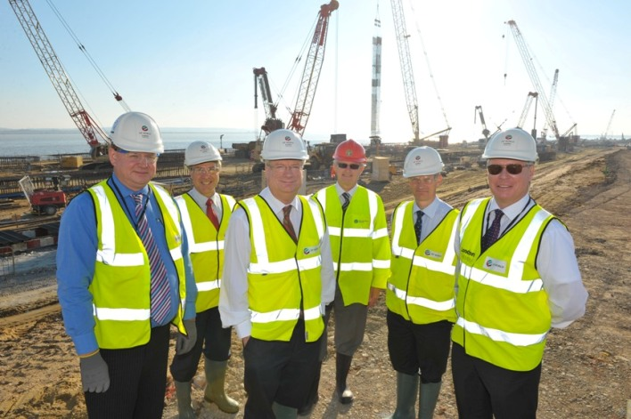
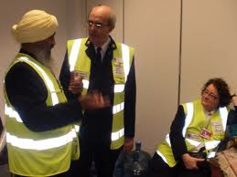
Environment Agency Task

Slide 8
Environment Agency Task
Imagine you’re an employee of the environment agency
You’re task is to present a proposal to the government of either Bangladesh or the UK suggesting what Flood Management Protection should be implemented in order to ensure that floods like the ones in 2004 and 1998 never happen again
You should include the causes of flooding, some statistics and facts about the flooding that did take place and details about how much the government need to invest
You have only 30 minutes to complete this task!
http://www.youtube.com/watch?v=M2dhD9zR6hk

Slide 9
Learning Objectives
Recap Knowledge about Causes of Flooding
Recap Knowledge about types of Flood Management
Use this Information to decide how best to stop Flooding in Boscastle or Bangladesh

Slide 10
Plenary
Put forward your proposal to the government (as played by the rest of the class)

