Slide 1
World Urbanisation
Learning Objectives:
To be able to…
Define the term urbanisation
Explain the causes of urbanisation in LEDCs
Develop casestudy details of urbanisation and how it links to migration

Slide 2
What is urbanisation?
Discuss on your tables what you think urbanisation is
Present this in the form of a spider diagram in the back of your books

Slide 3
What is urbanisation?
Most developed countries urbanised in the late 1800s
In 1800 only 3% of the population lived in cities
Gathered pace from 1950 onwards
Urbanisation is the increase in proportion of people living in cities and towns
In 1950 29% of the world’s population lived in cities
Mostly happening in LEDCs

Slide 4
"the process by which there is an increase in the proportion (not number) of people living in urban areas”

Slide 5
Homework- Due Thursday 4th October
Go to www.misswoodhead.weebly.com
Click on Population and Settlement page
Open the Counter Urbanisation File
Follow the instructions on page 3, using the Counter Urbanisation PowerPoint on the website rather than going onto the VLE
Create a Counter Urbanisation Case Study

Slide 6
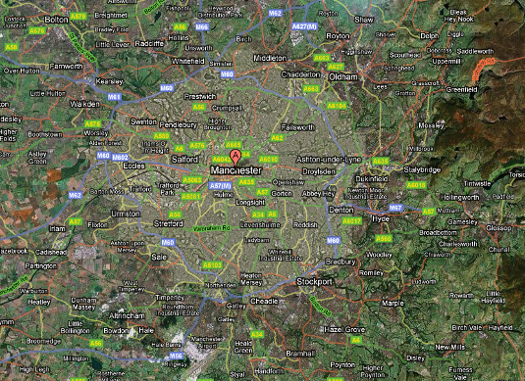
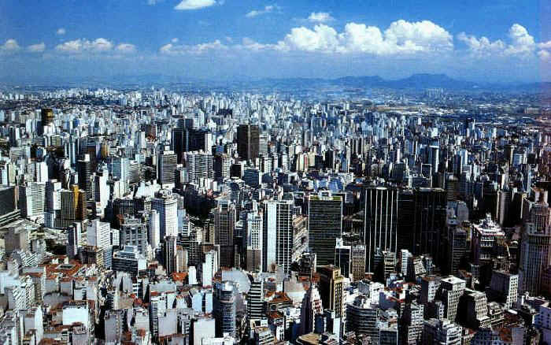
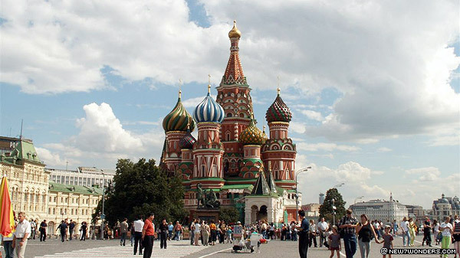
Key World Cities Terms
Millionaire Cities : cities with over 1m inhabitants
Megacities : cities with over 10 m inhabitants (20 in 2009, 15 are in LEDCs)
World Cities : cities which have a major impact on world events. Often major financial centres (London, New York, Singapore, Tokyo) or major political centres (Washington, Beijing, Moscow), or major cultural centres (Los Angeles, Paris)

Slide 7
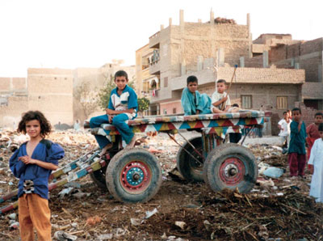
The push from the countryside:
Lack of jobs other than poorly paid farm work
Lack of services such as doctors
Lack of opportunity for life to be better for your children
The pull of the cities:
Chances of regular paid work
Chances of better health services and schools.
Chances of a more interesting life
Better prospects for children to survive and thrive
Desperation to avoid starvation in the rural areas.

Slide 8
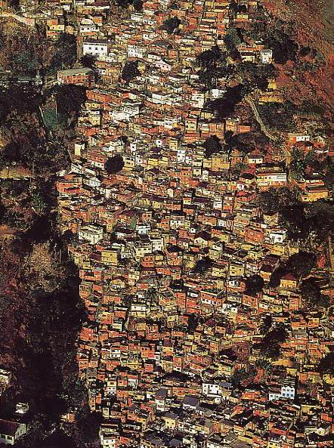
Rapid RURAL-URBAN migration is one of the main causes of rapid city growth in LEDCs
Cities in S. America have passed their fastest growth rate.
Cities in Asia are growing at their fastest at the moment
Cities in Africa have yet to grow at the maximum rate
Cities in N. America and Europe are DECLINING as people choose to leave them... This is called…

Slide 9
SHANTY TOWNS
Names given:
Favelas
Bustees
Squatter Settlements
Materials
Mud, straw, corrugated iron, cardboard, wood, plastic sheeting, tiles, basic building blocks / bricks
Origin of people
Most are rural migrants
They move in steps – from rural areas to small towns – then large towns – then cities
Where poor migrants have
come to set up basic homes
using whatever materials
they can – e.g. Mexico City
Where?
Typically found on cheap
Unwanted land near rivers
Or railways or places prone
To landslides
Conditions and problems
Few doctors in their local area – have to travel a long way
Poor infrastructure (roads) – eg South Africa
Water has initially to be collected – not piped to the house
Long hours – low pay – eg taxi drivers
Education costs and often have to send children a long way in the city
Community:
Sense of community
Everyone is in it together
Chance of starting a self help scheme

Slide 10
Video on Urbanisation
http://www.youtube.com/watch?v=HGAGr0yZPY4&playnext=1&list=PL0459319AE5F2A54B&feature=results_video

Slide 11
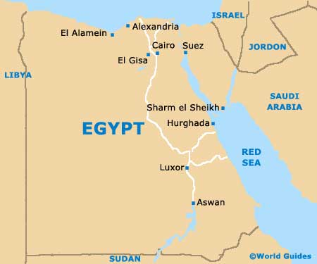
Case Study: Urbanisation In Cairo, Egypt

Slide 12
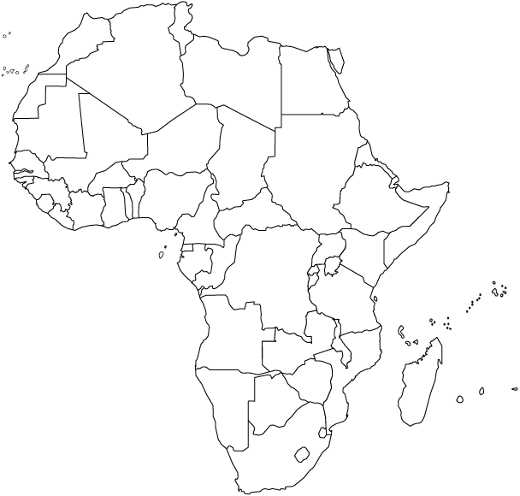
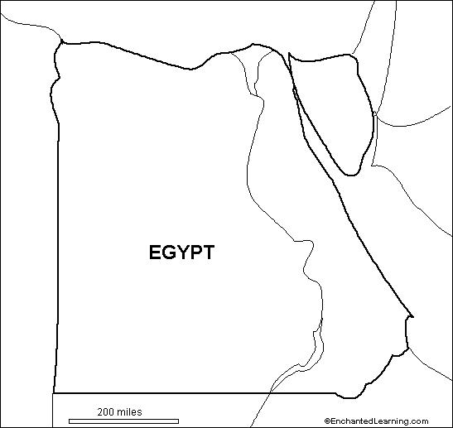
Urbanisation in Cairo, Egypt
Rural push factors
Problems
Urban pull factors
Solutions

Slide 13
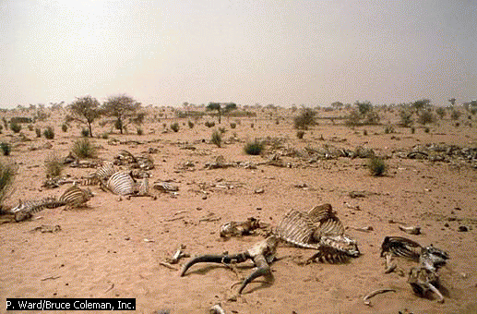
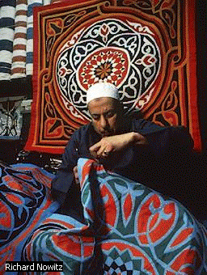
Push Factors - from countryside
Drought in desert
Unreliable weather, bad for growing crops, no water
Unreliable water supply, runs out
No jobs
Unpleasant conditions

Slide 14
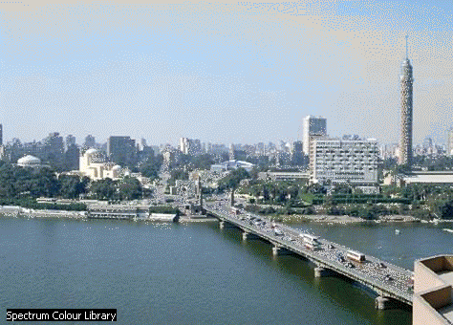
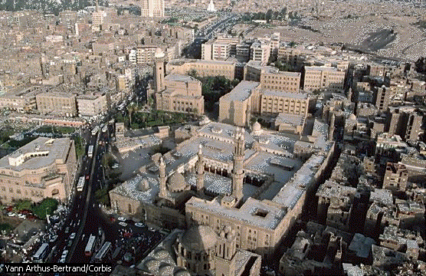
Pull Factors - to urban areas
Irrigated, fertile land on the Nile delta
reliable water supply
“bright lights of city” effect
job opportunities
inertia - if people move, others will follow

Slide 15
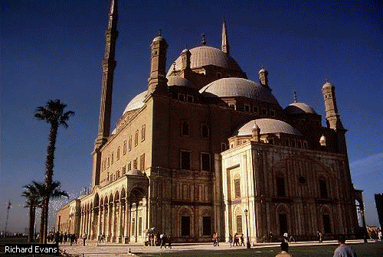
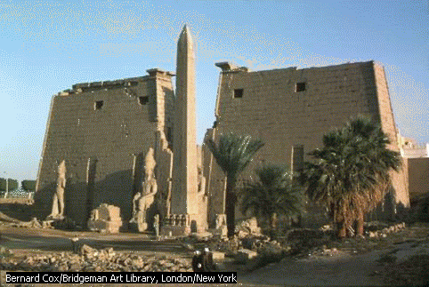
New, modern European additions to the city, such as Parisian style boulevards and commercial centres, as well as bridges and transport links
New suburbs built
Egypt becomes free of European control

Slide 16
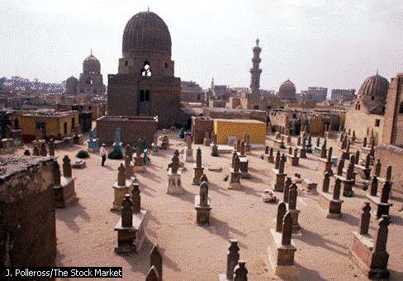
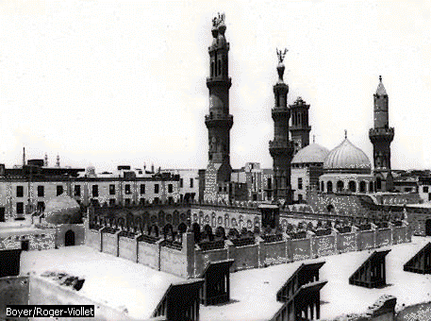
Urban Problems
Strain on services - demand for piped water, sewers, schools, paved roads and electricity
Traffic congestion, air pollution and water pollution
Housing shortages - people live in ‘The City of the Dead’ = old cemetery

Slide 17
Lack of permanent jobs
illegal housing is built on ‘green’ land, and protected farmland
overcrowding, lack of basic sanitation and poor refuse collection, in temperatures of 40oC +, leads to disease and illness.
3 million people now live in the city of the dead in the tombs of old Cairo
people are squatters on rooftops of office buildings and flats in home made huts

Slide 18
Private landlords illegally add extra storeys to their existing blocks of flats
rich poor imbalance - very few rich, many poor
no enforcement of catalytic converters on cars, or unleaded fuel, this leads to toxic smog
low pay for jobs, and unskilled jobs are hard to come by
polluted sewage water raises the water table, and rots the foundations of buildings

Slide 19
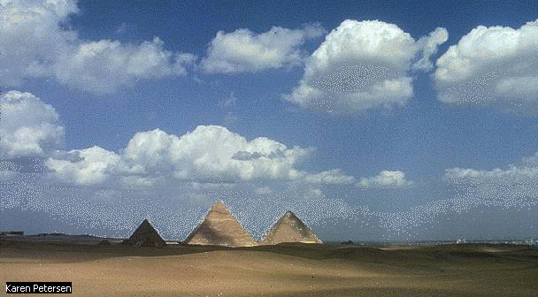
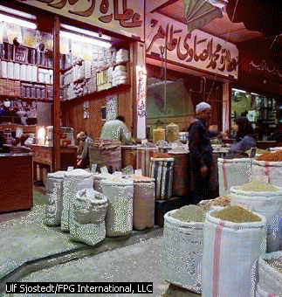
Solutions
Gentrification - improving city
Building a new sewage system (greater Cairo sewage project)
Zabbaleen people given official contract to collect waste and sewage

Slide 20
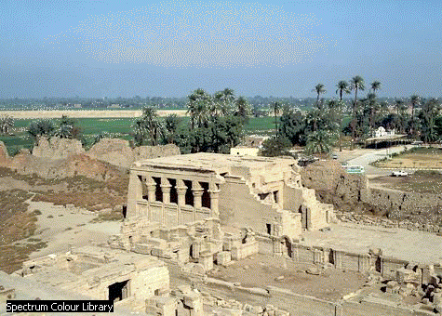
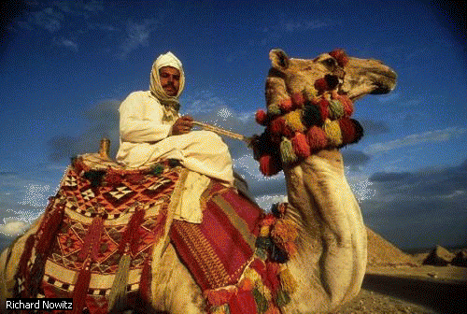
New satellite and dormitory town are built in areas around Cairo
a massive new ring road and metro system have been built
waste is seen as a resource
a drop in birth rate may be the best solution long-term

Slide 21
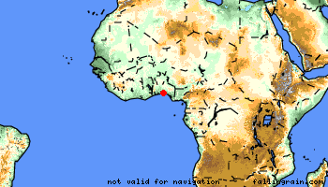
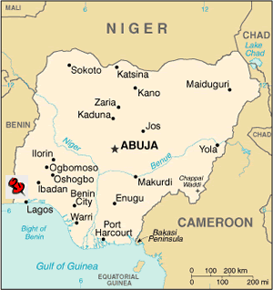
Case-Study of a rapidly urbanising city
Lagos, Nigeria, W. Africa
What are the consequences of rapid urbanisation?
Lagos, Nigeria Background
Nigeria is the economic power-house of West Africa with vast natural resources
Nigeria is the most populated country in Africa with 149m people. The urban/rural balance is 48:52
Nigeria’s population is one of the fastest growing in the world with a doubling rate of 22 years. Over half the population is under the age of 20.
Lagos used to be the capital of Nigeria, but the more central Abuja became the new capital in 1991
Lagos is one of the fastest growing mega-cities in the world. Due to become the world’s 3rd largest city in 2010

Slide 22
Plenary
Come up with a sentence which uses as many key words as possible
The person with the most key words wins some haribo!

