Slide 1
Boxing Day Tsunami, 2004
26th December, 2004
Magnitude 9
Off the coast of Sumatra
Death Toll= 300,000+

Slide 2
Fukoshima
11th March 2011
Magnitude 8.9
Tohku
Death Toll= 16,000

Slide 3
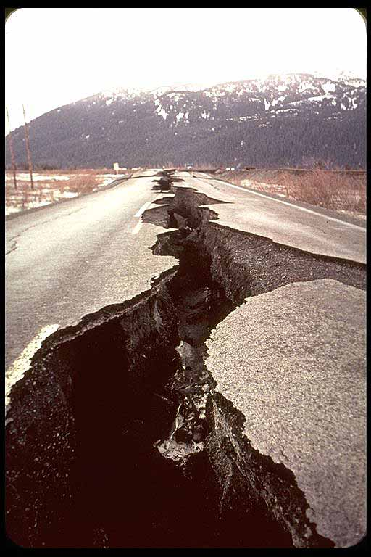
Hokkaido
26th September, 2003
Magnitude 8.3
Island of Hokkaido
Death Toll= 1

Slide 4
Kobe
17th January, 1995
Magnitude 7.2
Kobe, Japan
Death Toll= 5,000

Slide 5
Haiti
12th January, 2010
Magnitude 7
Caribbean
Death Toll= 230,000

Slide 6
UK
27th February, 2008
Magnitude 5.3
Lincolnshire
Death Toll= 0

Slide 7
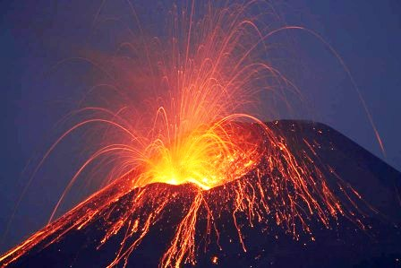
Mt Etna
2001-2003 (Various Eruptions).
VEI up to 3
Sicily, Italy
Death Toll= 0

Slide 8
Yellowstone- Super Volcano
Future
VEI- Unknown, but massive
Wyoming, USA
Death Toll= Unknown

Slide 9
Eyjafjallajökull
April-May, 2010
VEI 2
Iceland
Death Toll= 0

Slide 10
Mount Pinatubo
15th June, 1991
VEI 6
Philippines- Luzon Island
Death Toll= 800

Slide 11
Monsterrat
18th July, 1997
VEI up to 3
Caribbean
Death Toll= 19

Slide 12
Mt. St Helens
18th May, 1980
VEI 5
Washington
Death Toll= 57

