Slide 1
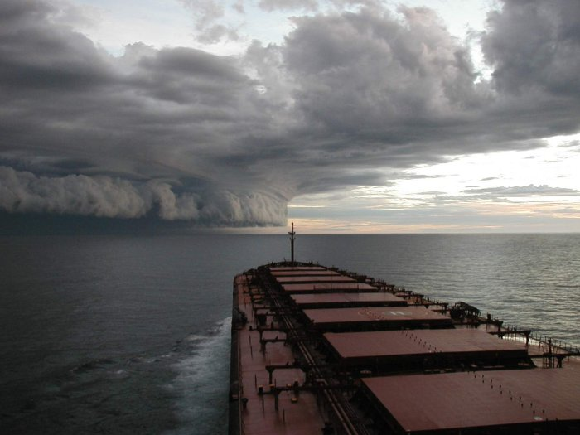
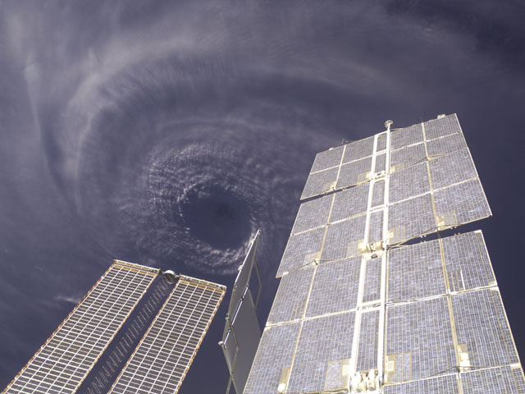
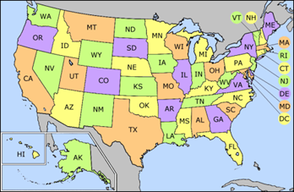
Which of these Hurricane photos is for real?
You need to be prepared to justify your answer!!!
Hurricane Ivan, September 2004, Louisiana, USA
Hurricane Isabel, September 2003, North Carolina, USA

Slide 2
Real
The swirling eye of Hurricane Ivan was photographed above from the orbiting International Space Station as the storm's sustained 200 km/hr winds wreaked havoc in the Caribbean. The bad news is that tropical storm Jeanne is next in line coming across the mid-Atlantic Ocean.

Slide 3
NOT REAL
This photo has been doing the rounds on the internet for a few years now. This is a fake image, it’s originator is unknown.
The main clue is that the sea is far too calm for a ship in this position.
An additional clue is that it is highly unlikely that the captain would be steaming towards the hurricane - unless he had a death wish of course.

Slide 4
Aims today:
To identify the causes/effects/responses to hurricane Sandy
This could lead to an C grade.
To explain how hurricane Sandy formed and explain using evidence the causes, effects and responses to the hurricane.
This could lead to an A/B grade
To understand how hurricane Sandy formed. To explain using evidence the causes, effects and responses to the hurricane. To evaluate the preparation/ prediction of the hurricane
This could lead to an A* grade.

Slide 5
Your Task
Complete your case study information sheets to the best of your ability, using the links provided to help

Slide 6
Ways to access this Powerpoint
Public-Geography-GCSE

Slide 7
Hurricane Sandy For A* (Type in the Date and Category Here)
Cause
In this box, find a diagram of a tropical storm and explain it to someone who doesn’t know how hurricanes are formed.
Short Term Effects
Find some images and annotate on the effects of the hurricane. Also find some statistics to show the immediate impact of the hurricane.
Insert a map which shows the path of Hurricane Sandy here
Prediction
In this box, type in your own words what predictions were made and how they were made. Were these predictions accurate? Explain your answer.
Long Term Effects
Have New York recovered from the hurricane? If so, why? Would the same long term effects be predicted for an LEDC? Explain your answer.
Preparation
In this box, type in your own words what preparations were made for the storm. How successful were these preparation attempts? Use evidence to back up your ideas.
Colour code your font according to whether the words relate to Cause, Effect or Response. Replace this text with a key

Slide 8
Hurricane Sandy For A/B (Type in the Date and Category Here)
Cause
In this box, find a diagram of a tropical storm and explain it to someone who doesn’t know how hurricanes are formed.
Short Term Effects
Find some images of the effects of a hurricane. Also find some statistics to show the immediate impact of the hurricane.
Insert a map which shows the path of Hurricane Sandy here
Prediction
In this box, type in your own words what predictions were made and how they were made..
Long Term Effects
Have New York recovered from the hurricane? If so, why? Would the same long term effects be predicted for an LEDC? Explain your answer.
Preparation
In this box, type in your own words what preparations were made for the storm. How successful were these preparation attempts? Use evidence to back up your ideas.
Colour code your font according to whether the words relate to Cause, Effect or Response. Replace this text with a key

Slide 9
Hurricane Sandy for C (Type in the Date and Category Here)
Cause
In this box, find a diagram of a tropical storm and type the key words out underneath
Short Term Effects
Find some images which illustrate the short term effects of the hurricane
Insert a map which shows the path of Hurricane Sandy here
Prediction
In this box, use bullet points to explain predictions were made and how they were made.
Long Term Effects
Have New York recovered from the hurricane? If so, why? Would the same long term effects be predicted for an LEDC? Explain your answer.
Preparation
In this box, bullet point the main preparation that took place before the Hurricane
Colour code your font according to whether the words relate to Cause, Effect or Response. Replace this text with a key

Slide 10
Cause

Slide 11
Prediction
http://www.bbc.co.uk/schools/gcsebitesize/geography/natural_hazards/hurricanes_rev2.shtml
http://spectrum.ieee.org/tech-talk/computing/software/predicting-hurricane-sandy
http://www.bbc.co.uk/news/world-us-canada-20122246
http://www.oas.org/cdmp/document/forecast/forecast.htm
http://www.washingtonpost.com/blogs/capital-weather-gang/post/the-national-hurricane-centers-striking-forecast-for-superstorm-sandy/2012/11/01/e2633b5e-2427-11e2-ac85-e669876c6a24_blog.html
http://www.guardian.co.uk/world/interactive/2012/oct/29/hurricane-sandy-predicted-path-mapped
http://www.nhc.noaa.gov/graphics_at3.shtml?5-daynl

Slide 12
Preparation
http://www.guardian.co.uk/world/2012/oct/29/hurricane-sandy-new-york-arrival
http://news.yahoo.com/prepare-hurricane-sandy-171013217.html
http://www.forbes.com/sites/sethporges/2012/10/28/simple-last-minute-tips-to-prepare-for-hurricane-sandy/
http://www.ibtimes.com/hurricane-sandy-preparation-tips-how-prepare-if-frankenstorm-knocks-out-your-power-floods-your
http://www.usgs.gov/blogs/features/usgs_top_story/usgs-finalizes-hurricane-sandy-preparations/
http://thelede.blogs.nytimes.com/2012/10/26/preparing-for-hurricane-sandy-along-the-east-coast/
http://abcnews.go.com/Business/top-tips-prepare-hurricane-sandy/story?id=17573064#.UWWP7aI4uSo

Slide 13
Short Term Effects
http://www.nytimes.com/interactive/2012/11/17/nyregion/hurricane-sandy-map.html?_r=0
http://www.bbc.co.uk/news/world-us-canada-20141883

Slide 14
Long Term Effects
http://switchboard.nrdc.org/blogs/ahuang/hurricane_sandys_disproportion.html
http://www.bbc.co.uk/news/magazine-20128378
http://www.theglobeandmail.com/report-on-business/international-business/us-business/art-insurers-face-record-loss-from-hurricane-sandy/article6653837/
http://www.beckershospitalreview.com/quality/lessons-learned-from-hurricane-sandy-6-steps-every-hospital-should-implement-before-disaster-strikes.html
http://threevillage.patch.com/articles/hurricane-sandy-symposium-will-explore-climate-change-storm-preparation
http://www.guardian.co.uk/commentisfree/2012/dec/04/hurricane-sandy-won-president-obama

Slide 15
Colour Coding

Slide 16
Plenary
Exam Q

