Slide 1
F. The River Course – Downstream Change

Slide 2
Homework
Complete page 14 in Rivers’ Booklet
Update Key Words list with words such as Rejuvination, Hjulstrom Curve and any others that we look at today
Due on Friday (28th)

Slide 3
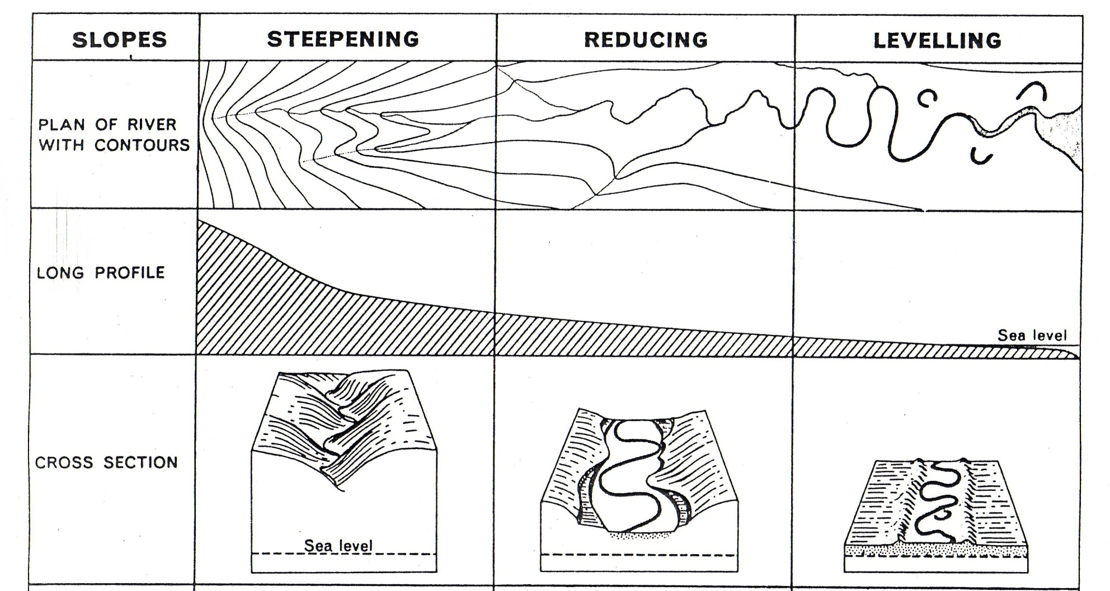
Downstream Change

Slide 4
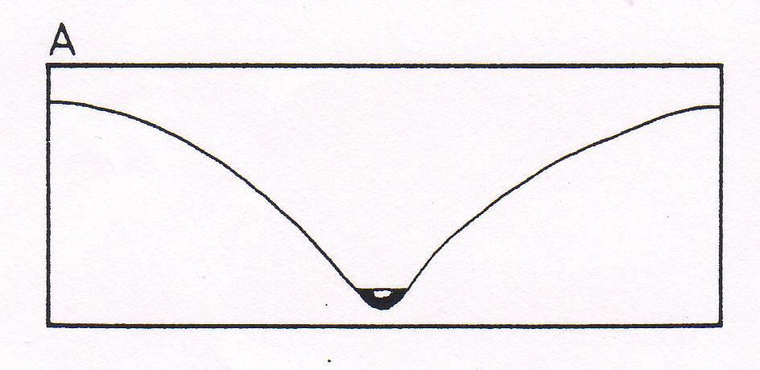
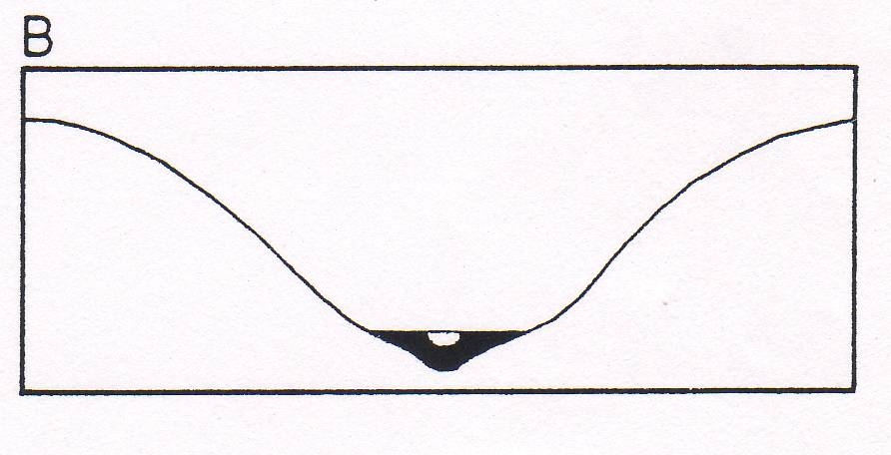
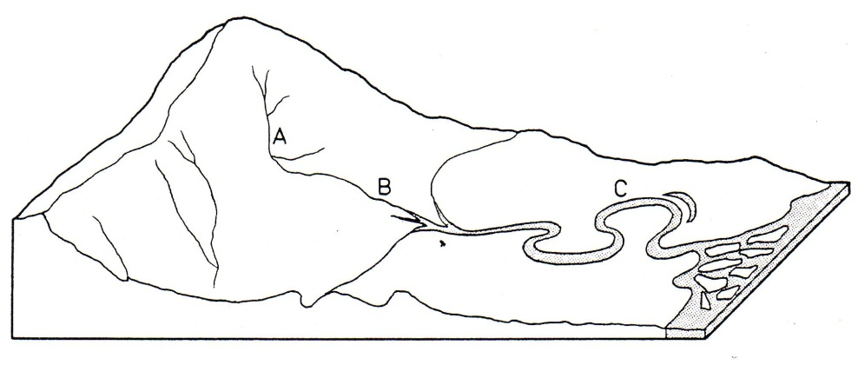
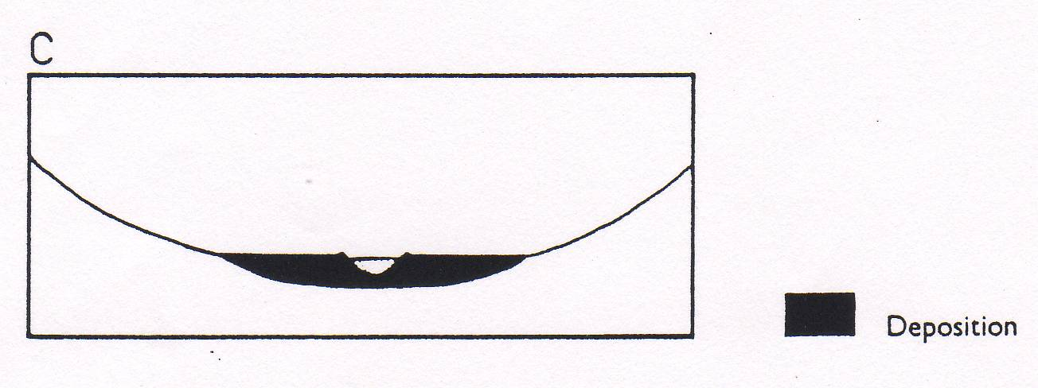
Valley Cross Profiles
There are three main factors that influence the shape of valley cross profiles:
Processes associated with the river
Valley side processes
History of the region e.g. glaciation/tectonic activity

Slide 5
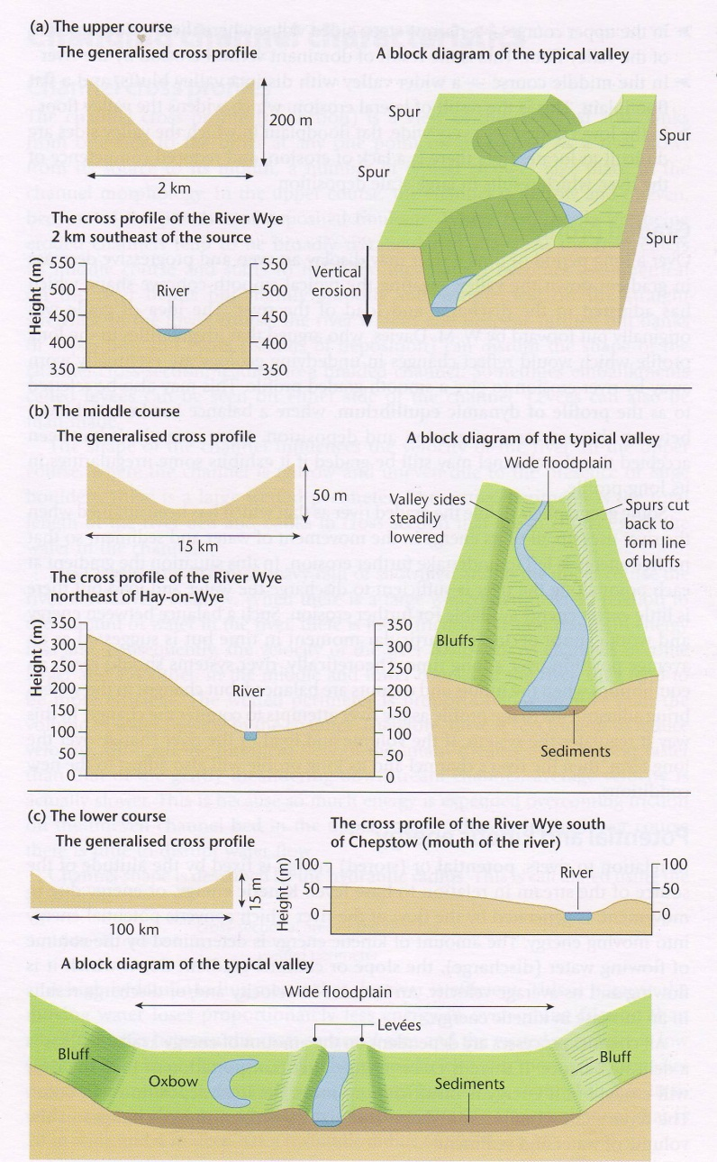
Essay question: Describe and suggest reasons for three different valley cross profiles that exist along the rivers in a drainage basin.

Slide 6
E. The River Course Long Profile

Slide 7
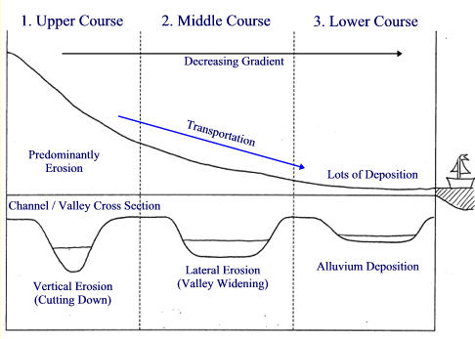
From Source to Mouth

Slide 8
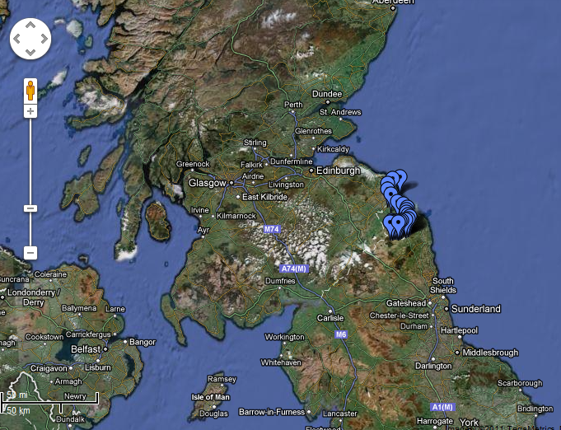
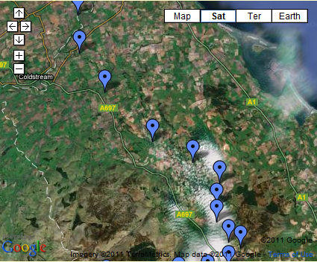
Long Profile Breamish

Slide 9
Eustatic and Isostatic Sea Level Change
Eustatic refers to a worldwide fall or rise in sea-level due to changes in the hydrological cycle caused by water being held in storage on land in ice sheets (or released following the melting of ice sheets).
Isostatic adjustment is a more local change in sea-level resulting from the depression (or uplift) of the Earth’s crust by the increased (or decreased) weight imposed upon it by a growing (or a declining) ice sheet. E.g. Scotland and South West England.

Slide 10
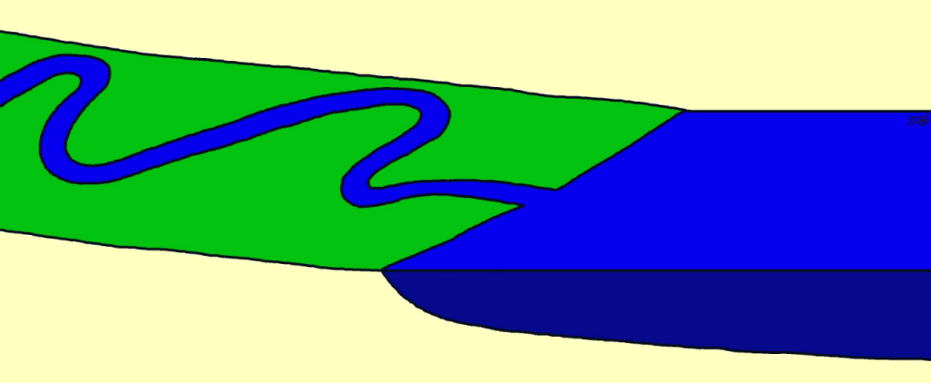
Rejuvenation
River in grade
Flood plain

Slide 11
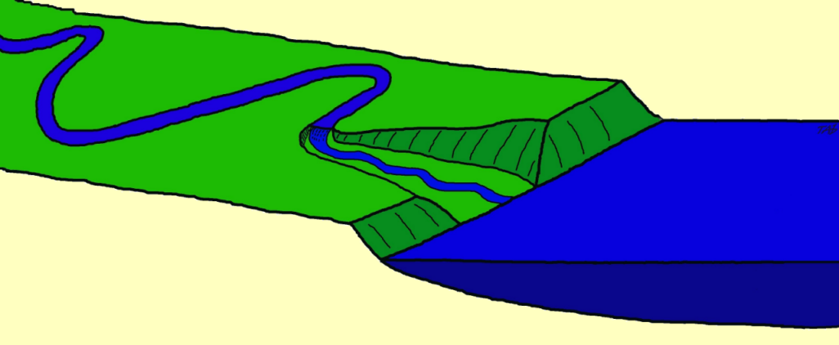
Waterfall retreats cutting
a lower valley
Fall in sea level
River bluffs
New flood plain forms

Slide 12
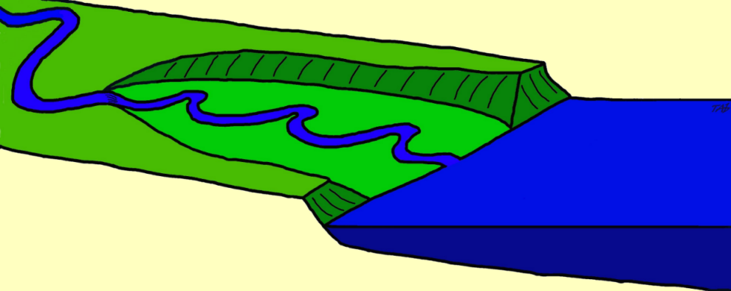
River bluffs
Waterfall decreases in size to form rapids (nick point)
New flood plain forms

Slide 13
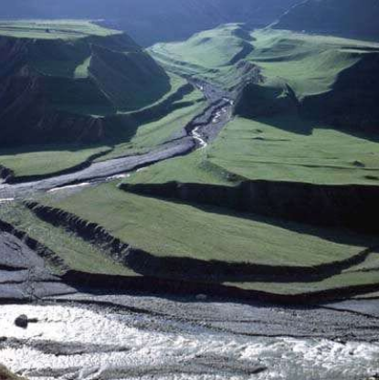
Rejuvenation
http://www.bbc.co.uk/learningzone/clips/river-terraces/402.html

Slide 14
D. Stream Load and Transport

Slide 15
Three types of sediment load
Bed Load (Or Traction Load)
Largest sediments e.g. boulders, pebbles
Only moved at times of high flow.
Can only be moved by traction
Highly erosive!
Turbulent entrainment: the movement of the water which allows the material to be picked up or start movement.
Ballistic impact: one piece of particle landing on another and shooting it forwards.
Saltation: bouncing along

Slide 16
Three types of sediment load
2. Suspended load
Silt and clay kept afloat by turbulent flow.
The greater the turbulence and velocity, the larger the quantity and size of particles which can be picked up.
The material held in suspension usually forms the greatest part of the total load; it increases in amount towards the river’s mouth, giving the water its brown or black colour.

Slide 17
Three types of sediment load
3. Wash load (or dissolved/solution load)
Very fine particles of mud, may enter the stream at the source and remain until it reaches the sea.
Greatest in regions of soluble rock e.g. limestone and chalk. In other areas, the material held in solution is a small proportion of the whole load.

Slide 18
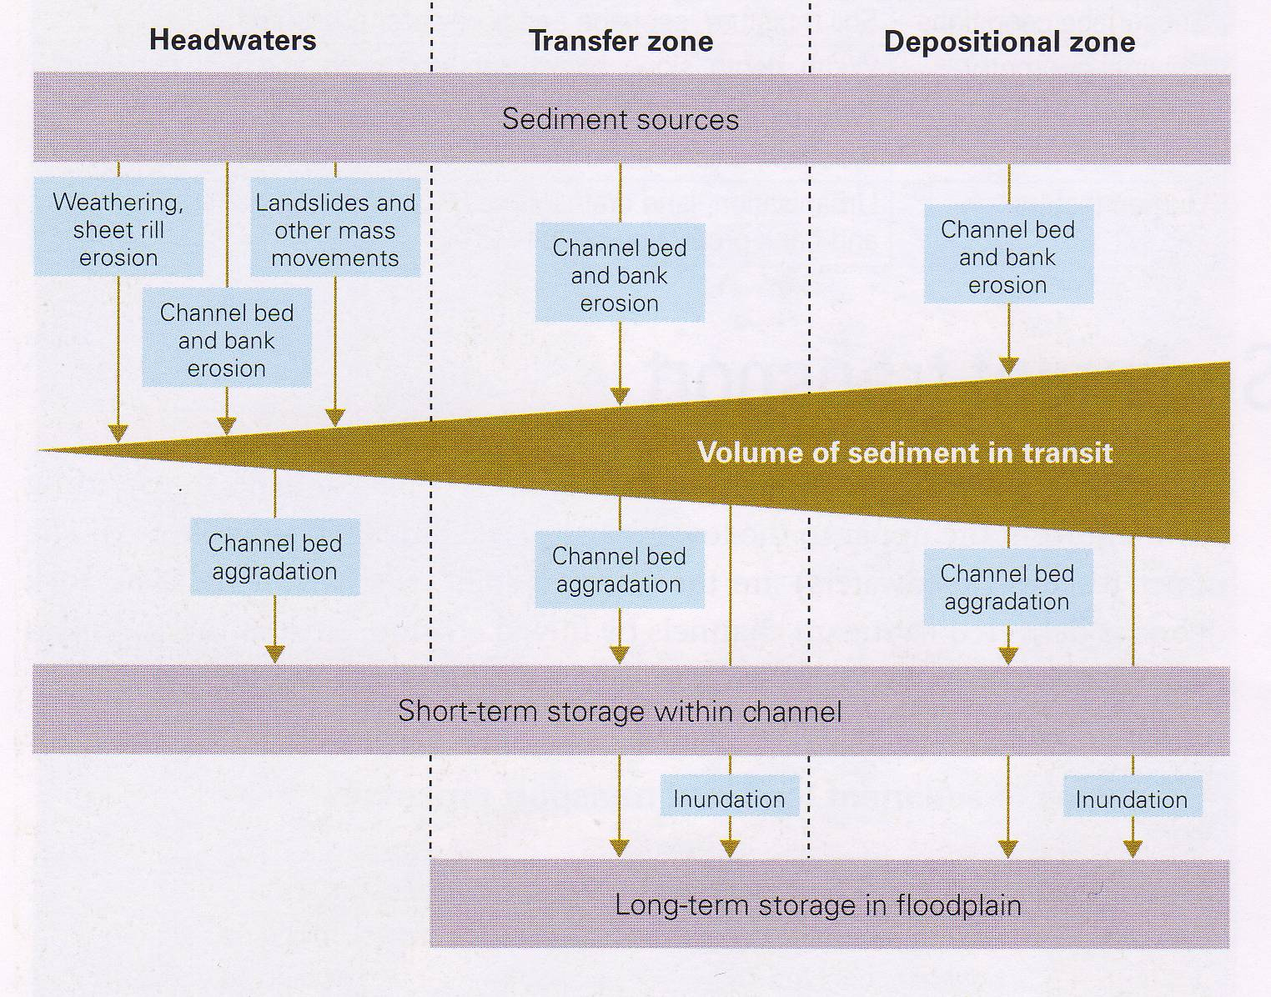

Slide 19
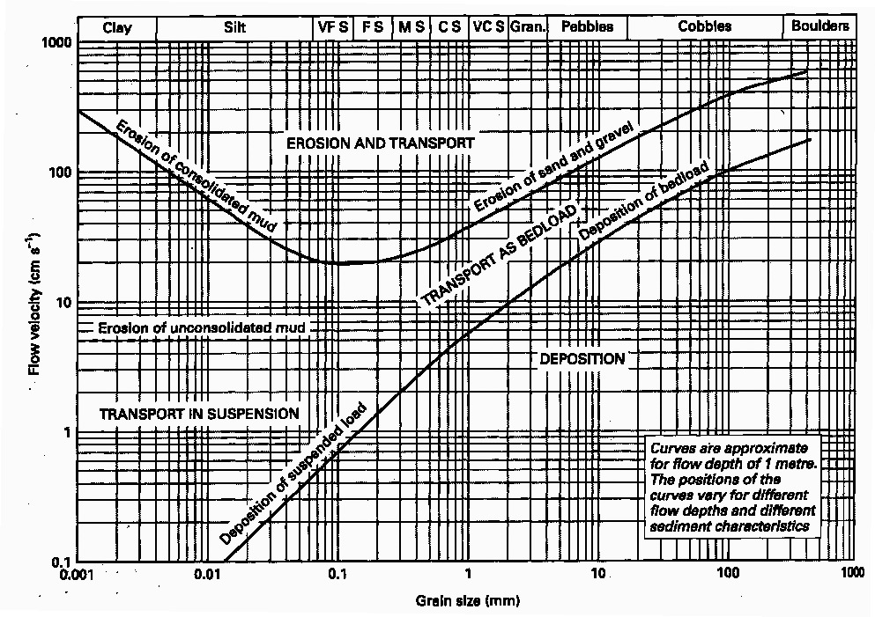

Slide 20
Sentences to Finish
The larger the grain size the…………
The exception to this is……………..because………
Erosion is greatest with (what types of sediment?)
Transportation is greatest with (what types of sediment?)
Deposition is greatest with (what types of sediment?)

Slide 21
Hjulstrom Curve Game
Study your card, think of when you will stand/sit/walk.
Try and guess which sediment and size!

Slide 22
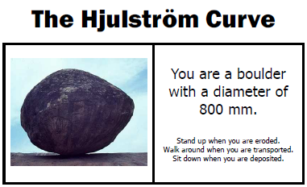

Slide 24
Hjulstrom Curve Question Sheet

