Slide 1
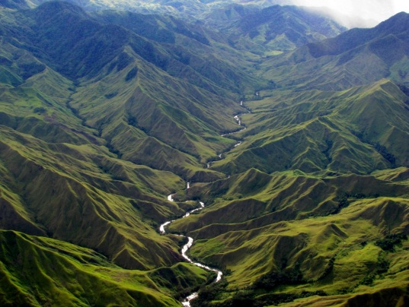
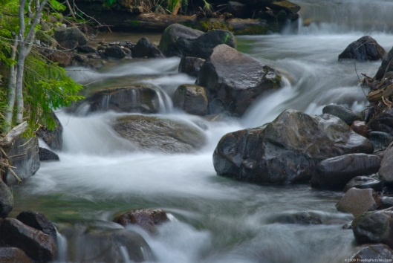
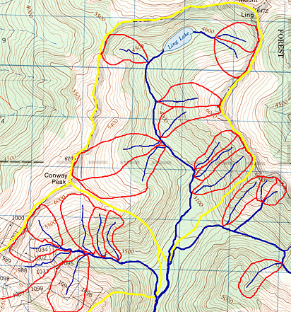
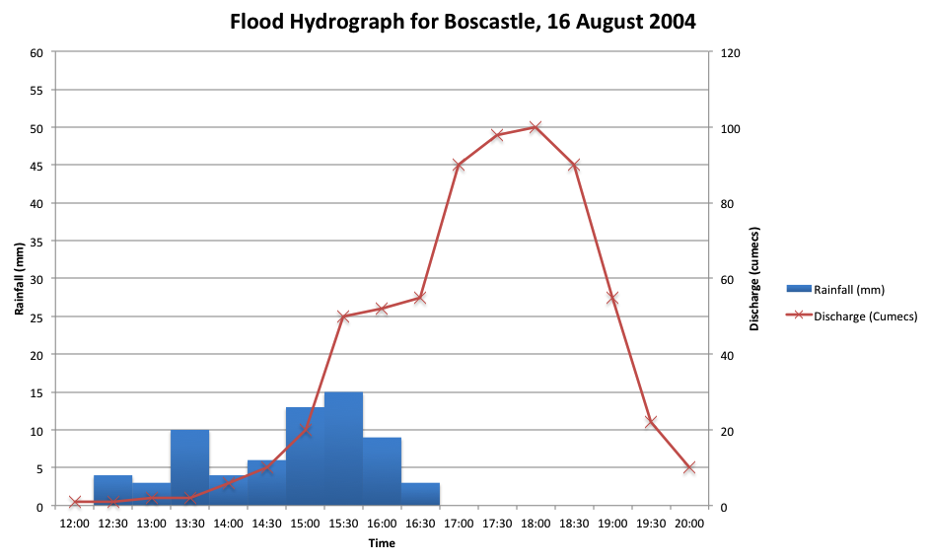
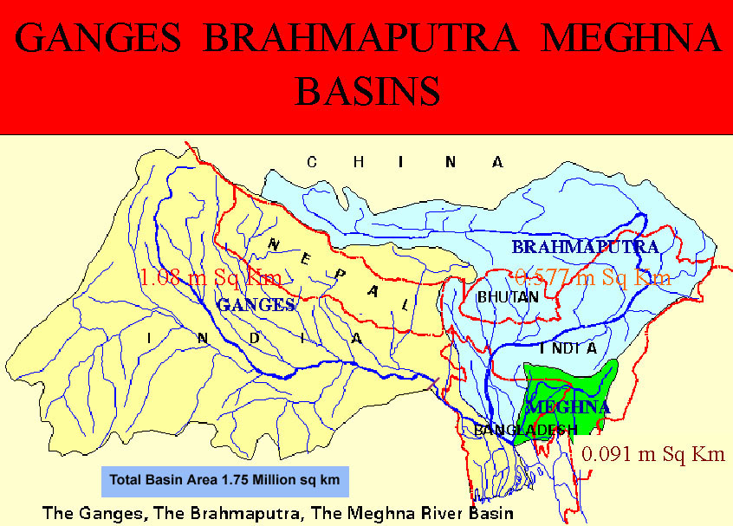
Rivers
Revision Workbook

Slide 2
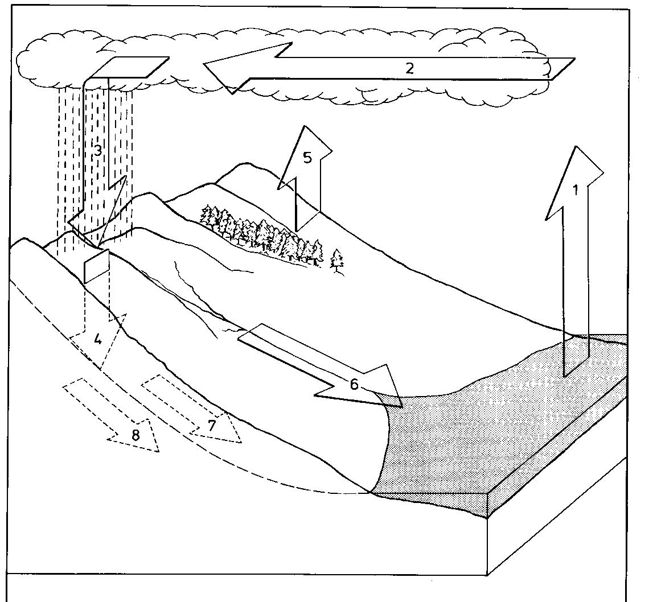
Fill in the diagram below by adding the key words from the list below: Evaporation, Groundwater flow, Precipitation, Movement of Moisture in the atmosphere, Throughflow, Infiltration, Surface run-off, Evapotranspiration
Section 1- Hydrological Cycle
1.
2.
3.
4.
5.
6.
7.
8.

Slide 3
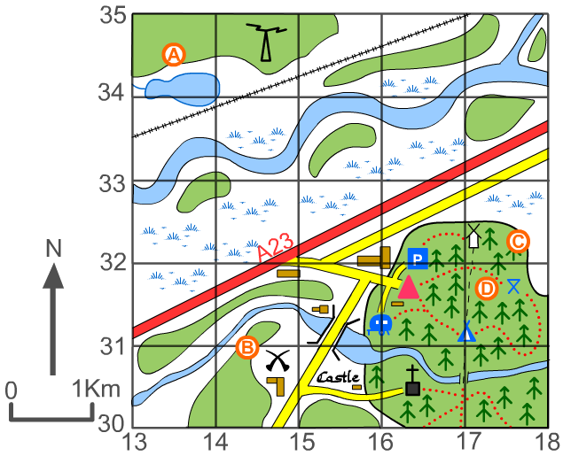
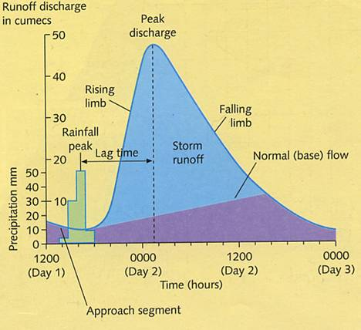
Section 2- Map Skills
Give the 6 figure grid references for:
A) __________________
B) ___________________
C) ____________________
D)____________________
Give the 6 figure grid reference for:
The triangle___________________
The castle____________________
The church ______________
Section 3- Hydrographs
Explain what river discharge is and how
It is measured (what units)……………………….
………………………………………………………………….
………………………………………………………………….
………………………………………………………………….
2. What would decrease the lag time and
Why?.........................................................
…………………………………………………………………
…………………………………………………………………
………………………………………………………………….
3. What does base flow indicate?............
…………………………………………………………………………………………………………………………………………………………………………………………………………………………………………………………………………
……………………………………………………………………………………………………………………………………

Slide 4
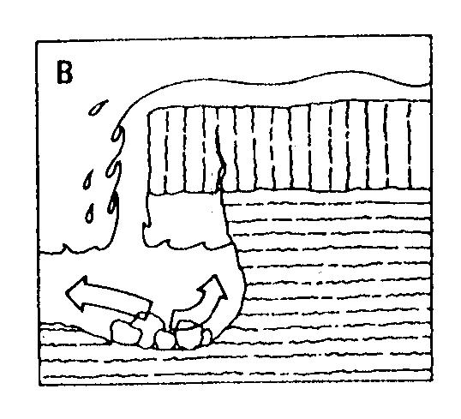
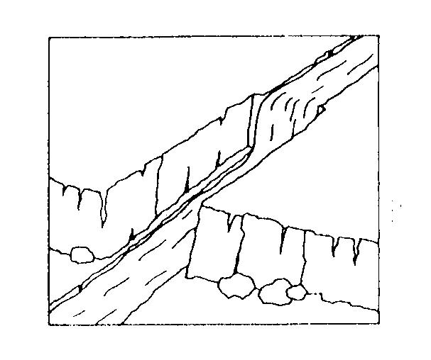
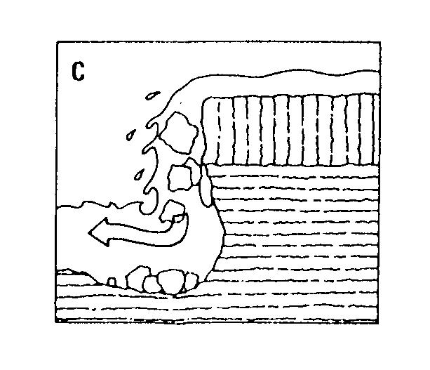
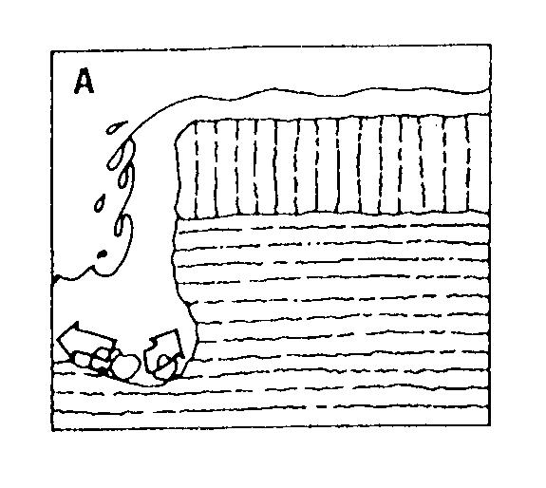
Section 4- Waterfalls
Put the images in the correct order and add at least 8 labels
Section 5- Ox-Bow Lakes
Draw a diagram above to and use the space below to explain how ox-bow lakes are formed

Slide 5
Section 6- Types of Erosion
Match the types of erosion to the correct definition
This is the chemical reaction between certain rock types and other acids in seawater. This is particularly evident on limestone and chalk cliffs where the water is a milky blue at the bottom of the cliffs due to the dissolved lime.
Hydraulic
Action
This is the pressure of the water being thrown against the cliffs. It also includes the compression of air in cracks: as the water gets into the cracks in the rock face, it compresses the air in the cracks; this puts even more pressure on the cracks and pieces of rock break off.
Corasion (Abrasion)
Corrosion (Solution)
This is a slightly different process that involves the wearing away of the rocks which are in the sea. As the boulders in the sea continually roll around, they chip away at each other until smooth pebbles and sand are formed
Attrition
Sand and pebbled carried within waves are thrown against the cliff face with considerable force. These particles break off more rocks which, in turn, are thrown against the cliff by the breaking wave
What is the difference between corasion and corrosion?
Section 7- Types of Transportation
Label on the diagram to show the 4 types of transportation (movement of river bedload)

Slide 6
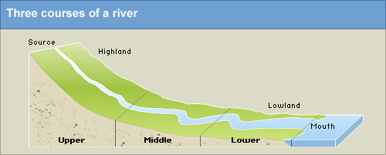
Section 8- How an River Changes Down Stream
Complete the table below to show how a river changes throughout its long profile
 | UPPER COURSE | MIDDLE COURSE | LOWER COURSE
SPEED OF FLOW
SIZE AND SHAPE OF BEDLOAD
DISCHARGE OF RIVER
GRADIENT

Slide 7
Section 9- Case Studies
Complete the table below to show the causes, effects and responses of both an LEDC and an MEDC Flood event.
 | Causes | Effects | Response
Boscastle Floods 2004
Bangladesh Floods 1998-2007

