Slide 1
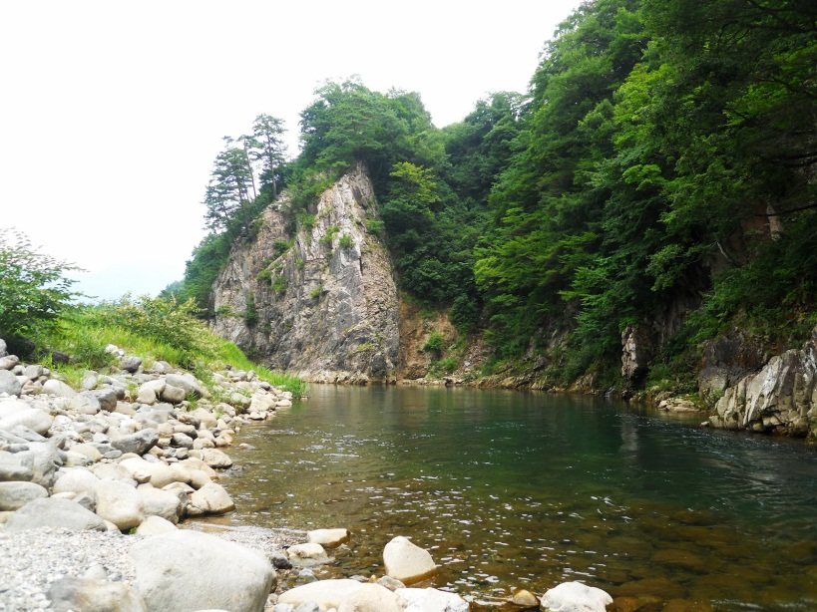
Year 9 Rivers– End of Unit Test
Name:
/40
Duration – 40 minutes
Question 1 (25 marks)
Study the OS map extract (fig. 1)
There has been intense rainfall in the following grids (9206 and 8406). Which grid is more likely to flood? …………………………………………….. [1]
Explain the reasons for your choice…………………………………………………………………………………………………………………………………………………………………………………………………………………………………………………………………………………………………………………………………………………………………………………………………………..…………………………………………….. [2]
Study the image of a river in Japan (fig. 2)
(i) Annotate the photograph to show 2 pieces of evidence to prove deposition has taken place here.
(ii) Name and describe 2 processes of river transportation which might have affected this area.
1)…………………………………………………………………………………………………………………………………………………………………………………………………………………………………………………………………….............………………………………………………………………………………….………2)…………………………………………………………………………………………………………………………………………………………………………………………………………………………………………………………………………………………………………………………………………..………………………... [4]
Fig. 2 Japanese River
[2]

Slide 2
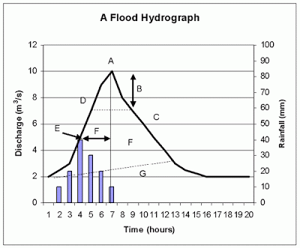
(c) Name and explain 2 ways in which a river erodes its banks
1)…………………………………………………………………………………………………………………………………………………………………………………………………………………………………………………………………….............………………………………………………………………………………….………2)…………………………………………………………………………………………………………………………………………………………………………………………………………………………………………………………………………………………………………………………………………..………………………... [4]
Study the flood hydrograph shown in figure 3.
Which letter indicates peak
discharge?.......................[1]
Which letter indicates
lag time?......................[1]
Is this flood likely to have taken
place in an area already saturated
with precipitation? Explain your answer……………………………………………………………………………………………………………………………………………………………………………………………………………………………………………………………………………………………………………………………………………………..………..[2]
Fig. 3 Flood Hydrograph
CASETUDY: Impacts of Flooding. Name and locate 2 areas of different levels of development that have experienced flooding:
MEDC:………………………………………………………LEDC:………………………………………………
Why are the effects of flooding usually worse in LEDCs rather than MEDCs? Use examples in your answer. Include at least 3 developed points.
…………………………………………………………………………………………………………………………………………………………………………………………………………………………………………………………………….............………………………………………………………………………………….…………………………………………………………………………………………………………………………………….

Slide 3
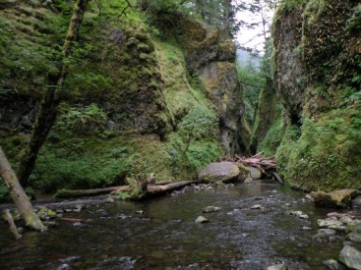
continued
…………………………………………………………………………………………………………………………………………………………………………………………………………………………………………………………………….............………………………………………………………………………………….……………………………………………………………………………………………………………………………………………………………………………………………………………………………………………………………………………………………………………………………………………………………………………………………………….............………………………………………………………………………………….………………………………………………………………………………………………………………………………………………………………………………………………………………………………………………………………………………………………………………………………………………………………………………………………………….............………………………………………………………………………………….…………………………………………………………………………………………………………………………………[8]
Question 2 (15 marks)
With the aid of a diagram, explain how a river meander is formed
…………….............………………………………………………………………………………….………………………………………………………………………………………………………………………………………………………………………………………………………………………………………………………………………………………………………………………………………………………………………………………………………….............………………………………………………………………………………….…………………………………………………………………………………………………………………………………[4]
(b) Study Figure 4, a river gorge.
Explain how a gorge is formed…………………………………
…………………………………………………………………………………………
…………………………………………………………………………………………
………………………………………………………………………………………………….………………..[2]
Figure 4- A Gorge

Slide 4
(c) Complete the diagram of the hydrological cycle below
[3]
(d) Explain how a river channel changes as the river moves downstream (include changes in shape, load, and discharge )
…………….............………………………………………………………………………………….………………………………………………………………………………………………………………………………………………………….............………………………………………………………………………………….…………………………………………………………………………………………………………………………………………….............………………………………………………………………………………….…………………............………………………………………………………………………………….………………………………………………………………………………………………………………………………………………………………………………………………………………………………………………………………………………………………………………………………………………………………………………………………………….............………………………………………………………………………………….………………………………………………………………………………………………………………………………..………….………[6]

