Slide 1
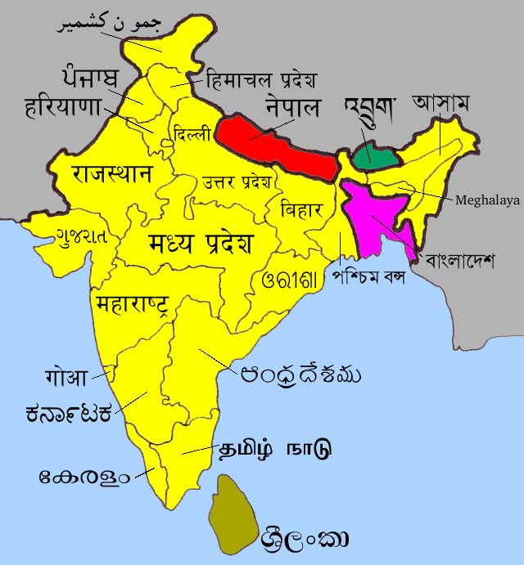
Bellwork- Front of Books
Starter: Sketch the map below with a pencil and label the countries.
Please borrow a coloured pencil from the front if you don’t have one.
China
India
Nepal
Bangladesh
Pakistan
Bhutan

Slide 2
FLOODING IN BANGLADESH
An example from an LEDC Flood event

Slide 3
Floods in Bangladesh- Over Many Years, but with a Close Look at 1998 and 2004
Learning Objectives:
To be able to describe the location of Bangladesh
To classify the causes, effects and responses to the floods
To build upon personal learning and thinking skills (PLTS)

Slide 4

Starter
As you watch the video, jot down some questions you have about the Bangladesh Floods in your books

Slide 5
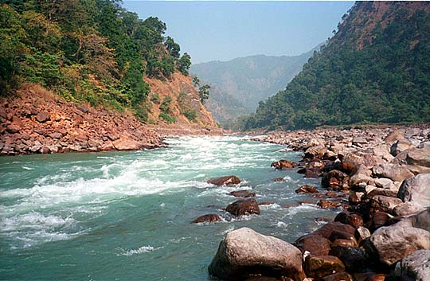
3 Great Rivers
Ganges

Slide 6
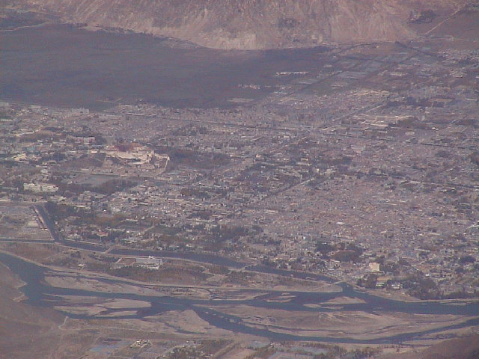
Brahmaputra

Slide 7
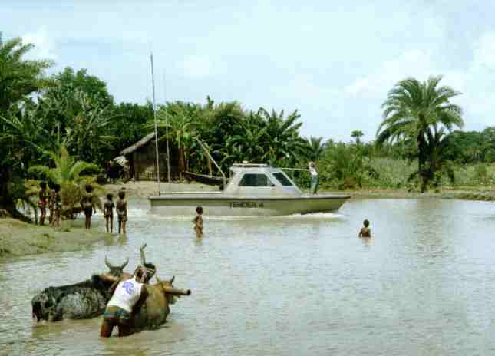
Meghna

Slide 8
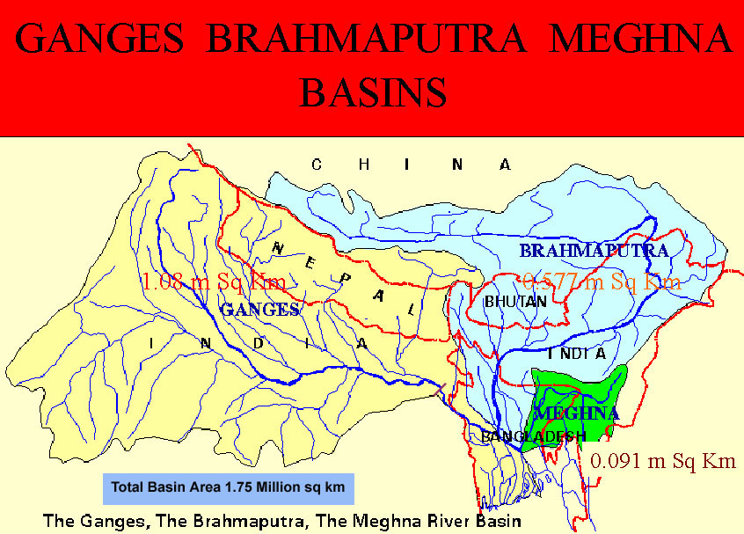

Slide 9
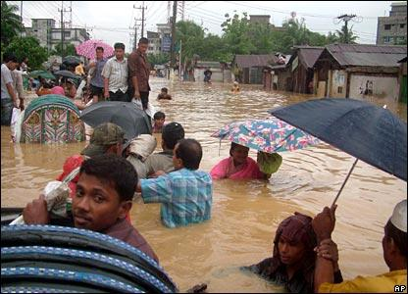
Heavy monsoon rains have caused devastation in Bangladesh. The port city of Chittagong has been particularly badly hit.

Slide 10
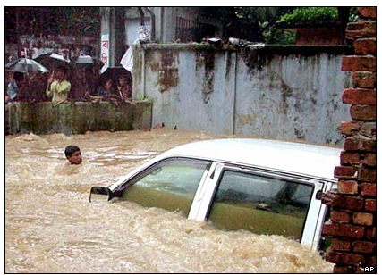
The city and surrounding areas have suffered both flooding and landslides.

Slide 11
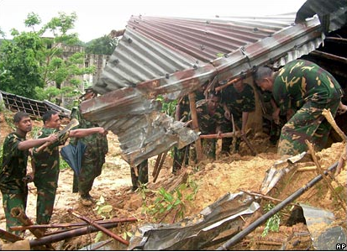
Worst hit was a crowded shanty town near a military area.

Slide 12
Classification
What do the following three terms mean…?
Cause
Effect
Response

Slide 13







Classification - an example!
Biscuit classification:
Bourbon
Jaffa Cake
Jammy dodger
Digestive
Hobnob
Shortbread
Custard Cream

Slide 14
Classification
Causes - what made the floods happen?
Effects - what problems did the floods bring?
3. Responses and Solutions - what did people have to do afterwards?

Slide 15
Cast Study Sheet

Slide 16
Task- Case Study Sheet
You have 15 minutes to travel around the room and collect information from the sheets that have been printed around the room
DO try and get at least some information for each box
DO collect statistics
Do NOT copy each information sheet word for word- there’s not enough time

Slide 17
Missing Any Information?
Then fill it in now….
http://www.youtube.com/watch?v=DQQSqjpjm6I

Slide 18
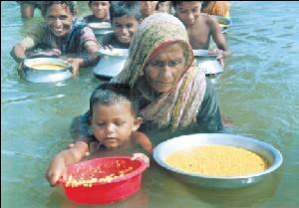
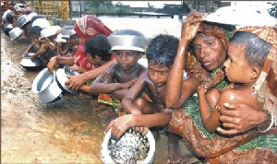
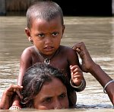
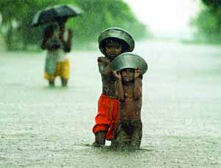
Positive impact of flooding:
Regular annual flooding is essential to people who live on the flood plain of these rivers, the farming season is planned around the floods, rice is a main crop and requires large quantities of water. Also, when the river floods it leaves behind fertile silt.

Slide 19
China
India
Nepal
Bangladesh
Pakistan
Bhutan

Slide 21
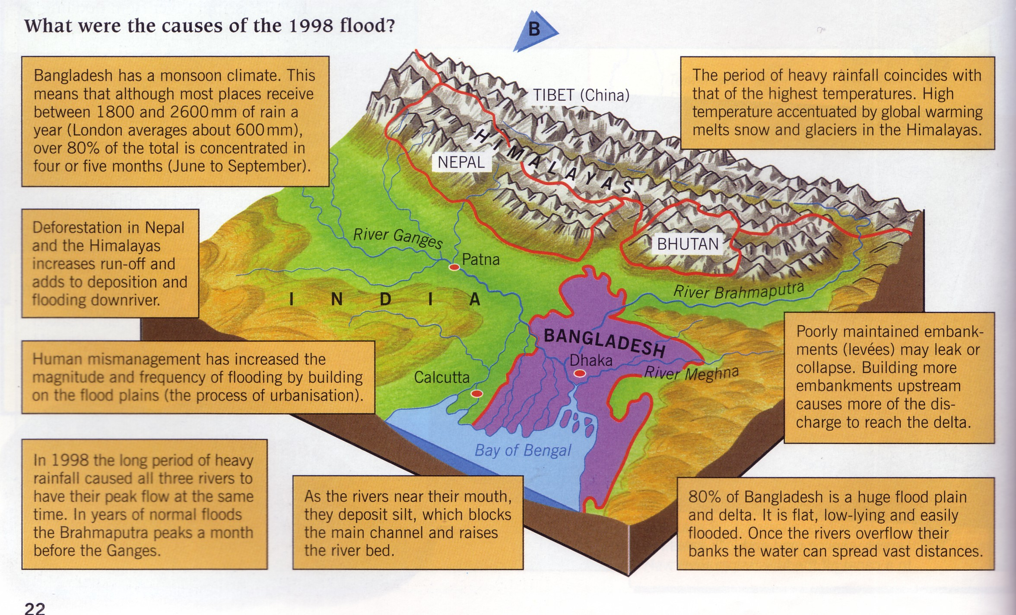
CAUSES OF FLOODING

Slide 22
MANAGING THE FLOOD - SHORT TERM
Bangladesh Government
Distributed money and 400 tonnes of rice
Relief supplies of fresh water, water purification tablets and sanitation services provided
Aid Agencies
Provided Boats to rescue people
Supplied medicines
Supplied clean drinking water
Set up a medical treatment centre
Distributed fodder for livestock
Distributed food and plastic sheeting
Planned a rehabilitation programme to repair and construct housing and provide sanitation
Other Governments
Gave aid including wheat, money, medicines, water tablets, house repair, sanitation and rehabilitation for farming and fishing
Notes:
22
Discuss and compare with pupils the Yarm example and whether they are seeing individual/community and government responses to the floods.

Slide 23
MANAGING THE FLOOD - LONG TERM
In 1989 the Bangladesh government working with several international agencies and the world bank produced a FLOOD ACTION PLAN (FAP):
SHELTERS AND WARNING SYSTEMS
Built 5000 flood shelters in high risk areas
Improve flood forecasting system using satellite and computer technology
Prepare flood disaster management plans which provide early warning and clear, effective instructions as to what people should do before, during and after a flood
Flood Control
12-15 floodwater storage basins to hold floodwater diverted from main rivers
Divide the land into compartments and control water flow through a system of channels by sluice gates and water pumps
In the dry season water can be moved to farming areas requiring irrigation
DAMS
Building 7 new dams to control river flow and to hold back the monsoon rainwater in reservoirs
The water would be used for irrigation and generating electricity
Embankments
Complete and strengthen the embankments along all the main river channels to a height of up to 7 metres
More than 7500km of embankments are already in place but repairs, heightening and new building would cost over $6 billion
Other controls
Pumping water out of the ground in the Himalayas during the dry season to create underground storage for the monsoon rains
Replanting of forest cover in Nepal and Tibet
Notes:
23
Continue as before.

Slide 24
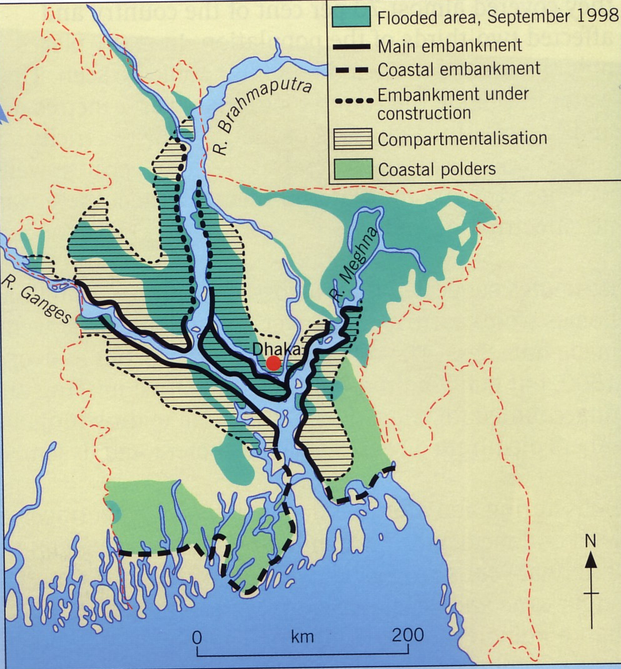
Protection
5000 shelters
Improve flood forecasting scheme
Flood disaster management – early warning, clear instructions
Dams – in Bangladesh and Nepal
Flood control compartments
Embankments

Slide 25
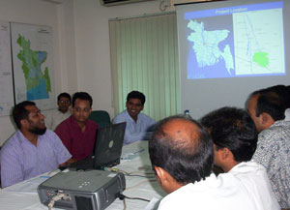
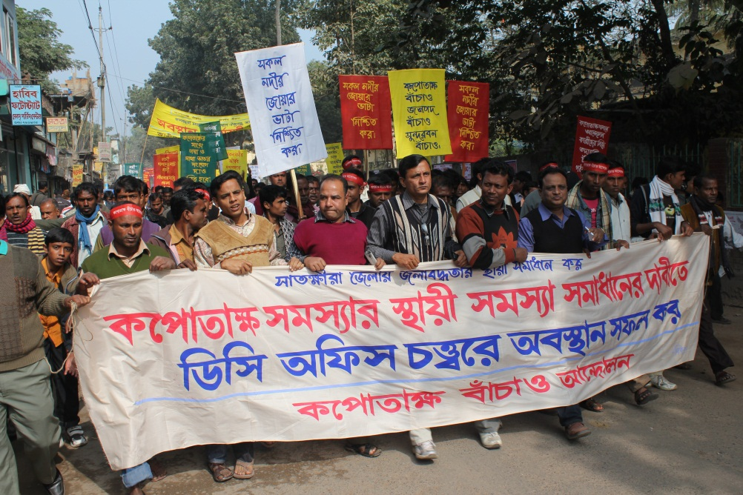
Info Card 1
Flood shelters save lives
Flood shelters provide a safe place for almost everyone
Flood shelters don’t protect land and property

Slide 26
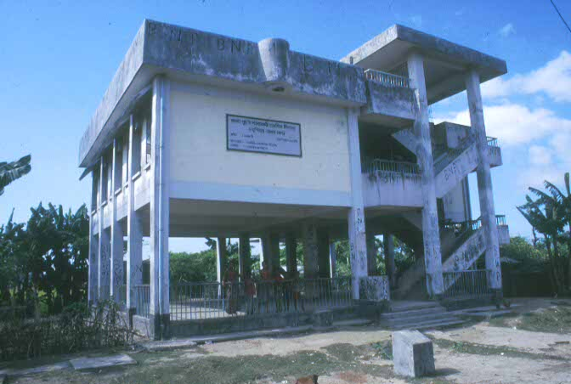

Info Card 2
The plans are expensive and Bangladesh might get in debt trying to afford them
Local people could make the flood shelters
Flood shelters need to be well stocked with food
Embankments trap rainwater and prevent it from reaching/ returning to the river - this can make flooding worse

Slide 27
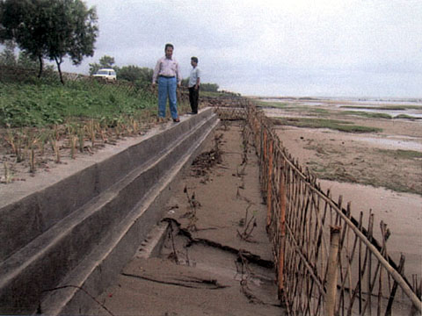
Info Card 3
Flood shelters are cheap to construct
Up to half a million Bangladeshi people will lose their land to reservoirs and embankments
Water stored in reservoirs behind dams can be used to water crops (irrigation)
Flood warning systems would give people instructions to people to tell them what to do before, during and after the flood

Slide 28
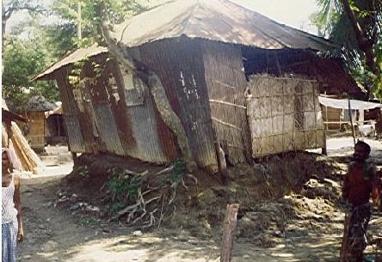
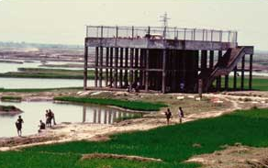
Info Card 4
Water stored in reservoirs behind dams can be used to generate cheap electricity
Building dams increases the build up of silt, this can make flooding worse

Slide 29
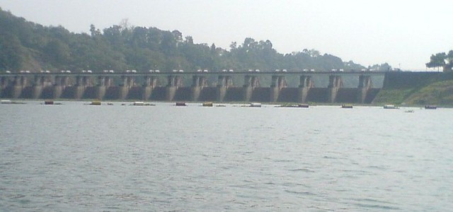
Info Card 5
Embankments strengthen the banks of the river so water stays in the river channel
Embankments stop people fishing on the river
Help would be given to people to plant crops for next year
Dams control the river flow and hold back the monsoon rainwater in reservoirs

Slide 30
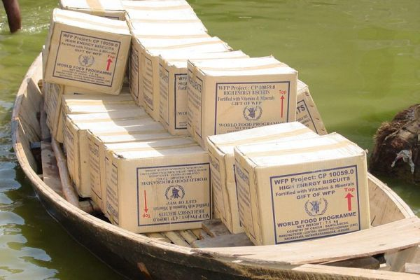
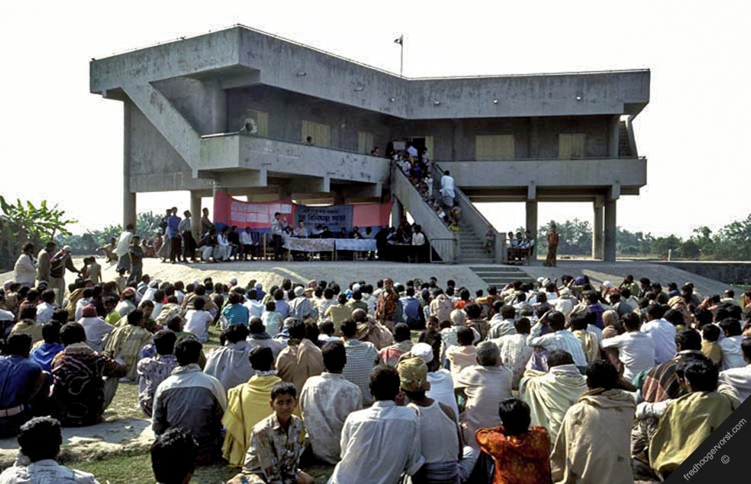
Info Card 6
The embankments could be up to 7m high in urban areas
5,000 flood shelters could be built in high risk areas
If people can’t fish it will affect their livelihood

Slide 31
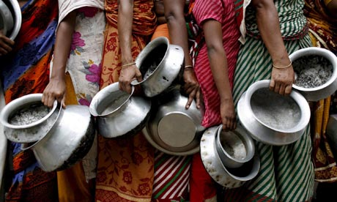
Info
Card 7
Flood warning systems would give early warnings of the floods
People would be taken to safety, given food and medical care
Because this river sediment is very fertile, it is good for growing crops like rice - embankments would stop this

Slide 32
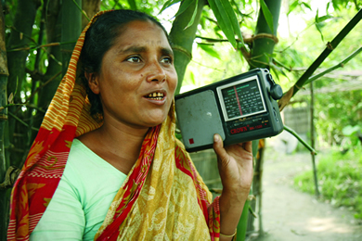
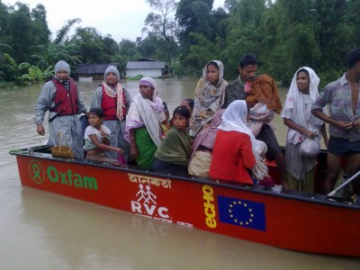
Info Card 8
Food, drinking water, tents and medicines would be available after the floods
Not everyone would get the warning
Providing emergency help when the floods arrive

Slide 33
Plenary- 8 Mark Question
Please complete the tasks on the worksheet and then rewrite the 8 mark question in your books in a way that would achieve a level 3 mark

