Slide 1
LO:
1. To use atlases and globes to find the location of the main tropical rainforests.
Extension: To use co-ordinates to locate rainforests.
LO:
2. To label a diagram of the rainforest layers
LO:
3. To recognise the impact that buying products made using palm oil has on the rainforest and the animals that live in it.

Slide 2
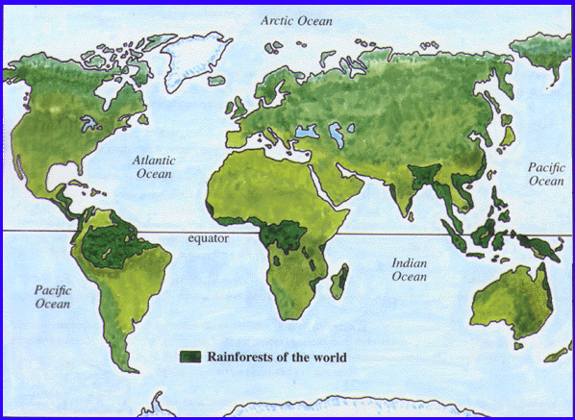
LO 1. To use atlases to find the location of the main tropical rainforests.
You need to mark on the
CONTINENTS in CAPITAL LETTERS
and the countries in normal hand-writing.
Extension- Find the degrees of latitude and longitude for the rainforests
Tropic of Cancer
Tropic of Capricorn
Notes:
Introduction:
This map shows the locations of the world’s major tropical rainforests.
Who can remember why we use the word tropical? (Tropic of Cancer, above. Tropic of Capricorn, below.)
The tropical rainforests are between the tropics and are close to the Equator. It is usually very hot there and very humid. You do not get Autumn, Winter, Summer and Spring.
What you are going to do is use an atlas to locate the different continents and countries of the major rainforests.
MODEL USING ATLAS. Some of you will use a globe instead. WRITE UP SUCCESS CRITERIA FOR USING ATLASES.
There are maps on your tables. Name the continents which have tropical rainforests, and name the countries.

Slide 3
Check your work now. Make any correction.
(South East) Asia
Mexico
Papua New
Guinea
Congo
Indonesia
Brazil
Africa
South
America
Madagascar
If you have found more information, CONGRATULATIONS
Notes:
Assessment for Learning: Children who need to change much to go to Mrs Charlesworth to check their work.
Rest of children to return to carpet.

Slide 4
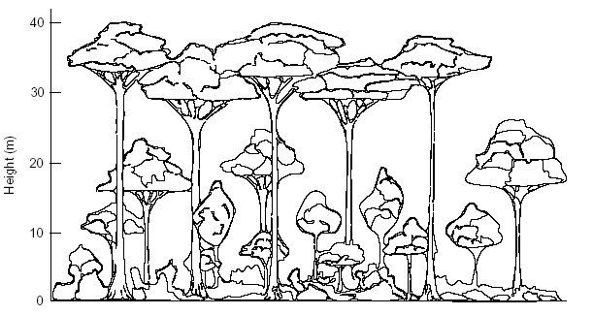
LO 2: To identify and describe the layers of a rainforest.
Watch Amazon Film of the rainforest. Which animals can you see living in different layers?
Notes:
Invite children to sit down.
Each child needs a whiteboard and pen to make notes from the video clips. Divide whiteboard into 2 sections, 1 for each video clip.

Slide 5
Rainforest plants
And the enormous the number of different species of plants grow in
rainforests, with many species occurring only in one particular region.
Unlike other forests, rain forests have an abundance of :
Epiphytes plants which live above the ground growing on
tree trunks and branches, Example orchids,
ferns, mosses
Climbing plants including large woody climbers called lianas
which are rooted in the soil and usually reach the
canopy. The climbers twist around the tree trunks,
and loop from one tree to another in the canopy,
binding the trees together.

Slide 6
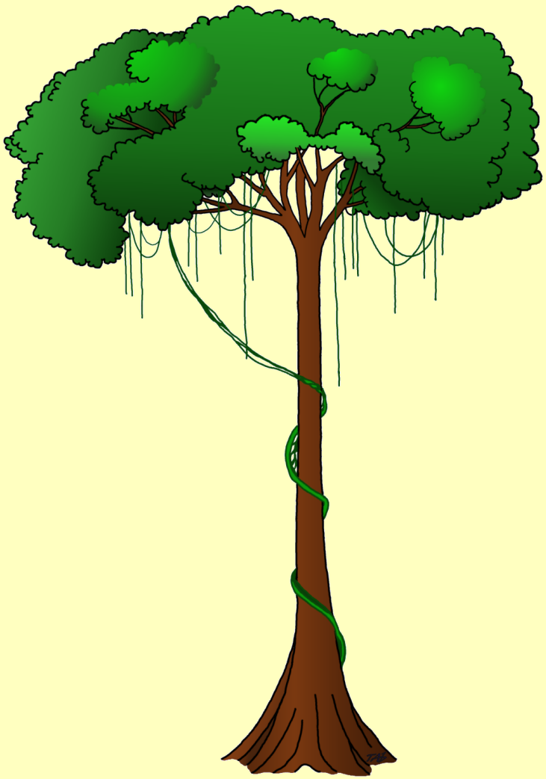
Strong scent of fruits attracts
animals, which feed on the
fruit and assist in dispersal
of the seeds
Thick, waxy surface of
leaves protects against
hot sun, heavy rain,
and strong winds
Strong scent and bright
colours of flowers
attract insects which
assist in pollination
Aerial roots of
epiphytes absorb
moisture from the
air
Tall straight trunks
no side branches
Thin, smooth bark
Shallow spreading
root system
Buttress roots

Slide 7
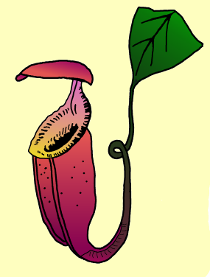
Pitcher plant - a carnivorous plant.
Parasitic plant
slippery rim
tendril
Orchid - sun-loving roots
attached themselves to
branches and absorb nutrients
Insects falling into the
pitcher are digested, and nutrients which are released are absorbed by the plant.

Slide 8
Structure of the rainforest
The dominant plants in a rainforest are giant trees. The hot wet climate enables them to grow all year round, and they remain evergreen, continuously shedding their leaves and growing new ones.
The average height of rainforest trees is about 45 metres, although the emergence (trees which tower above the others) may go as high as 90 metres. Smaller trees growing the under story (layer between the canopy and the forest floor).
Several layers can be identified within the forest

Slide 9
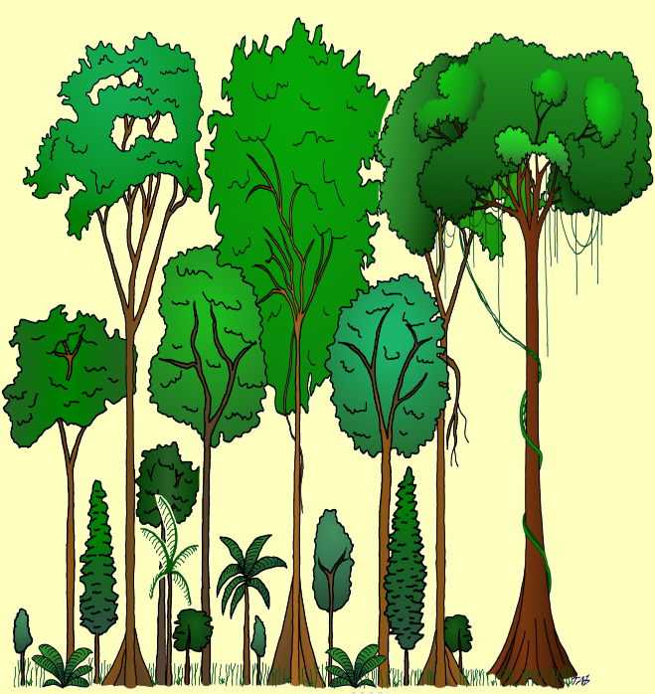
45
A Emergent
tree canopy
40
35
30
25
B Large trees
of Middle layer
20
15
C Lower tree
layer
10
D Shrub/small
tree layer
5
E Ground vegetation

Slide 10
Canopy layer - formed by the crowns of the tall trees and
contains a mass of branches, Leaves, flowers and fruit.
Conditions in the canopy vary, and include:
Hot sunshine
Heavy rainfall
Tropical storms
Middle layer - the Vegetation here is more sparse. The trees tend to have pointed crowns and, when a giant tree falls, they grow quickly to fill a gap in the canopy
Conditions within the forest on more or less constant:
There is little variation in temperature
The air is moist and still
Rain on the canopy drips to the forest floor several minutes later
A breeze is rare, even during storms

Slide 11
Shrub layer - scattered shrubs, saplings (young trees) and ferns.
Herb layer - a few non-woody, soft stemmed plants with thin leaves.
Leaf litter - thin layer covers the forest floor.
Soil layer - most roots growing the top 10 centimetres
whether nutrients are found.

Slide 12
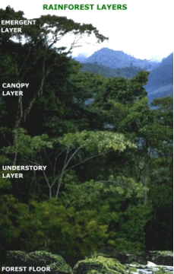
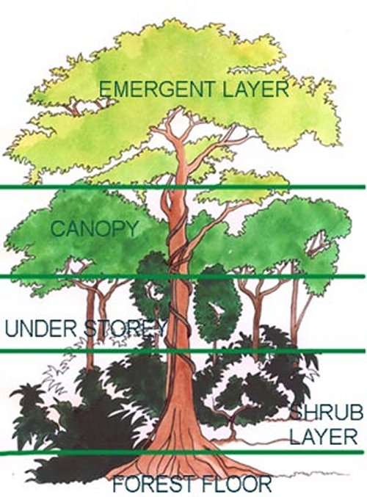
We need to label this diagram of the different layers of the rainforest.
Notes:
Compare photograph and diagram

Slide 13
Quick show of hands… who likes crisps?

Slide 14
Orang-utan info
In the Malay language, orangutan means "person of the forest.”
About 97 percent of an orangutan's genetic makeup is the same as a human's.
Orangutans live in the wild only in Borneo and northern Sumatra.
Orangutans are threatened by habitat destruction as people cut down trees for timber.
A female orangutan has a baby, on average, only once every eight years.
Orangutans find their food in the trees where they live. More than half their diet consists of fruit. They also eat nuts, bark, and other parts of plants and trees. Every once in a while they eat insects such as ants and termites, as well as bird eggs. Orangutans even find the water they need for drinking up in the trees—in hollows, on leaves, or even on their own fur after a rain.
There are approximately 20,000 Orang-utans in the world

Slide 15
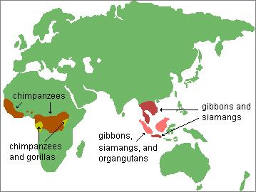

Slide 16
Newspaper Data Collection Activity
LO: 3. To recognise the impact that buying products made using palm oil has on the rainforest and the animals that live in it.

Slide 17
Quick show of hands… who likes crisps?

Slide 18
http://www.youtube.com/watch?v=MG7vx9NMDs4&feature=g-upl&context=G234fe9dAUAAAAAAAAAA

