Slide 1
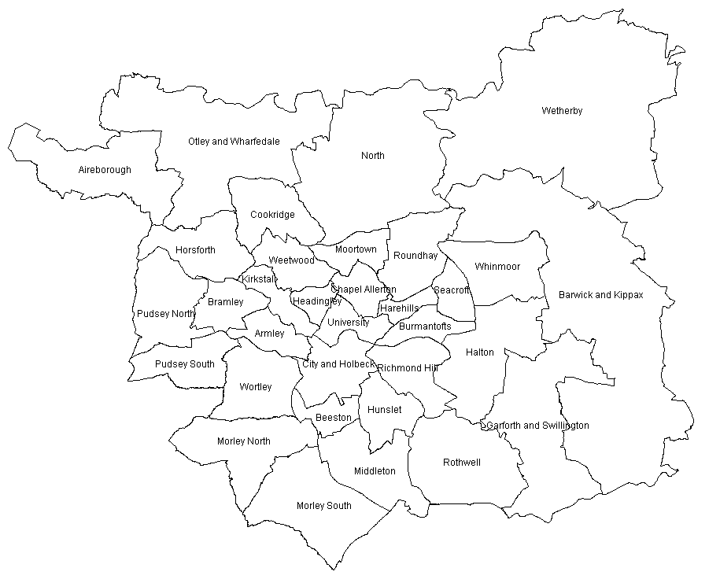

Slide 2
Task
Copy the slide with the map on it
Add on symbols which locate you chosen amenity
Low end supermarkets (Aldi, Lidl and Asda)
Hospitals
High end supermarkets (Waitrose and Sainsburys)
Main bus routes
Ring Road/ Main (A) Roads
Universities
GPs
Dentists
Gyms
Stop smoking clinics
Off Licences

