Slide 1
Health Geography
Variations within Leeds

Slide 2
Learning Objectives
I understand the correlation between different lifestyle, geographical, socio-economic factors and health
I can explain the patterns of correlation between these factors using GIS
I can work as a member of a team and present to a group of people

Slide 3
Bellwork
Using the map on the next slide, suggest what health variations you might expect to see around the city of Leeds

Slide 4
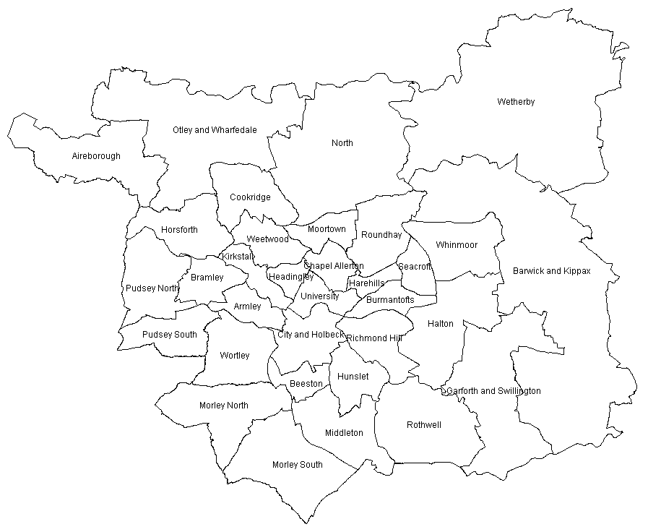

Slide 5
Starter
What is the average life expectancy in Leeds?
What is the average life expectancy in the UK?
What is the mean average age of people in Leeds?
What is the mean average age of people in the UK?
How does this help up to explain health patterns in Leeds?
Name an area of the country with a high % of elderly people?

Slide 6
Researching Maps in Pairs
And then sharing your maps (and explaining them) with the class next lesson

Slide 7
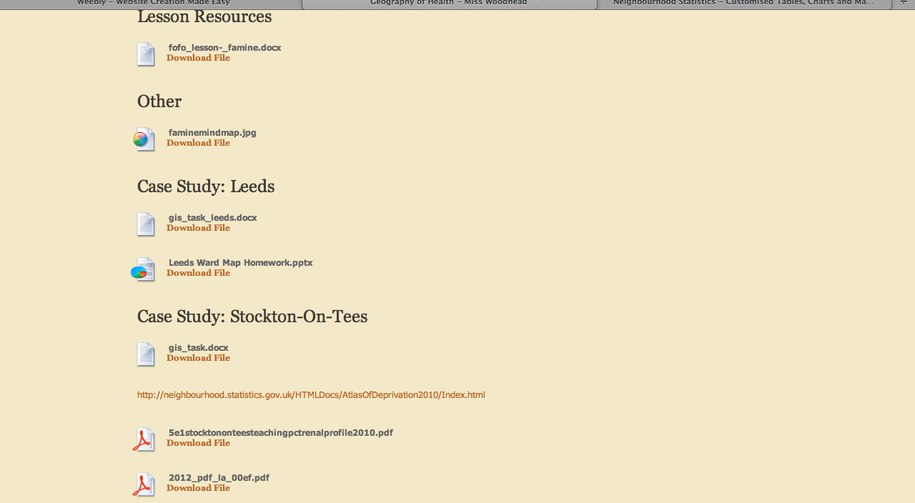
Go to Geography of Health Page on www.misswoodhead.weebly.com
30 Minutes to Work through the Worksheet

Slide 8
30 Minutes to Work through the Worksheet

Slide 9
Plenary Post It
How does what you have learnt from your GIS task link with the map from the start of the lesson?

