Slide 1
Health

Slide 2
Lesson Objectives
Finish collecting information for case study of AIDs in Zambia
Be able to categorise AIDs/HIV info into background, causes, impacts and strategies to tackle to epidemic
Learn statistics and information to evidence opinion regarding the AIDs/HIV epidemic

Slide 3
Reminder
Homework report is due on Monday
See Fronter for more details

Slide 4
Starter
Use the numbered squares to fill in the A4 sheet about AIDs and HIV in Africa
Write the number of the square next to the correct category

Slide 5
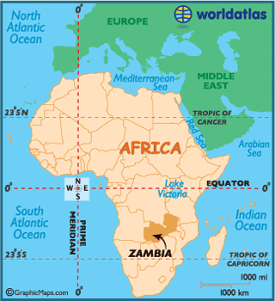
Main
Finish Video on AIDs in Zambia

Slide 6
Plenary: Value Lines
Can we solve the problem of AIDs in the next decade?
Is poverty the main problem concerning the spread of AIDs?
Will urbanisation reduce the spread of AIDs in Africa?
Is having HIV/AIDs worse in terms of the health impact or the social impact?

Slide 7
Malaria
Read your booklet and highlight the key facts.
Now study the diagram that shows how public health on smoking has been changed.
Working in small groups try to produce a new version of this diagram

