Slide 1
AS Health: Communicable and Non- Communicable Disease

Slide 2
Starter
A couple more graph analysis groups from Monday…

Slide 3
Lesson Objectives
Enhance our Geography of Health Language- Learn new key terms
Be able to give examples of diseases and measures for each key term
Begin to look at the case study of AIDs- a communicable disease

Slide 4
Hand out Booklets and Register
Page numbers on booklets

Slide 5
Matchup Activity
Match up the correct health term with its meaning and stick them down on some paper to keep as a reference

Slide 6
Page 3 of Health Booklet

Slide 7
Definitions
Communicable= Transmittable/Infectious e.g. AIDs
Non-Communicable= Non transmittable/Non Infectious e.g. CHD (Coronary Heart Disease)

Slide 8
Lesson Objectives
Enhance our Geography of Health Language- Learn new key terms
Be able to give examples of diseases and measures for each key term
Begin to look at the case study of AIDs- a communicable disease

Slide 9
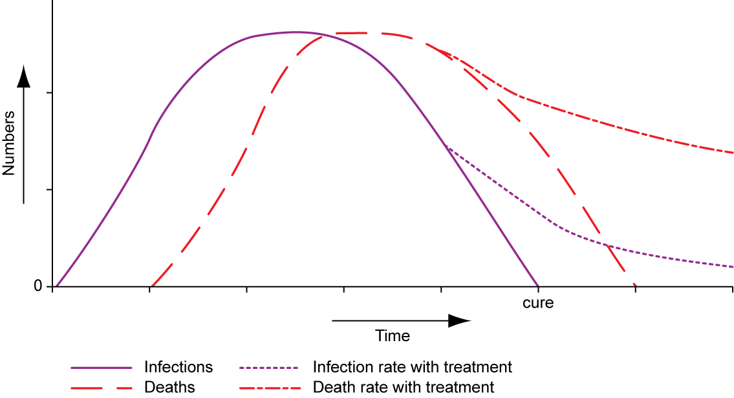
What is an Epidemic?

Slide 10
AIDs
P.4 in health booklet

Slide 11
AIDs
AIDS can be transmitted in several ways.
Sexual contact. Persons at greatest risk are those who do not practice safe sex, those who are not monogamous, those who participate in anal intercourse, and those who have sex with a partner with symptoms of advanced HIV infection and/or other sexually transmitted diseases (STDs). In the United States and Europe, most cases of sexually transmitted HIV infection have resulted from homosexual contact, whereas in Africa, the disease is spread primarily through sexual intercourse among heterosexuals.
Transmission in pregnancy. High-risk mothers include women married to bisexual men or men who have an abnormal blood condition called hemophilia and require blood transfusions, intravenous drug users, and women living in neighborhoods with a high rate of HIV infection among heterosexuals. The chances of transmitting the disease to the child are higher in women in advanced stages of the disease. Breast feeding increases the risk of transmission by 10-20%. The use of zidovudine (AZT) during pregnancy, however, can decrease the risk of transmission to the baby.
Exposure to contaminated blood or blood products. With the introduction of blood product screening in the mid-1980s, the incidence of HIV transmission in blood transfusions has dropped to one in every 100,000 transfused. With respect to HIV transmission among drug abusers, risk increases with the duration of using injections, the frequency of needle sharing, the number of persons who share a needle, and the number of AIDS cases in the local population.
Needle sticks among health care professionals. Present studies indicate that the risk of HIV transmission by a needle stick is about one in 250. This rate can be decreased if the injured worker is given AZT, an anti-retroviral medication, in combination with other medication.
HIV is not transmitted by handshakes or other casual non-sexual contact, coughing or sneezing, or by bloodsucking insects such as mosquitoes.

Slide 12
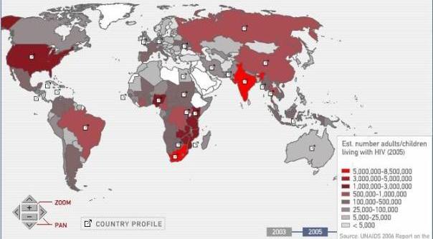
Mapping AIDs

Slide 13
Homework
Critically examine the following statement, “The problems associated with AIDs are growing”.
Your report should be at least 1 page long
It should include a map which is referred to
It should examine social, economic, political and environmental factors which link with the epidemic
It should be a balanced argument
It should refer to specific theories/knowledge (e.g. models (e.g. epidemic, theorists (e.g. Brandt) case studies (e.g. Zambia) and key statistics (e.g. from PowerPoint)

Slide 14
Video- Dispatches

Slide 15
Lesson Objectives
Enhance our Geography of Health Language- Learn new key terms
Be able to give examples of diseases and measures for each key term
Begin to look at the case study of AIDs- a communicable disease

Slide 16
Plenary
Without using your notes, create the longest sentence you can (that still makes sense) using as many different geographical key words (about the health topic) as possible
Sweets for the winner!

