Slide 1
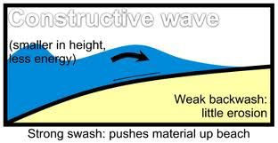
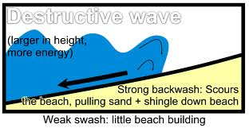
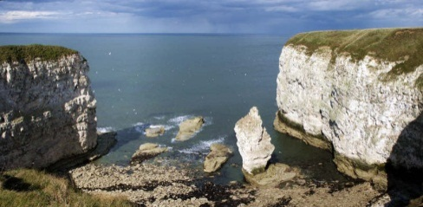
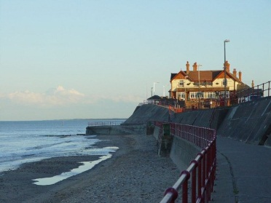
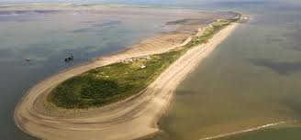
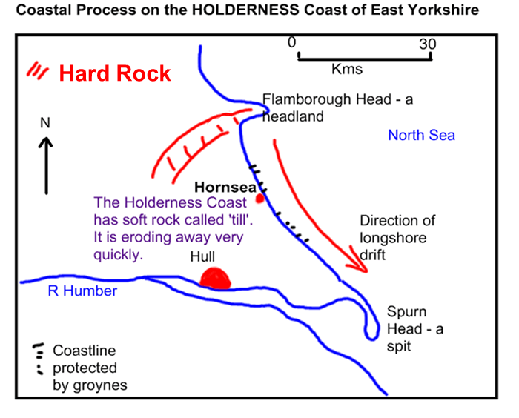
Coasts
Revision Workbook

Slide 2
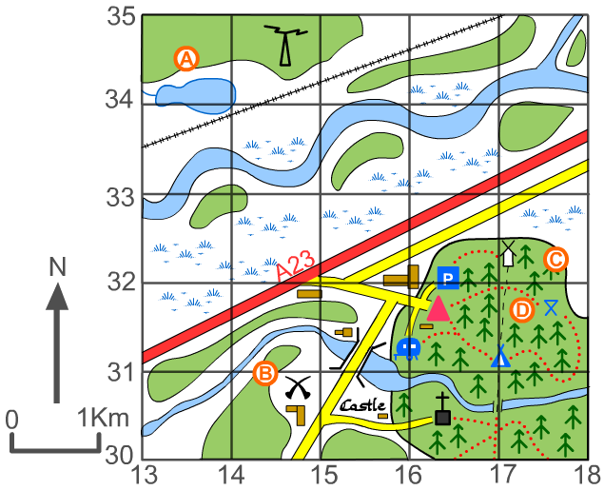
Section 1- Map Skills
Give the 6 figure grid references for:
A) __________________
B) ___________________
Give the 6 figure grid reference for:
The triangle___________________
The castle____________________
The church ______________
Section 2- Depositional Landforms
Match up the following definitions with the landform. You’ll need to write your own for a bar.
Longshore drift moves material along the coastline.
A spit forms when the material is deposited.
Over time, the spit grows and develops a hook if wind direction changes further out.
Waves cannot get past a spit, which creates a sheltered area where silt is deposited and mud flats or salt marshes form.
Spit
Bar
Tombolo
is a spit connecting an island to the mainland.

Slide 3
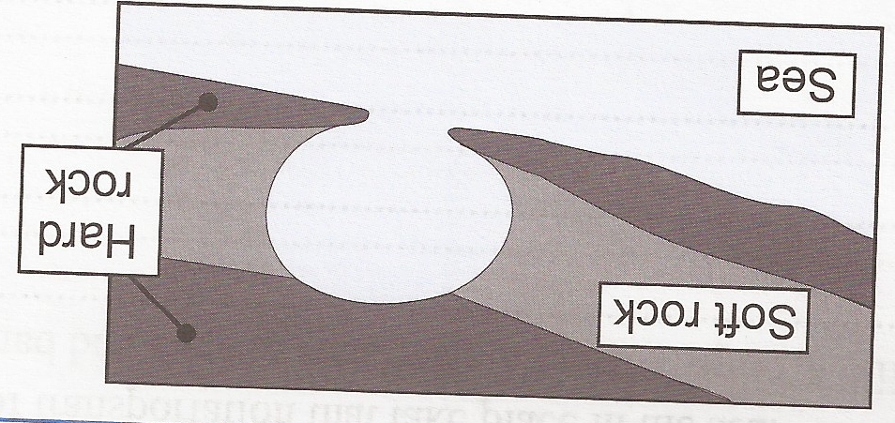
Section 3- Geological Landforms
Hard Rock (e.g. Chalk) Features
Order the following words:
Wave cut notch
Arch
Cave
Stack
Stump
Soft Rock (e.g. Clay) Features
Name 2 places along the Holderness coast that experience slumps and mudslides
.
.
Section 3(i)- Coves and Bays
Using the diagrams above, explain the differences between coves and bays.

Slide 4
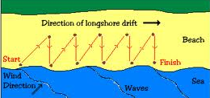
Section 4- Types of Erosion
Match the types of erosion to the correct definition
This is the chemical reaction between certain rock types and other acids in seawater. This is particularly evident on limestone and chalk cliffs where the water is a milky blue at the bottom of the cliffs due to the dissolved lime.
Hydraulic
Action
This is the pressure of the water being thrown against the cliffs. It also includes the compression of air in cracks: as the water gets into the cracks in the rock face, it compresses the air in the cracks; this puts even more pressure on the cracks and pieces of rock break off.
Corasion (Abrasion)
Corrosion (Solution)
This is a slightly different process that involves the wearing away of the rocks which are in the sea. As the boulders in the sea continually roll around, they chip away at each other until smooth pebbles and sand are formed
Attrition
Sand and pebbled carried within waves are thrown against the cliff face with considerable force. These particles break off more rocks which, in turn, are thrown against the cliff by the breaking wave
Section 5 Types of Transportation
Label on the diagram to show the 4 types of coastal transportation (longshore drift)

Slide 5
Section 5- Why Protect an Area?
As things like coastal tourism have become more frequent, humans have found it increasingly necessary to attempt to control the effects of the sea. The main reasons for coastal management are:
to protect the coast from the erosive effects of the sea.
to increase the amount of sand on the beach.
It is important that when answering a question on this topic, you remember to explain your answer if the question asks you to e.g.
“It is important to protect the beach as tourists come to the town to use the beach. They bring with them money to spend in the area.”
The second sentence in the above statement is the extending part of the answer which would give it its second mark.
Section 6- Hard Engineering
Complete the table below to show the advantages and disadvantages of different hard engineering strategies
Management Strategy | Advantages | Disadvantages
Groynes
Sea Wall
Gabions

Slide 6
Section 7- Soft Engineering
Complete the table below to show the advantages and disadvantages of different soft engineering strategies
Management Strategy | Advantages | Disadvantages
Beach Replenishment
Managed Retreat
Salt Marsh Creation
Section 8- Holderness Coast
Fill the spider diagram below with detailed, place specific, information about the Holderness Coast including geology, landforms and land use
Flamborough Head
Mappleton
Hornsea
Spurn Point

