Slide 1
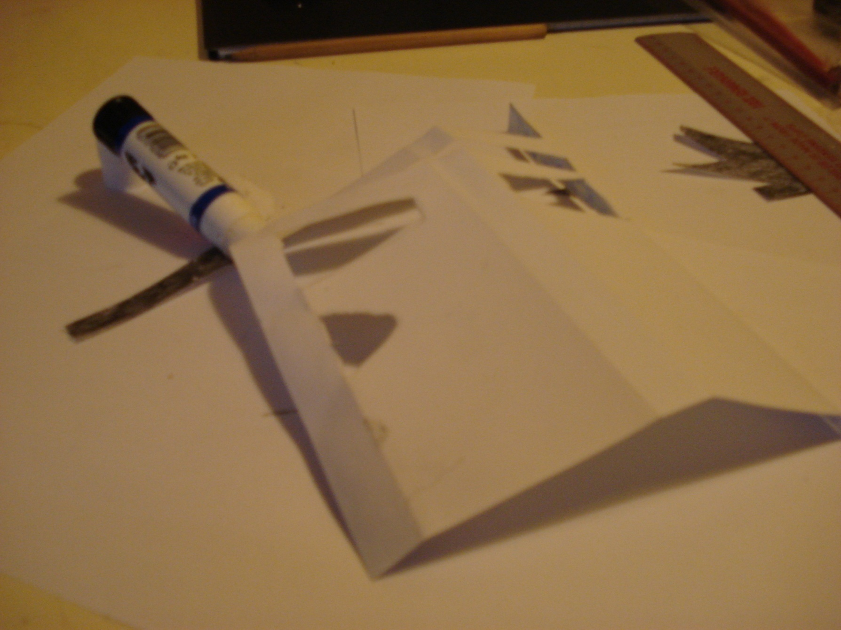
9
Glue along the two blue horizontal strips- on the reverse!

Slide 2
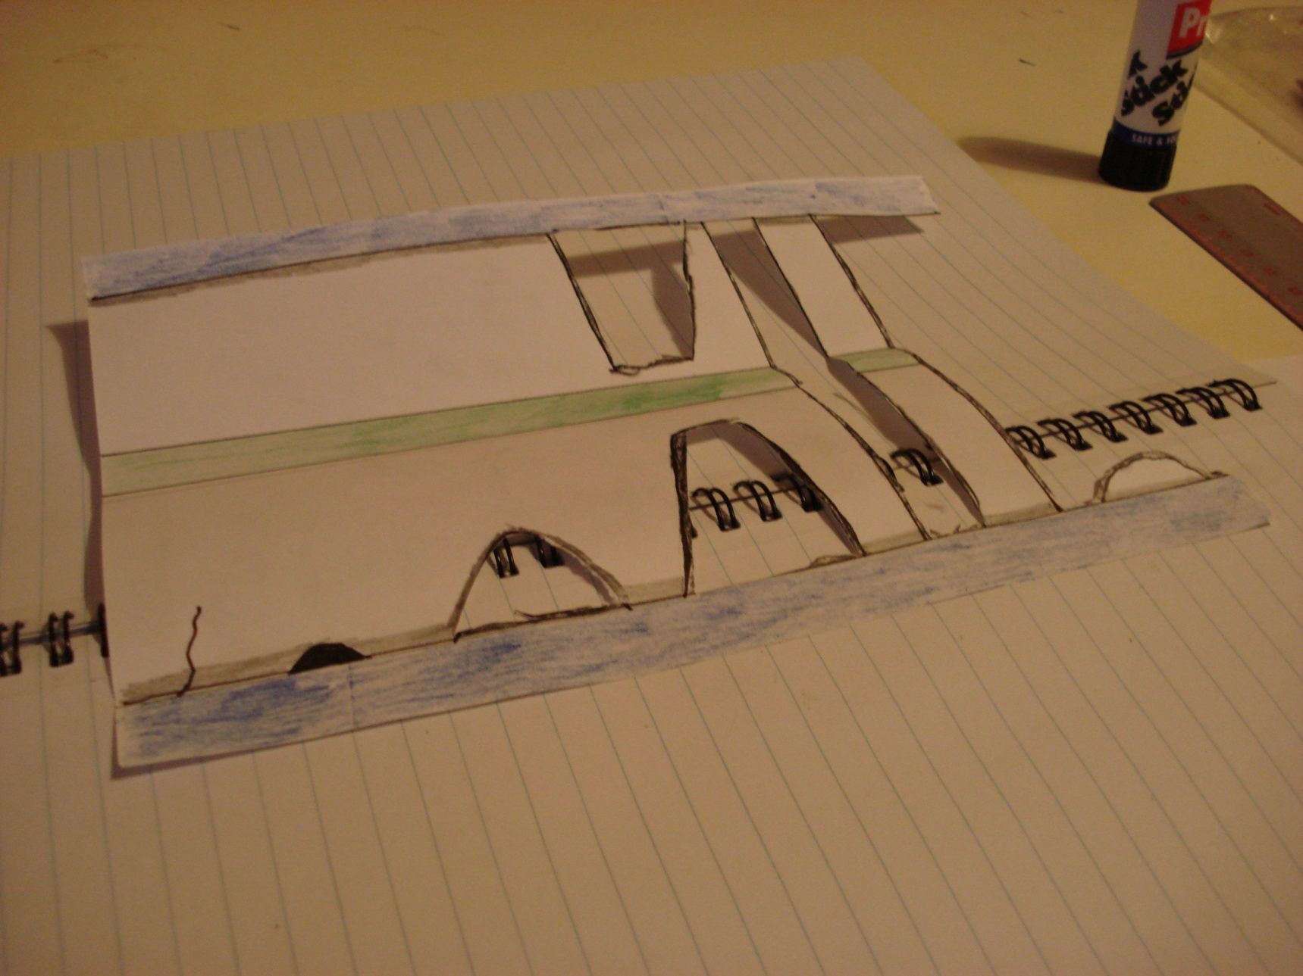
10
Position the green strip over the centre of your book. Gently glue down the blue horizontal strip- the one with the stump.- Practice your positioning first.

Slide 3
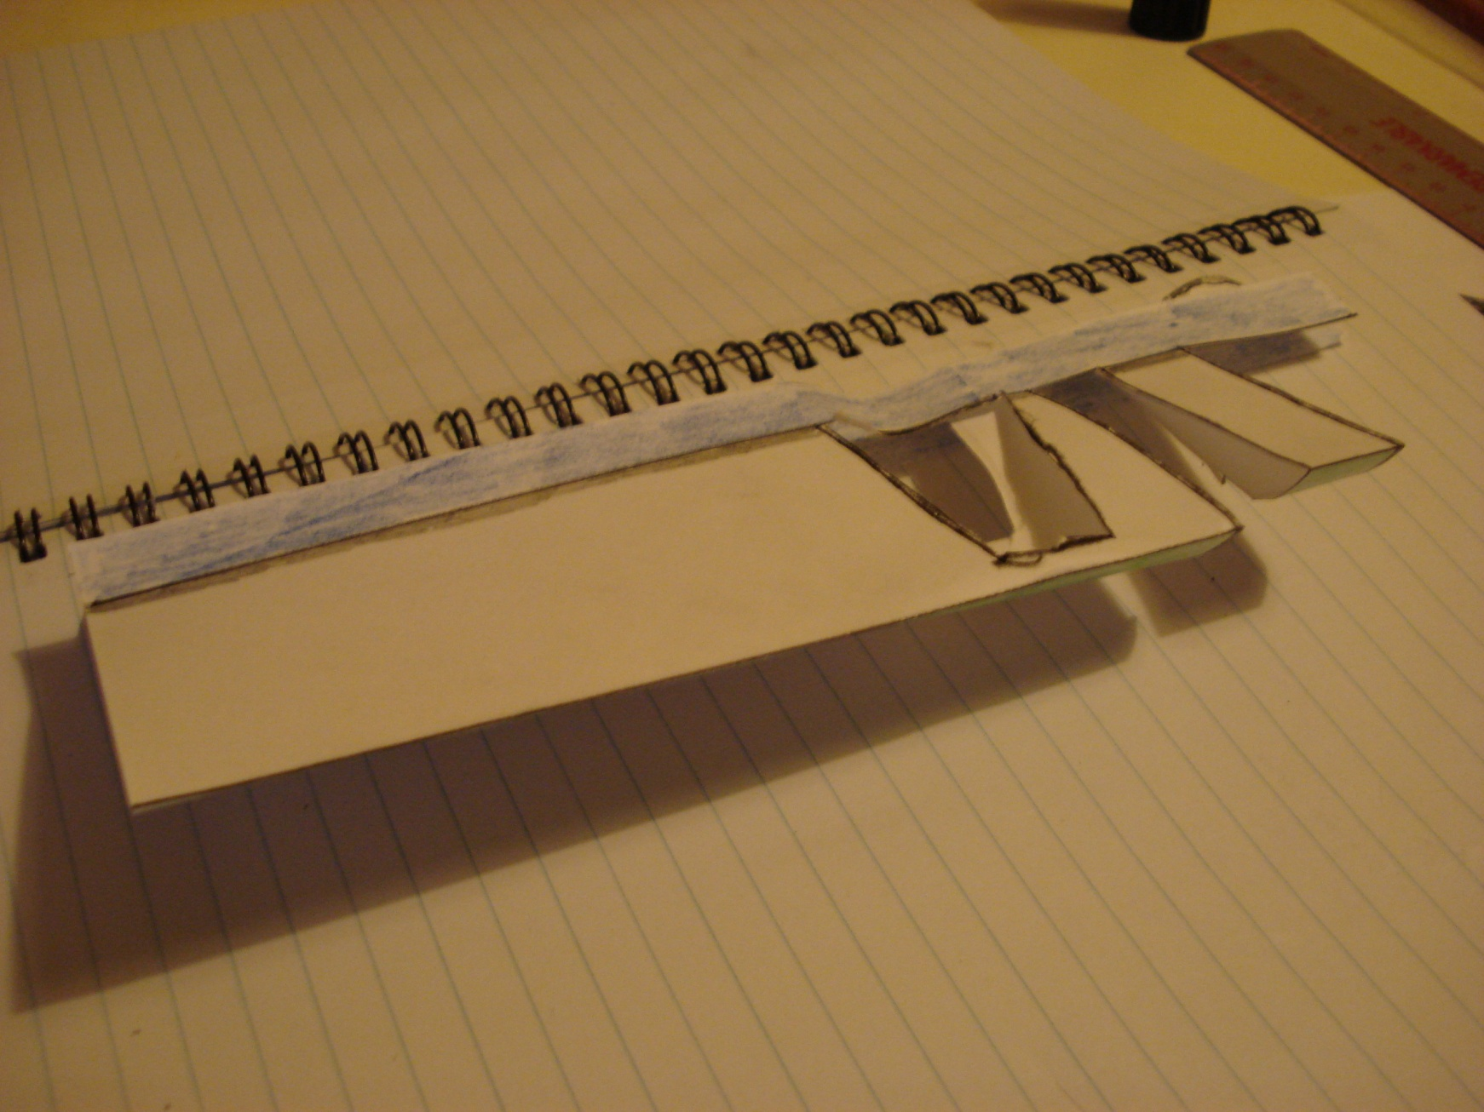
11
Carefully practice folding the model... are the folds the right way?

Slide 4
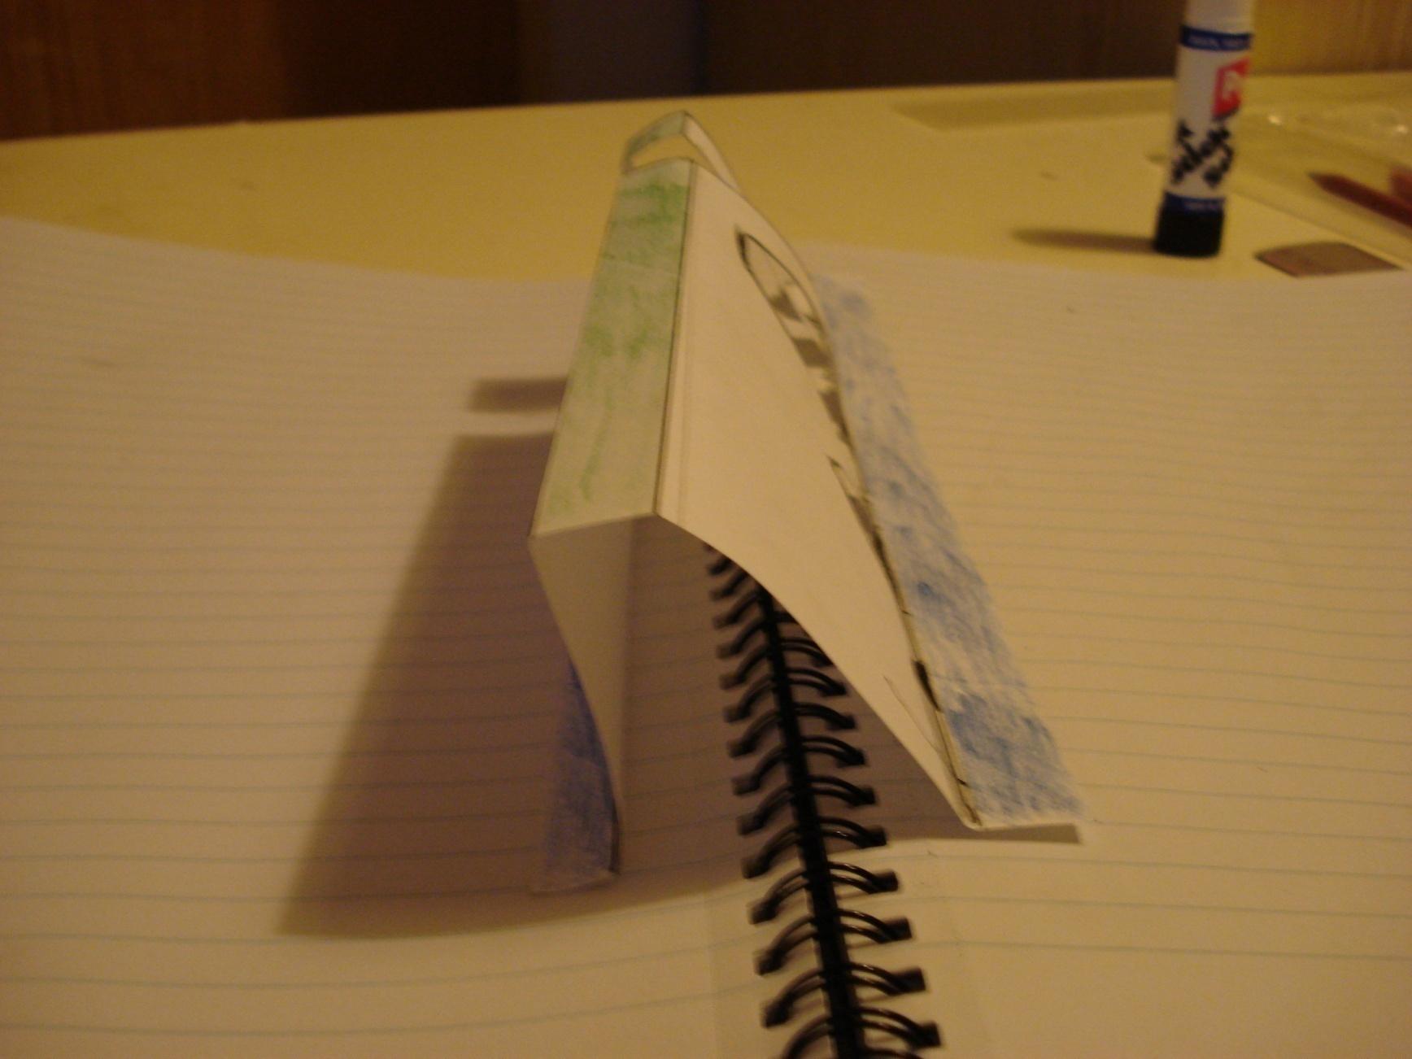
12
Finally, glue the final blue strip down. Practice the positioning first...

Slide 5
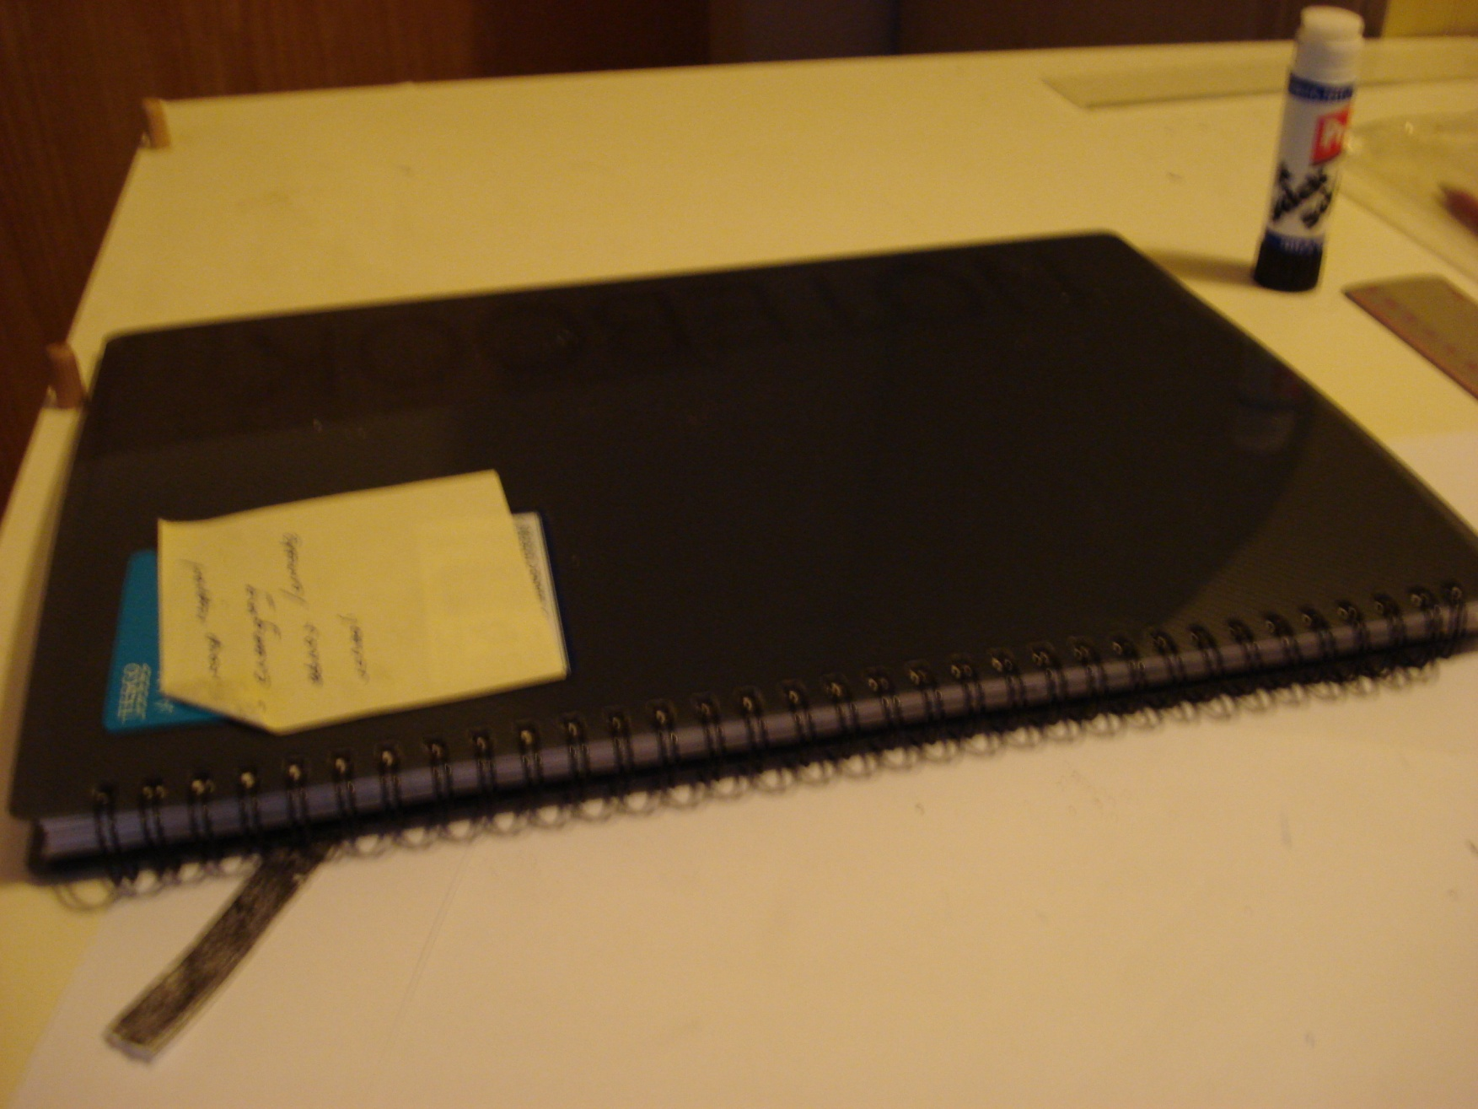
13
Gently close your book...

Slide 6
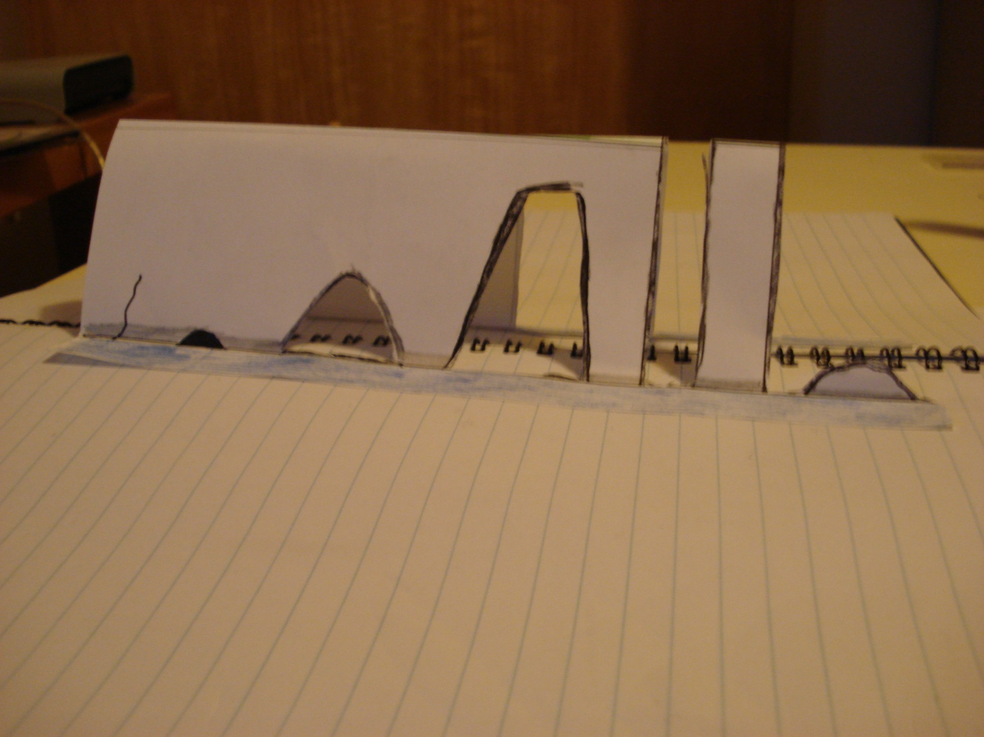
14
Magic...

Slide 7
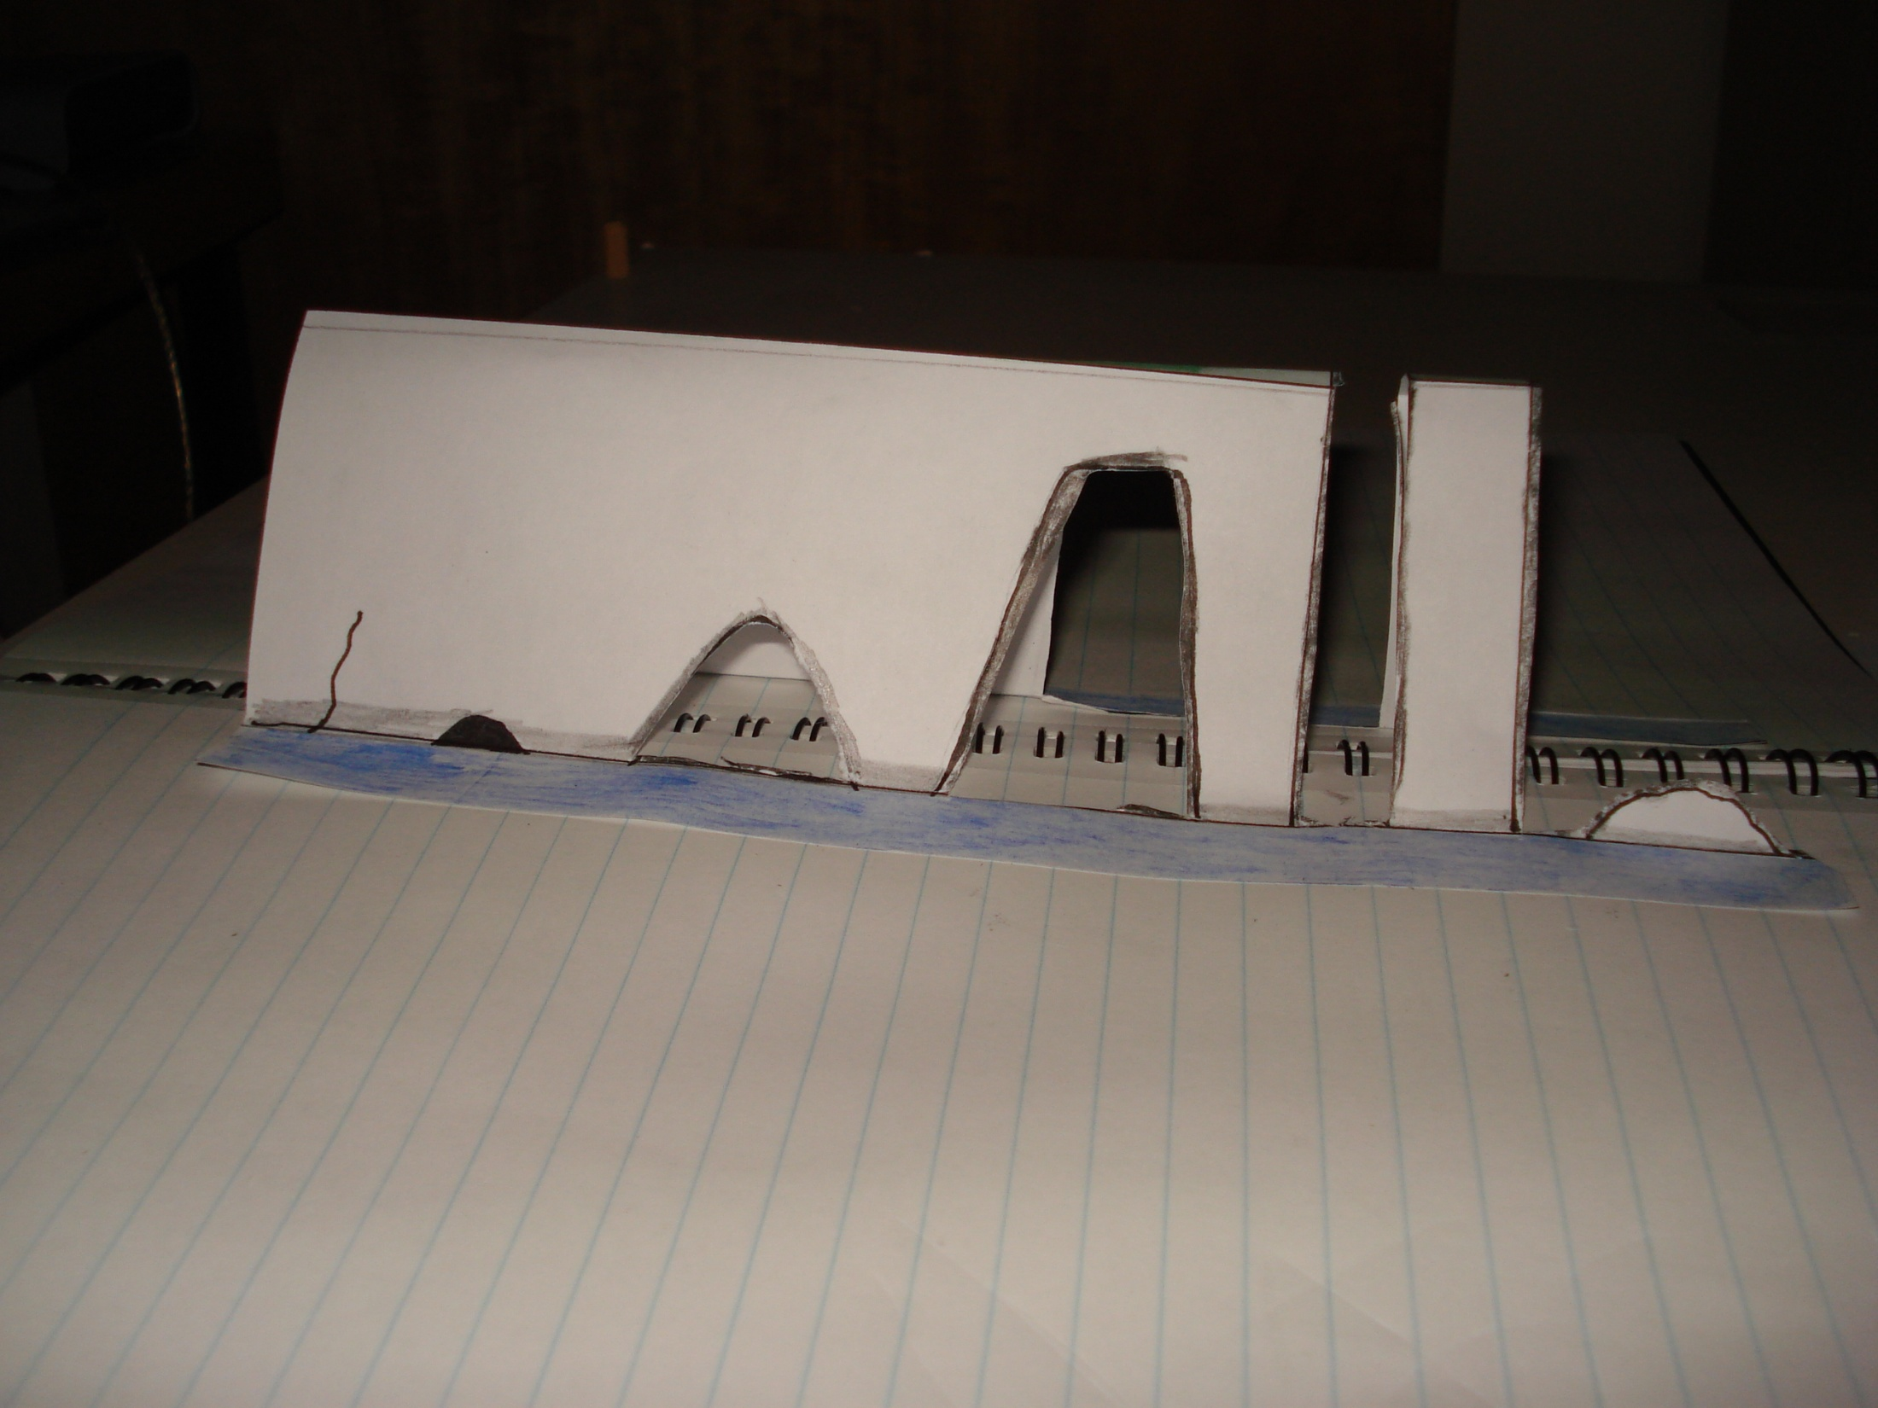
4
5
1
3
2
Either number each feature and add a key or Label
6
Extension Task- Create a step by step guide for a year 8 about how to make this pop up headland. Be sure to use key terms and explain their meanings

Slide 9
Explanation
Write a paragraph to explain the process of erosion which causes these headland features

