Slide 1
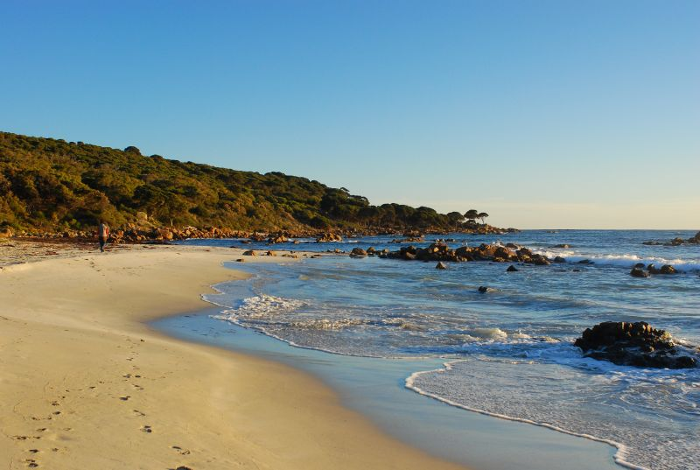
Headlands
and bays.
http://www.flickr.com/photos/anthonythomas/3085961629/

Slide 2
Text speak…
Mr Williams, being handy with a mobile phone, has texted me these definitions- but what are they?

Slide 3
Text speak…
d mechanical warin awy of rk
Notes:
Erosion

Slide 4
Text speak…
Breakdown of rk in situ
Notes:
Weathering

Slide 5
Text speak…
d movemnt of waVs ^ a bch @ d angL of d prevailing wind
Notes:
Longshore Drift

Slide 6
Text speak…
d distanC d wind cn travL uninterupted
Notes:
Fetch

Slide 7
Text speak…
d movemnt of material frm 1 plce 2 nothA
Notes:
Transportation

Slide 8
Learning Objectives
Explain the formation of Headlands and Bays
Recognise Key Features of Hard Rock Coastline
Define Key Words associated with chalk cliff erosion

Slide 9
Waves attack the coastline.
Harder rock
Softer rock
Harder rock

Slide 10
This area is now more sheltered, this encourages deposition and beaches are formed.
Harder rock
Harder rock
The softer rock is eroded by the sea- forming a bay.
Softer rock
The more resistant rock is left sticking out into the sea called a headland.
Harder rock

Slide 11
Surrounded by deep water and exposed to the full force of the waves- the headlands are eroded.
Harder rock
Harder rock
The shallower waters in the bay continue to encourage deposition.
Softer rock
Harder rock

Slide 12
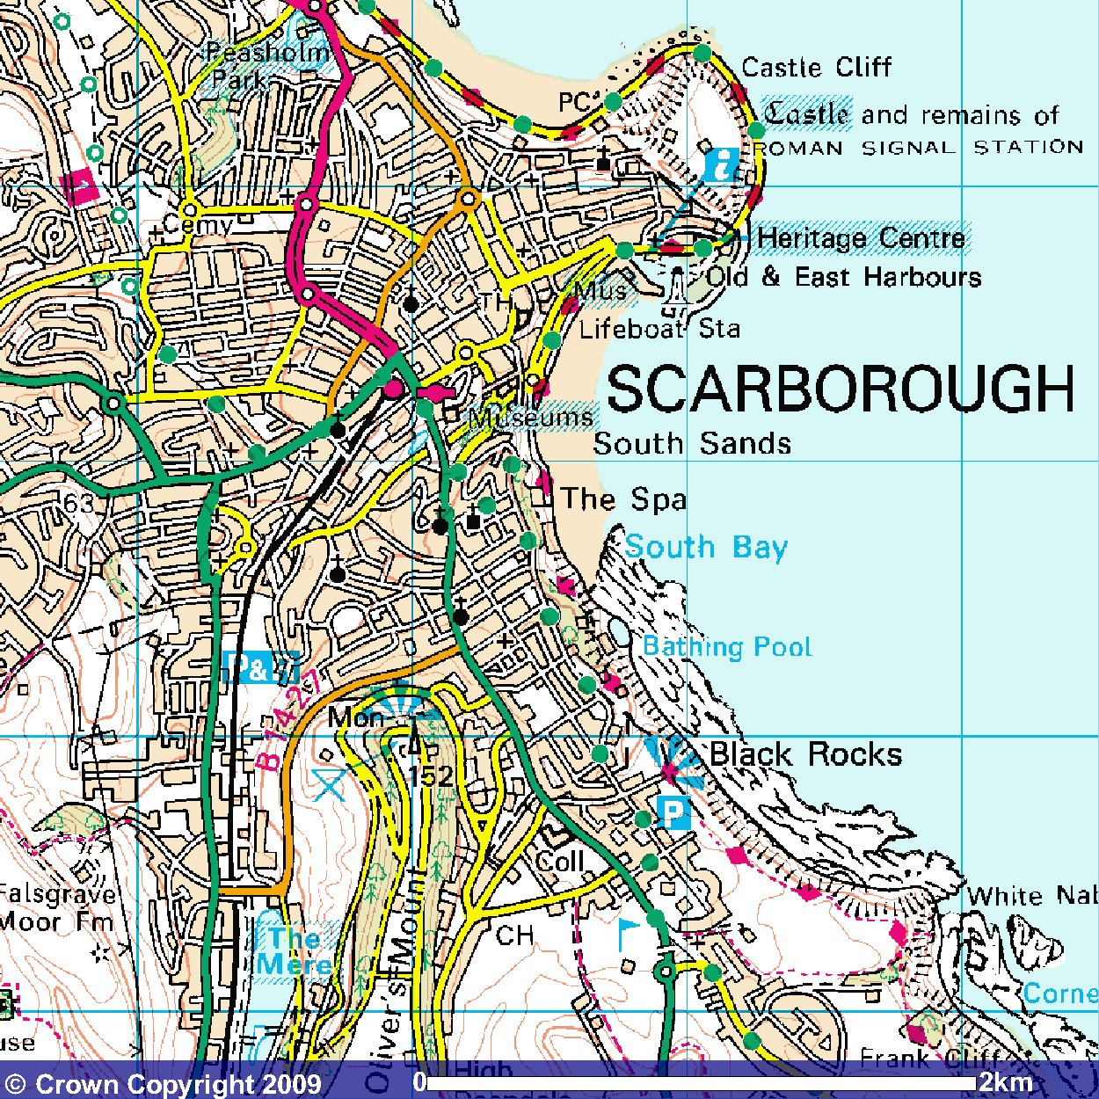
Headlands and Bays- Scarborough

Slide 13
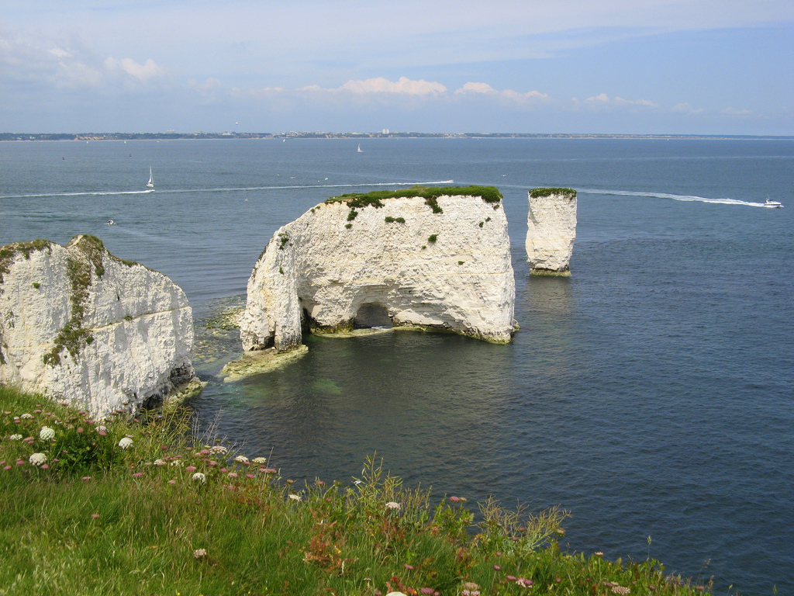
Stack formation…
http://www.flickr.com/photos/rosedavies/534844636/

Slide 14
This is a chalk headland.
Hydraulic action will exploit these weaknesses.
Because chalk is a sedimentary rock, lines of weakness run throughout the headland.

Slide 15
Between low and high tide, waves will attack the base of the headland.
HT
The process of corrasion will undercut the base of the cliff, forming a wave cut notch.
LT

Slide 16
The undercutting by corrasion will make the cliff unstable.
HT
This creates small caves which are enlarged over time by erosion.
LT

Slide 17
Caves develop on either side of the headland.
HT
LT
These caves erode back through the headland and meet, forming an arch.

Slide 18
Continued erosion at the base of the arch will cause the roof to become unstable.
HT
It may collapse leaving a stack.
LT

Slide 19
Continued erosion of the base of the stack may lead to its collapse, resulting in a stump.
HT
LT

Slide 20
Homework
Due next lesson- 21st January (Monday)
Find a picture of a chalk headland and label its features (e.g. Old Harry, Flamborough Head etc.)
Try and be original
If you have problems printing, come and see me before it’s due
No homework=after school detention
I don’t set you much so you can’t complain

Slide 21
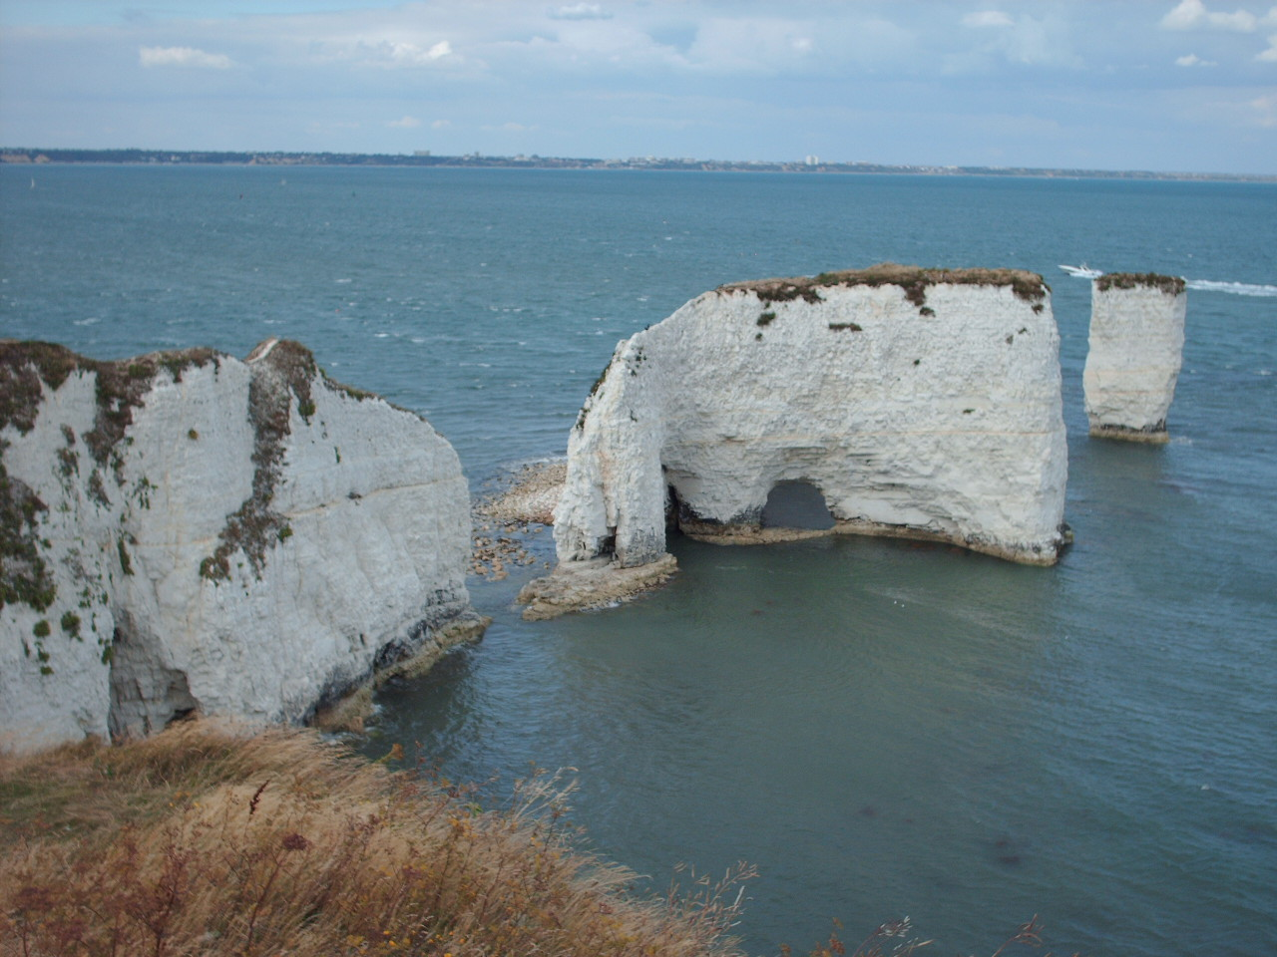
Pop-up headland..
http://www.flickr.com/photos/sacherfire/217113480/

Slide 22
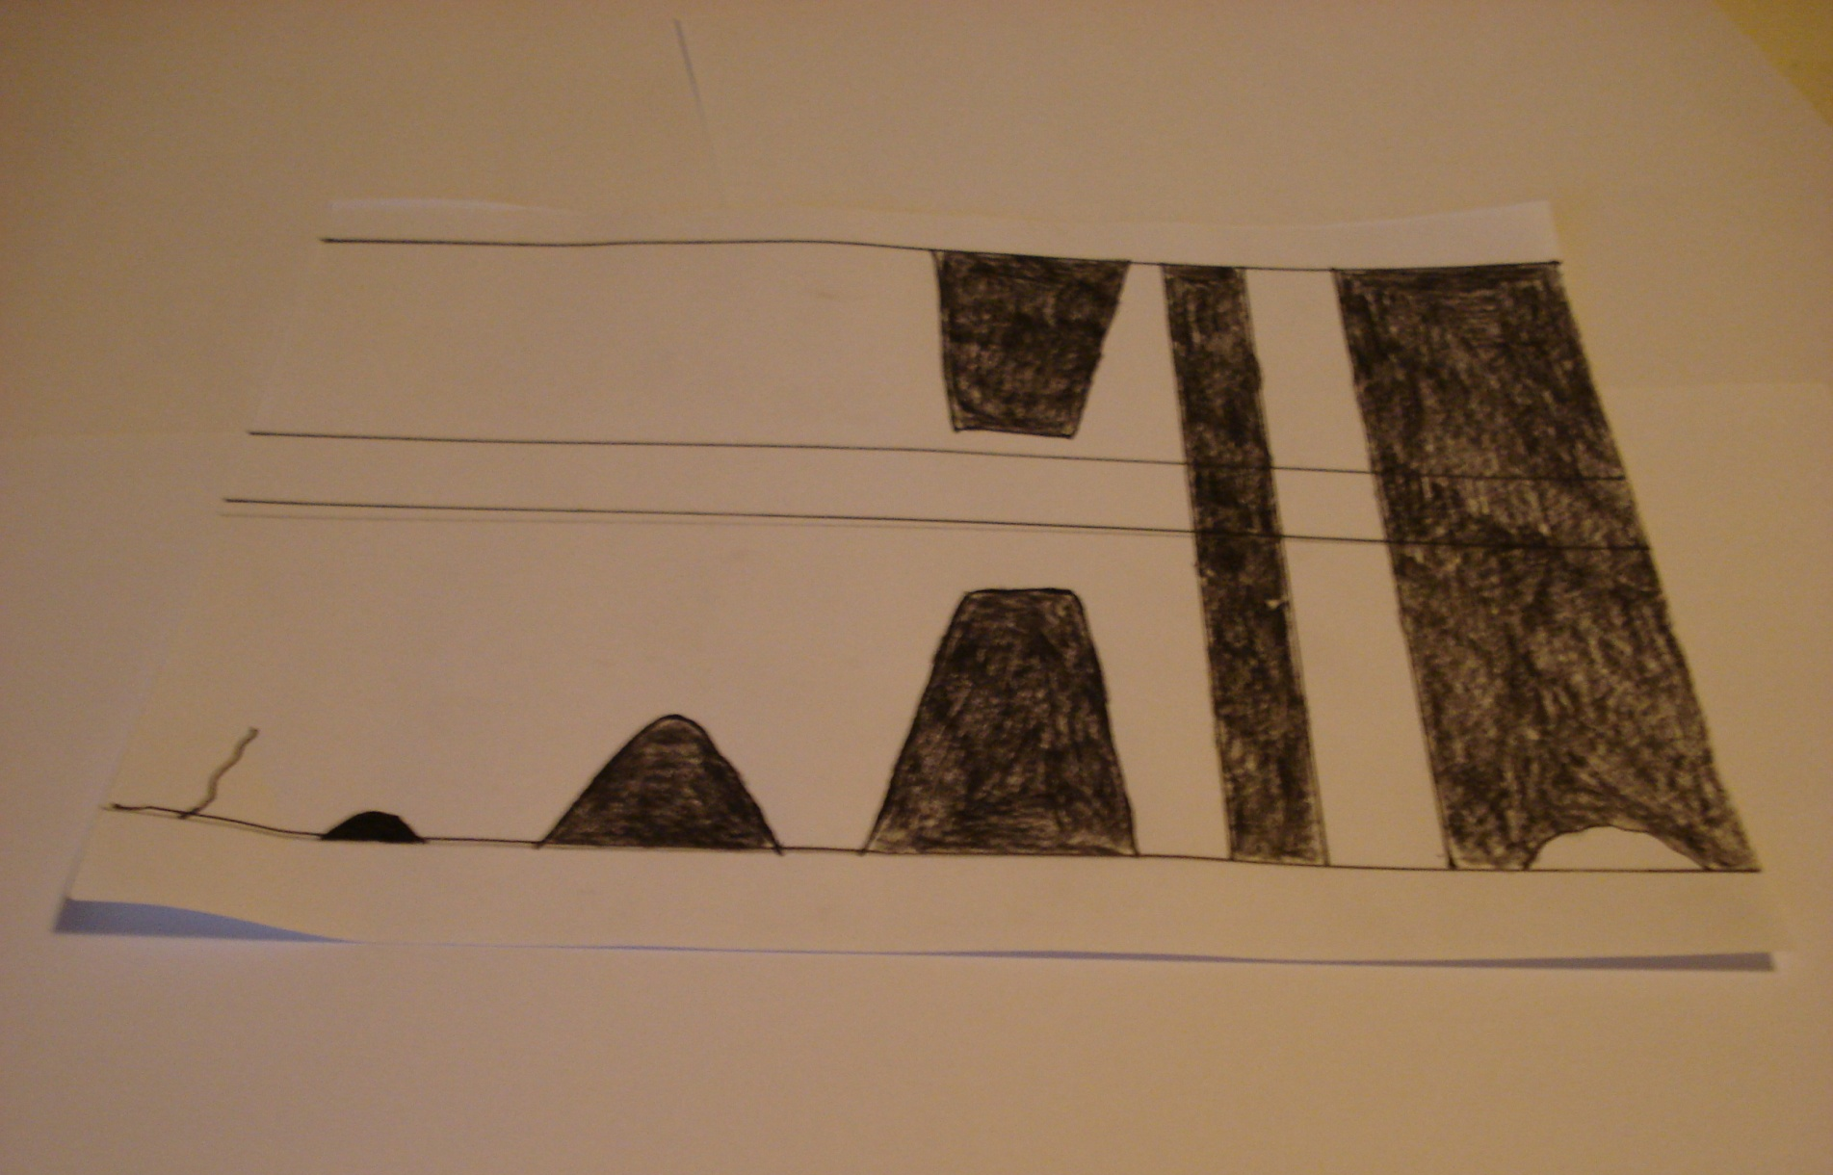
1
You need your template. This will represent a chalk headland.

Slide 23
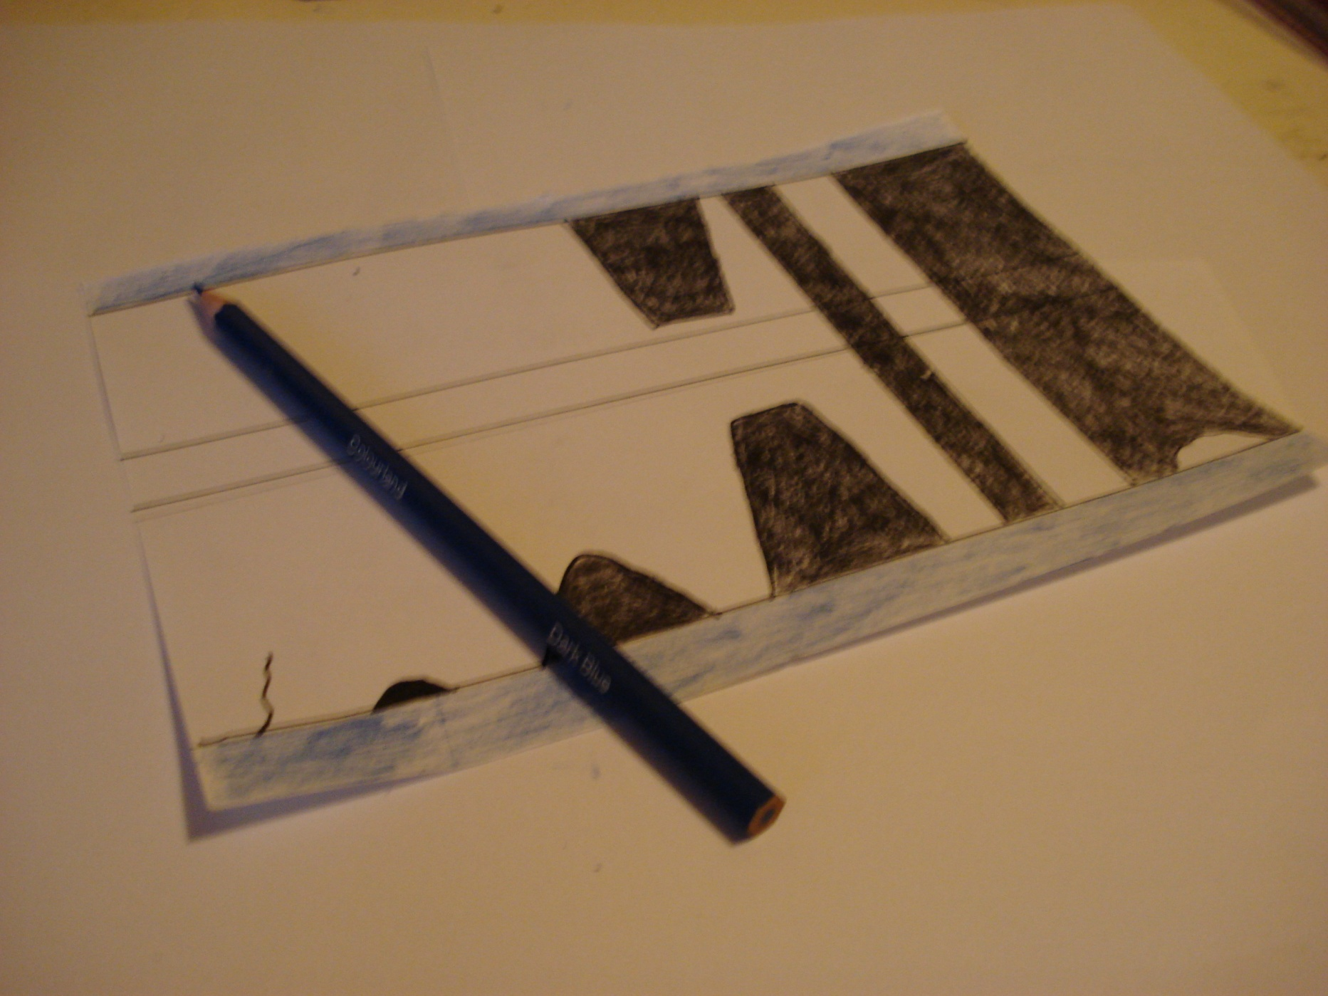
2
Using a blue crayon- shade the outside horizontal strips- these represent the sea.

Slide 24
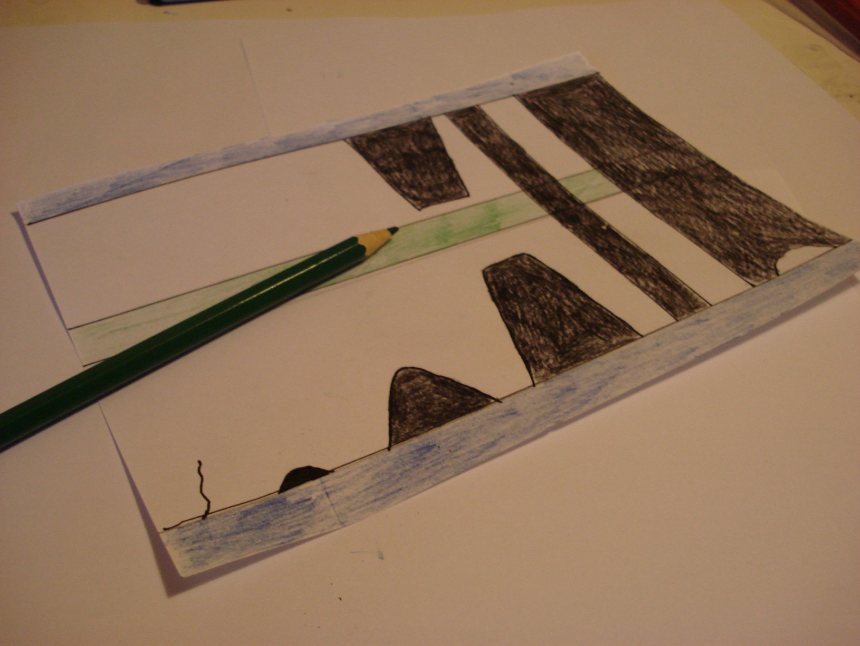
3
Using a green crayon- shade the middle horizontal strip- this represents the top of the headland- exposed to weathering.

Slide 25
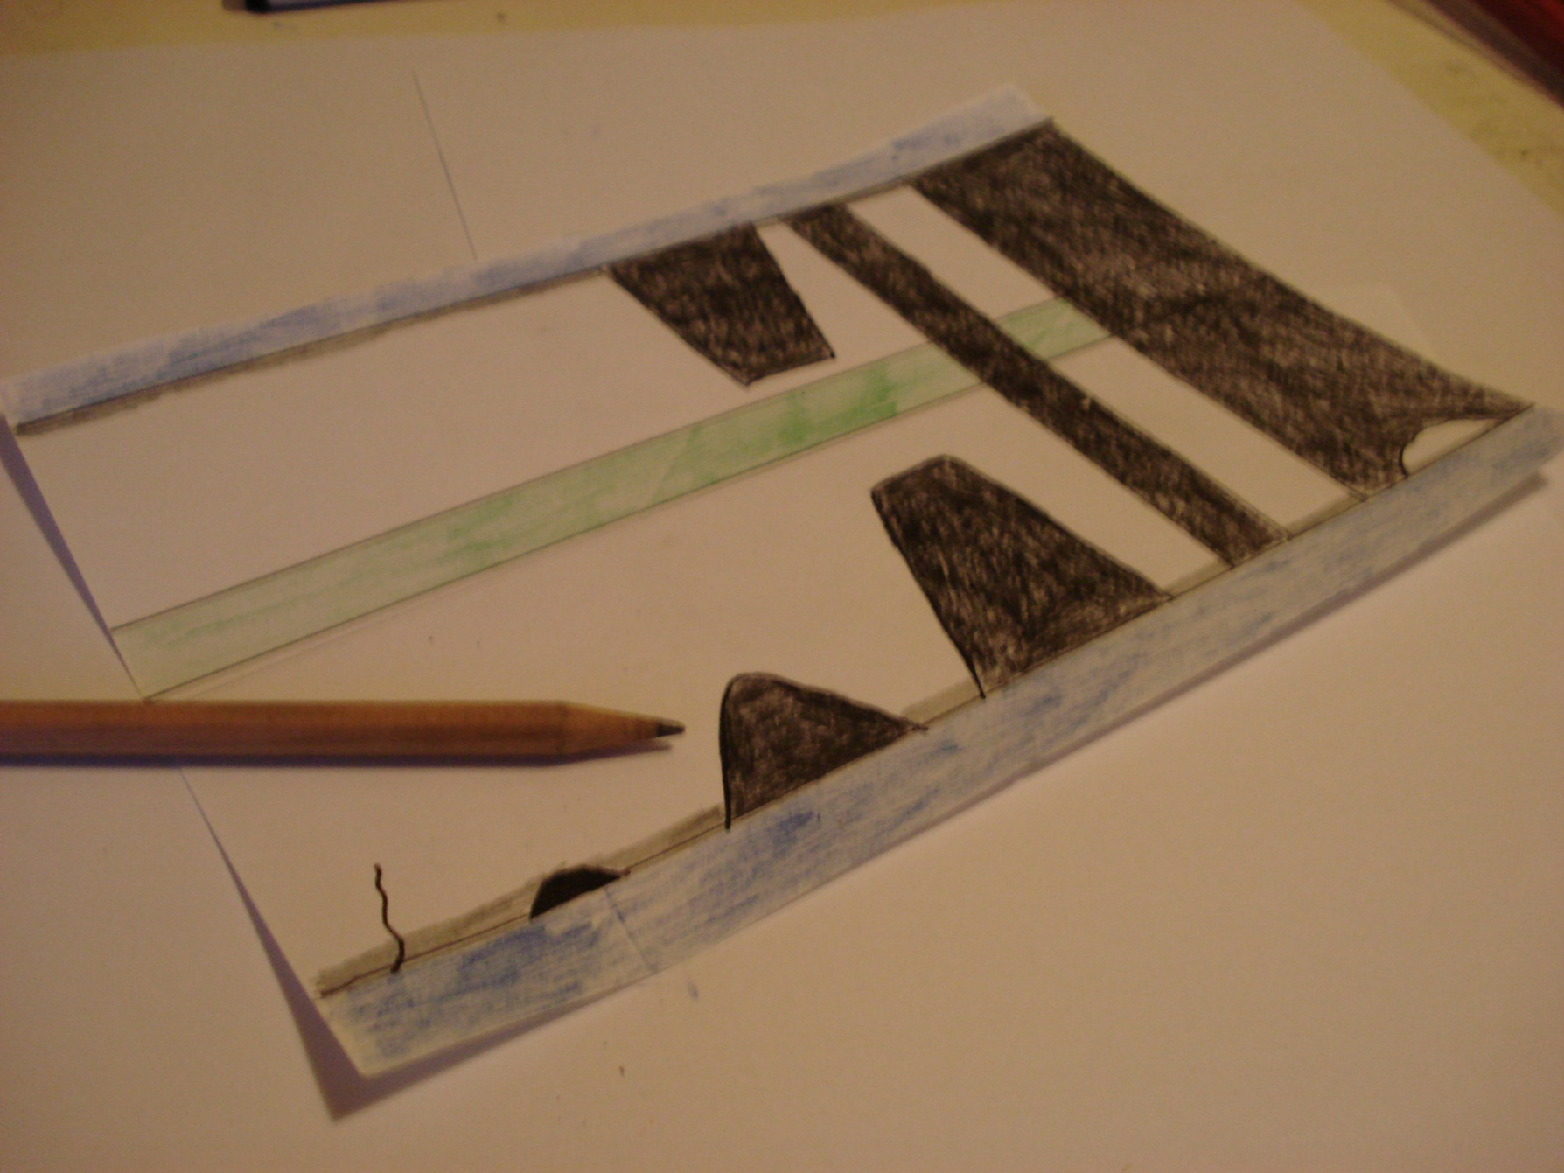
4
Just above the horizontal blue lines- shade a grey line- make sure it reaches the top of the wave-cut notch. This represents wave action between high and low tide.

Slide 26
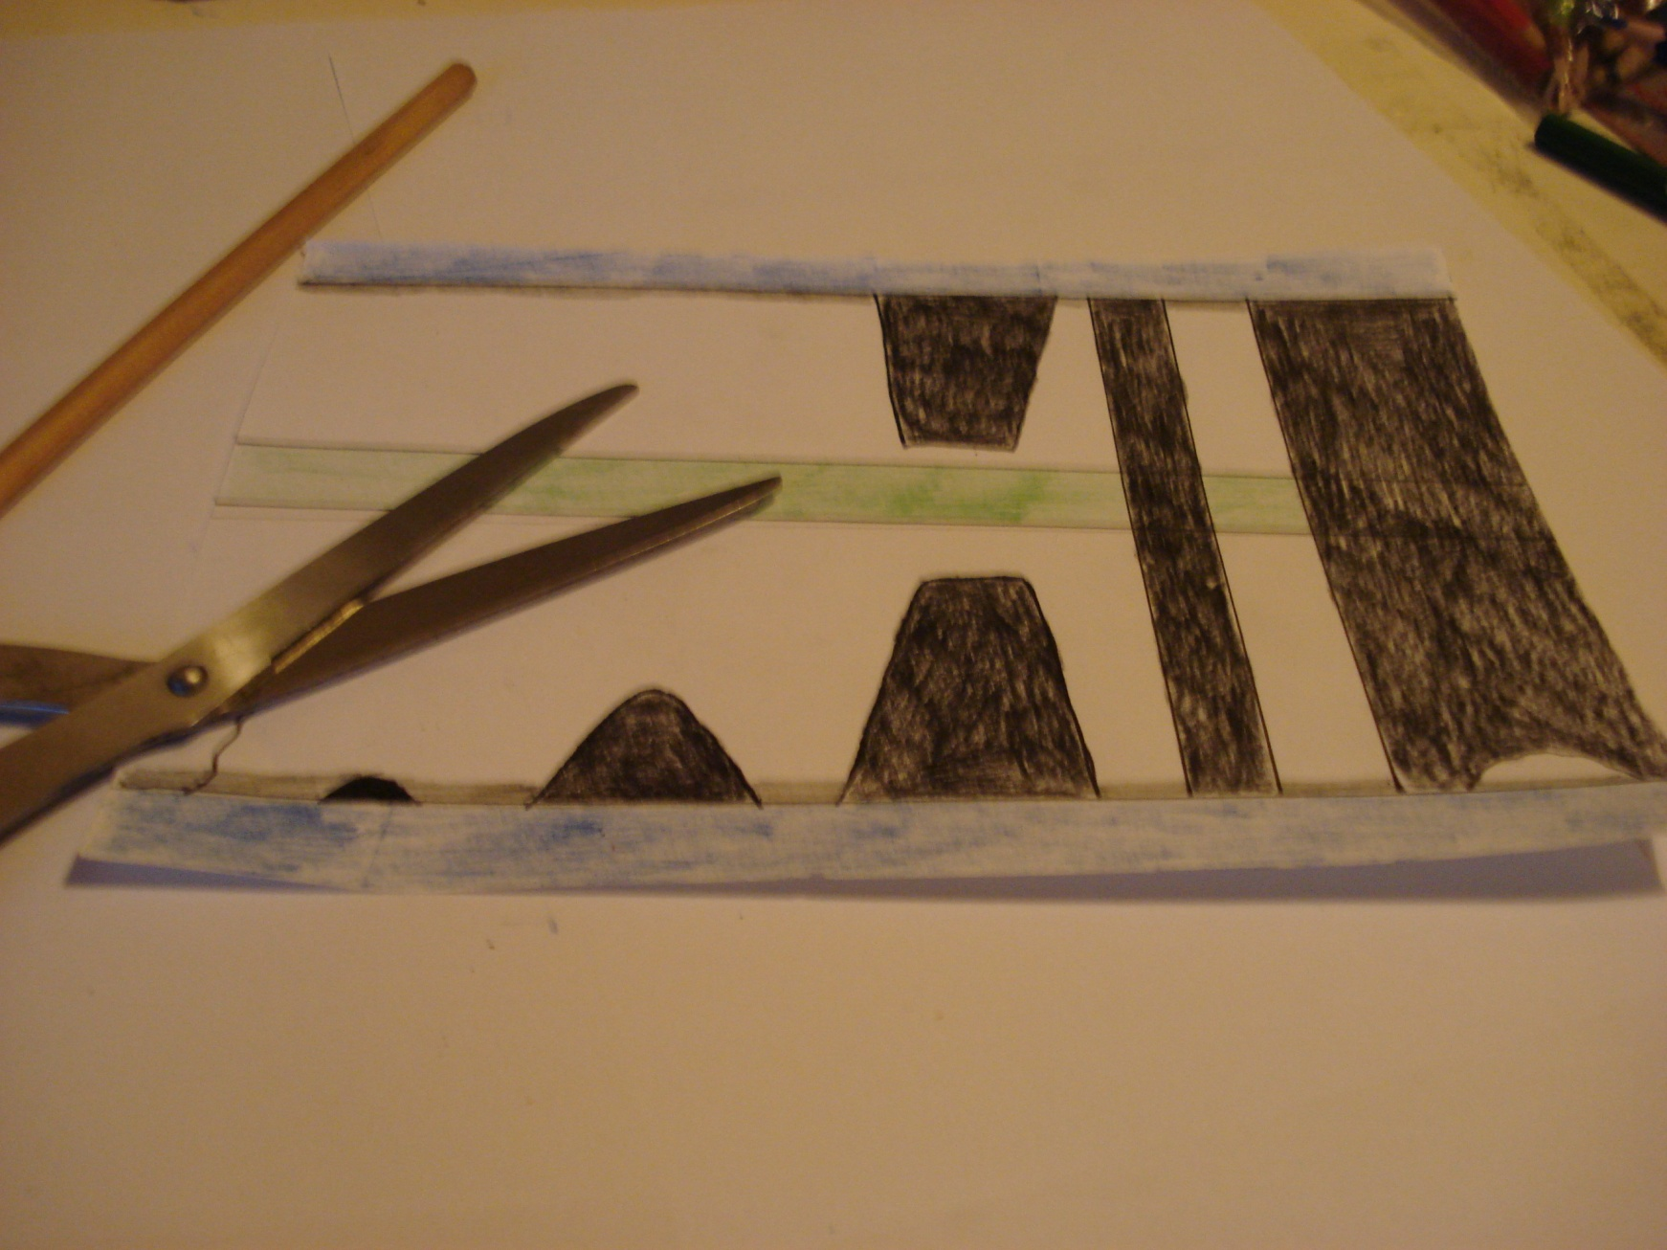
5
Don’t cut off your stump!
Carefully cut out all the black areas on the template- with the exception of the wave-cut notch.

Slide 27
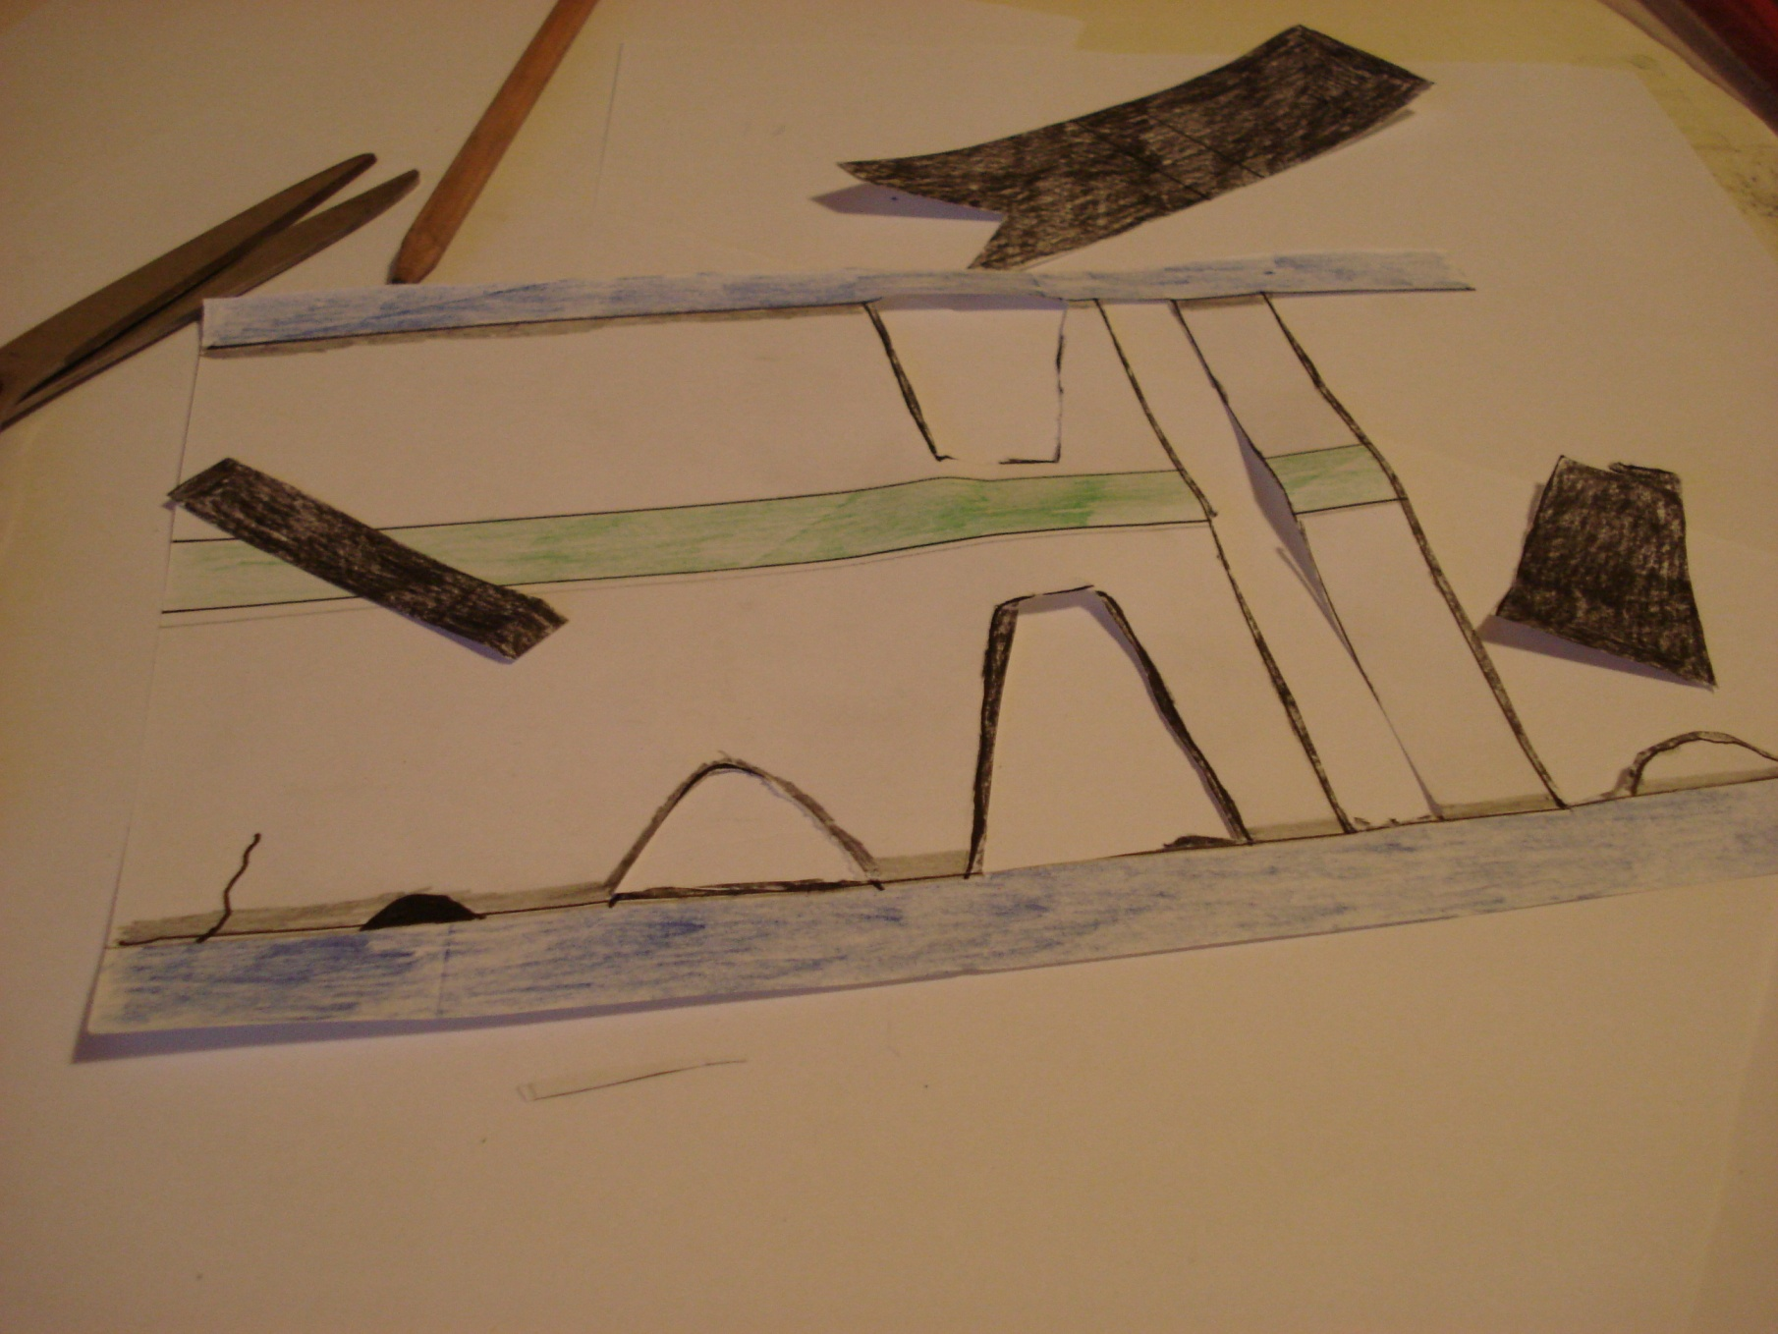
6
It should look like this...

Slide 28
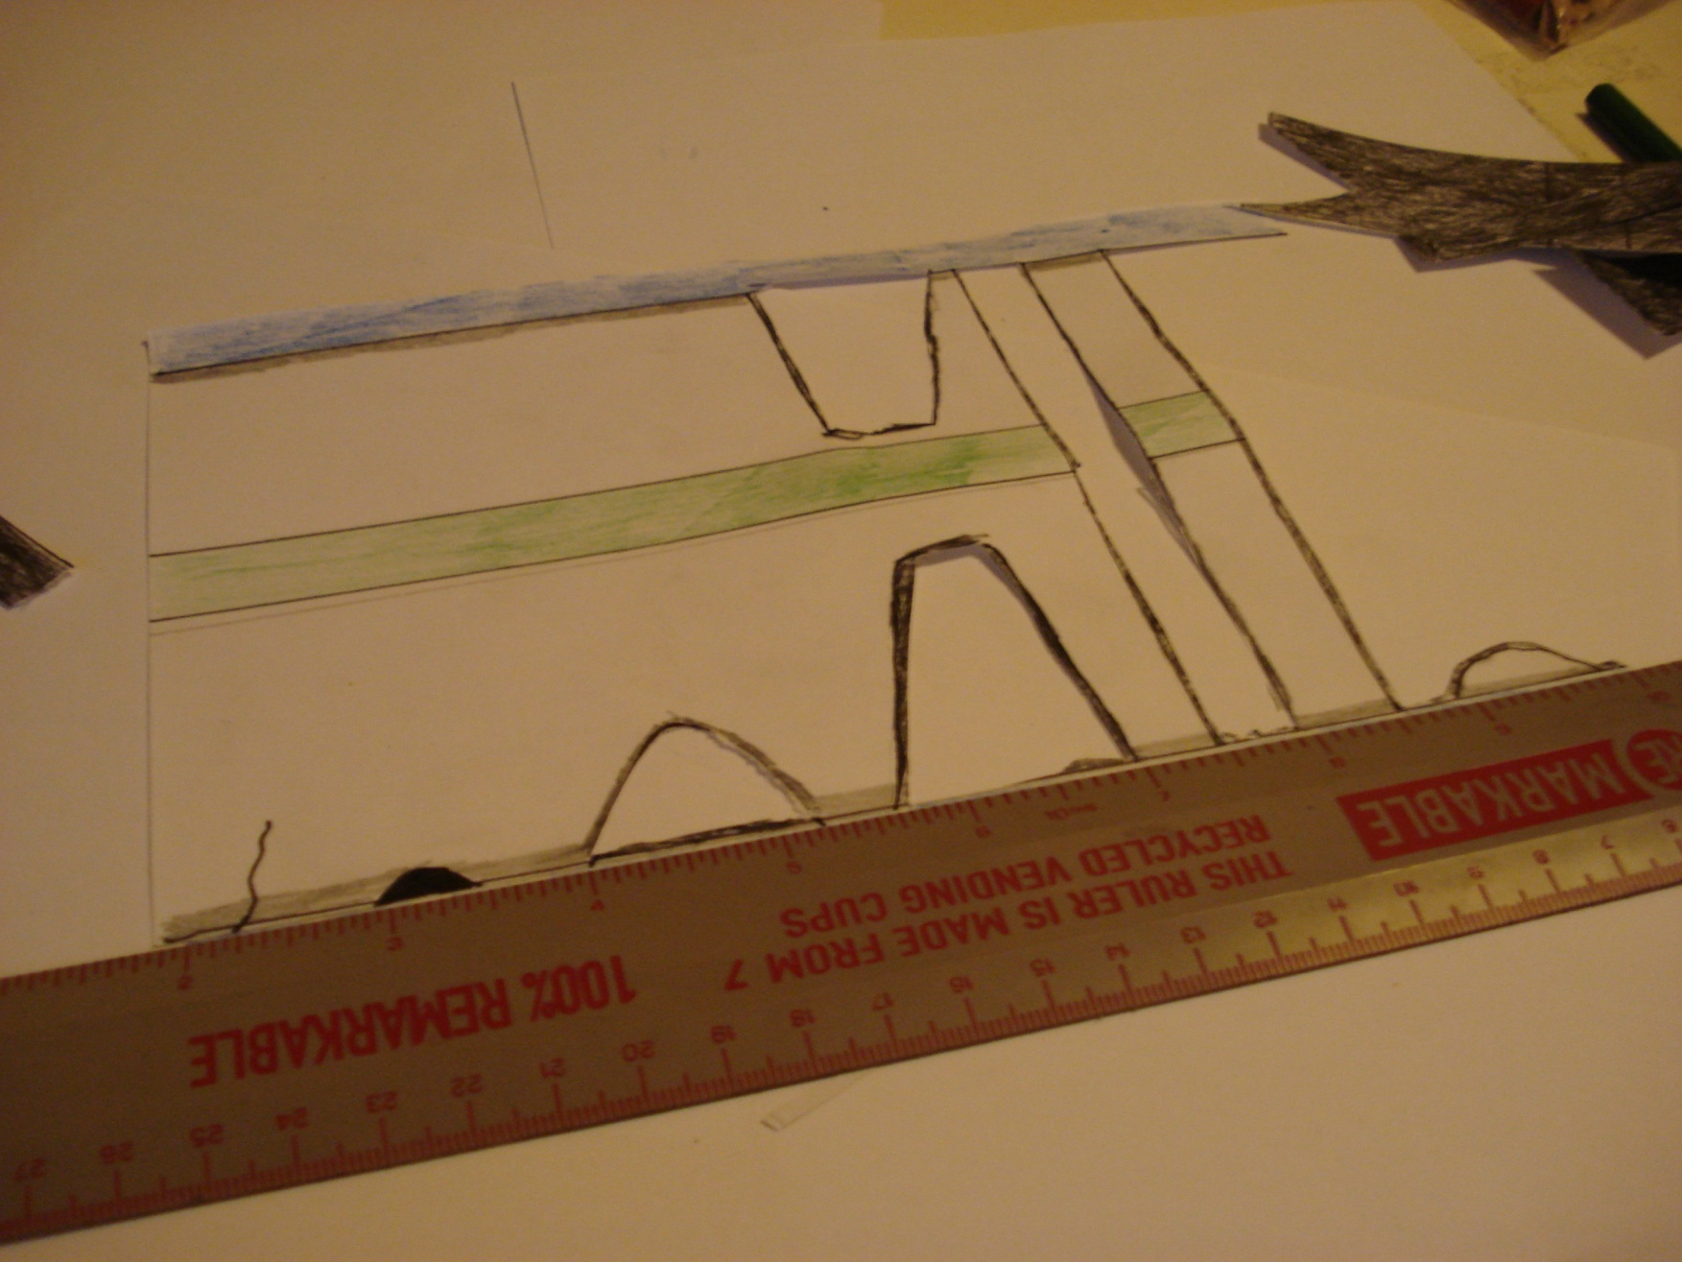
7
Using a ruler, carefully fold the horizontal lines.

Slide 29
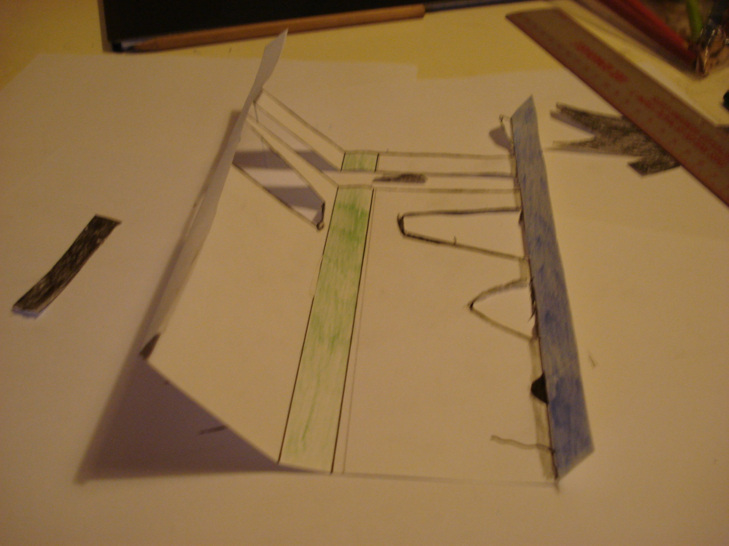
8
Like this...

