Slide 1
Year 10
How are coasts shaped by physical processes?

Slide 2
Bellwork
Thinking back to last week, answer the following questions in the back of you books
What does the term fetch mean?
Which type of waves creates a beach- constructive/destructive?
Does a constructive wave have a stronger swash or backwash?

Slide 3
Learning Objectives
To know how to measure fetch
To understand how different geology affects the coastline
To define different types of erosion
Title in your book- “How coasts are shaped by physical processes”, date is the 10th January, 2013. Please underline both date and title

Slide 4
Measuring fetch
http://www.bbc.co.uk/schools/gcsebitesize/geography/coasts/coastal_processes_rev1.shtml
Turn to page 76-77 in your atlases
If the wind was blowing from the East to the West, which area of the UK would have the longest fetch?
Which would have the shortest?
In which location will the waves be constructive?
In which location will the waves have most energy?
In which location will the waves be more likely to erode?

Slide 5
Please copy this into your books
The size and energy of a wave is influenced by:
how long the wind has been blowing
the strength of the wind
how far the wave has travelled (the fetch)

Slide 6
The Geology of the Coastline
Use the examples of rocks to determine which are hard rocks and which are soft
Which are easier to wear away?

Slide 7
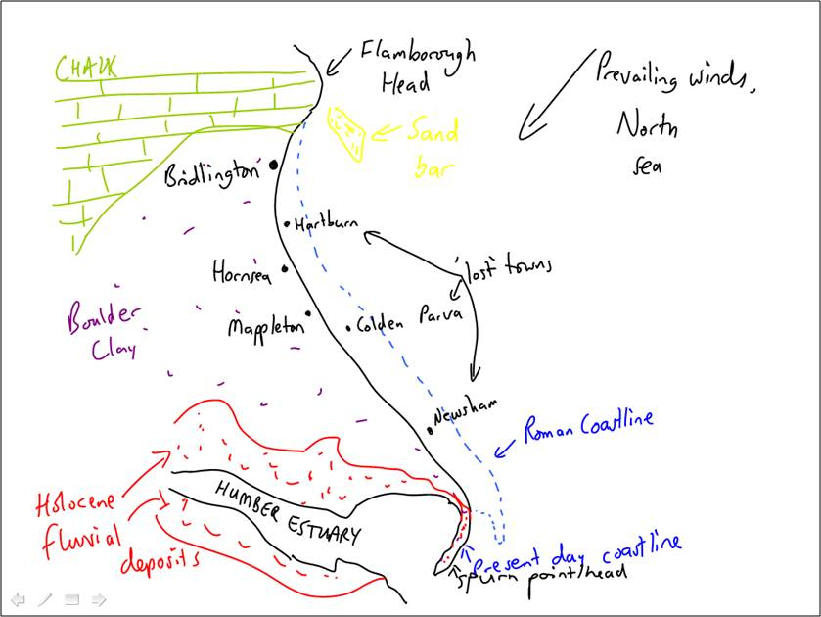
Task 1- Find this Coastline in your Atlases
Task 2- Annotate your map of the Holderness Coast to illustrate which areas are hard rock and which are soft
Task 3- Write a paragraph to explain the rate of erosion along the Holderness coast using the following key words:
Fetch
Hard Rock
Soft Rock
Rock Type
Constructive
Destructive

Slide 8
Types of Erosion- p.32
There are 2 categories of erosion at the coast: Marine Erosion and Weathering.
You should already know these terms from the rivers topic, but we’ll recap them
Marine Erosion | Weathering
Abrasion (Also known as Corrasion) | Solution (Also known as Corrosion)
Hydraulic Action | Wetting/Drying
Attrition

Slide 9

Video

Slide 10
Your Task
Copy down the names of the different processes and define them
Be sure the label them as either Marine Erosion or Weathering
You can choose whether to write the definition from the textbook or think of your own
Present it either as a table or a list. If you choose to do a table, use a ruler and keep it neat.
Marine Erosion | Weathering
Abrasion (Also known as Corrasion) | Solution (Also known as Corrosion)
Hydraulic Action | Wetting/Drying
Attrition

Slide 11
Plenary
Draw a picture of each of the different types of erosion to help you remember them (either put next to your definition if it’s going to be neat, or in the back of your books if art isn’t your strong point)

