Slide 1
Boscastle 2004 Floods
Marium, Alex, Billy, Ollie

Slide 2
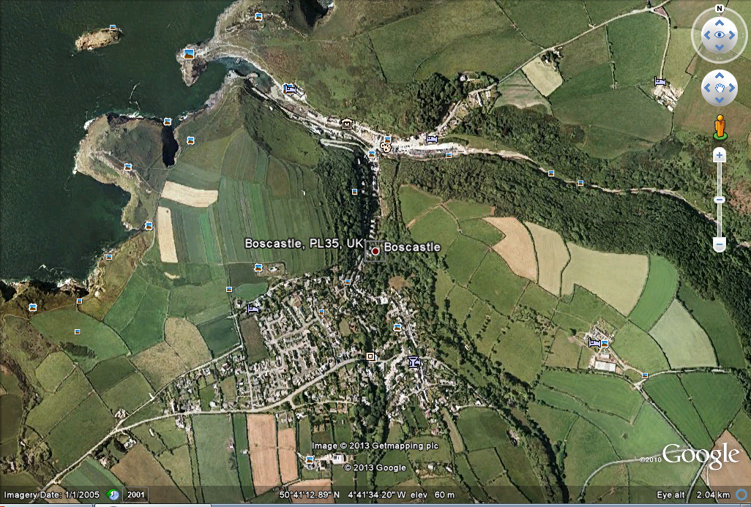
Where Is Boscastle?
Boscastle is on the
North Coast of Cornwall,
England, UK.

Slide 3
When?
16 AUGUST 2004
17:10 –
Major
incidents
Declared
RAF search
And rescue deployed
15:00 -
First power cut
Caused by
lightning
16:00 -
Access roads
closed
12:30 -
Heavy
rain begins
12:15 -
Dry in
Boscastle but
Dark clouds visible.
12:39 -
Flood watch
issued
15:46 -
River rises by
2m in one hour
17:00 -
Flood reaches
peak

Slide 4
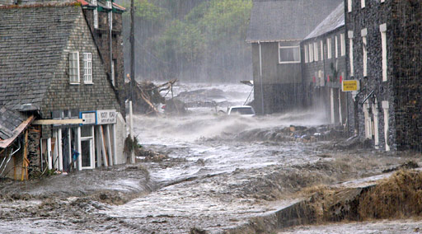
How?
At midday 1.4 million litres of water
Started to fall and this carried on for
2 hours. It carried to rain continuously
for 6 more hours.
Boscastle had no flood defences.
It was also in the middle of a river basin
So all the water went straight down the
High street.
Steep sided valleys funnelled water toward the sea, straight through Boscastle.
It was a wet summer so any soil was saturated, vastly reducing infiltration.
Boscastle was an urbanised area which meant there was more surface run-off
from buildings and impermeable ground.
There was a poor drainage system.
Small bridges trapped bed load and created a dam like effect.
Boscastle is at the confluence of three rivers - Valency, Jordan, and Paradise.
The flooding coincided with high tide.

Slide 5
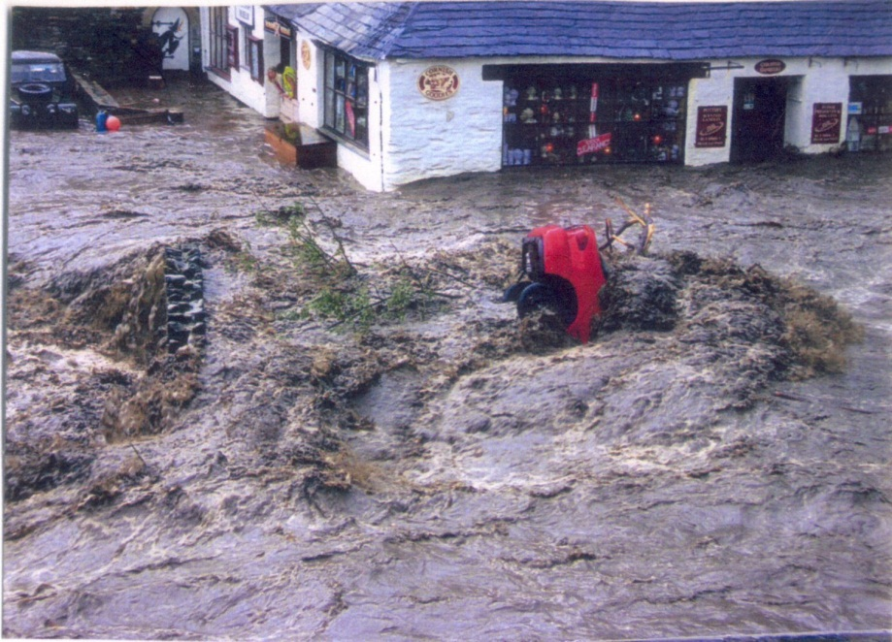
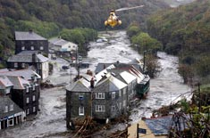
Facts & Figures
115 cars were washed away.
440 million gallons of water flowed
through the streets per second.
100 people had to be rescued by helicopters.
There was a 1/400 chance of the
flash flood happening.

Slide 6
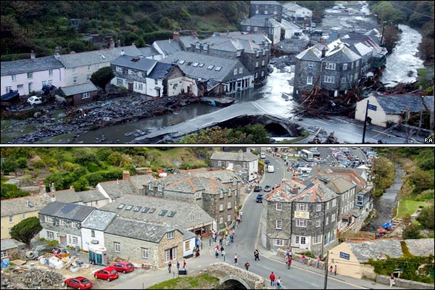
How could it have been prevented?
By placing flood defences (such as raised defences or even sandbags)
By not building on flood plains or around rivers.
By not building new homes in flood risk areas.
By ruralising the area to decrease surface run off and increase lag time.
By having less deforestation so interception can take place.

Slide 7
Effects Of The Flood
More than 1,000 people’s possessions were washed away such as houses and cars.
Due to Boscastle being a costal town a lot of income came from tourists however due
to the flood much income was lost.
Many people claimed back on their insurance.
Luckily, due to the rapid response of the emergency services, no lives were lost
Trees were uprooted
Loss of facilities such as tap water and electricity

Slide 8
Responses during and after the flood
1850 tonnes of debris and silt was cleared from buildings
Water, sewage systems and telephone lines were restored
7 rescue helicopters saved 150 people
River banks and flood walls were raised
Damaged bridges and roads were repaired
People were put in temporary accommodation
Sand bags were put in
Evacuation
Panic
The river Jordan’s relief channel was enlarged
People donated money to the red cross appeal

Slide 9
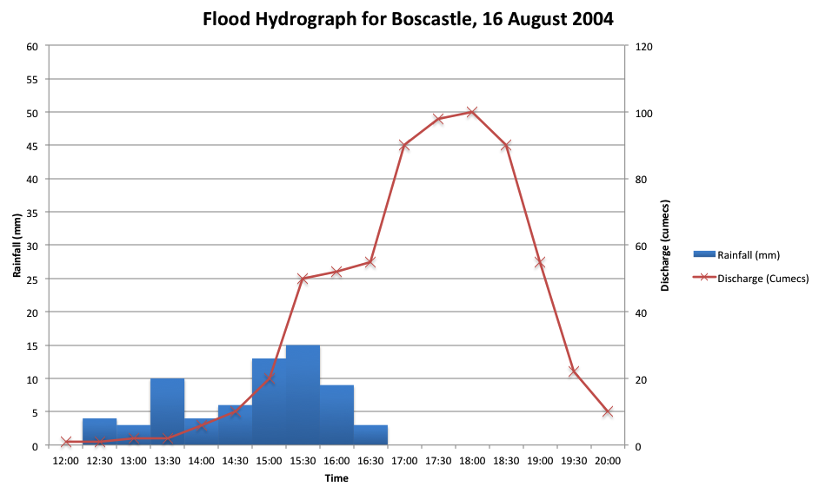
Boscastle flood hydrograph

