Slide 1
Bellwork (front of books)
Deconstruct and reconstruct the exam question at the bottom by…
Writing out the question in your books
Underlining command words
Identify geographical words
Re-writing the question in simple terms
Noting down your writing structure
Jot down casestudy and answer ideas
Name a type of climatic hazard and the location where it took place.
............................................................................................................................................
Explain the natural processes which caused this event and how human activities affected the impact of the climatic hazard. Include at least three developed ideas.

Slide 2
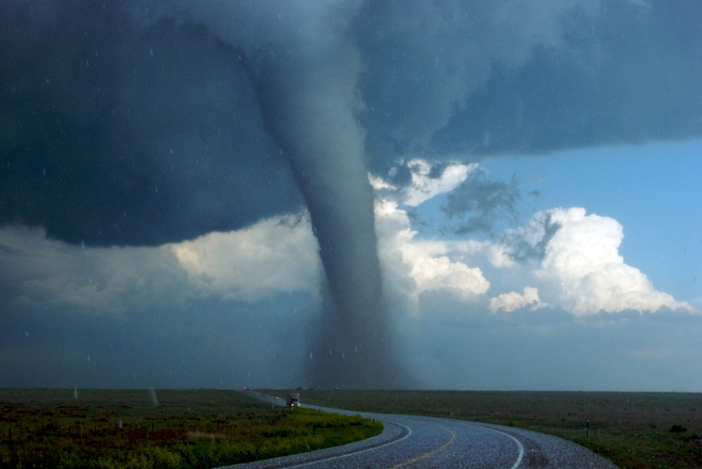
Exam Questions: Atmospheric Hazards
Learning Objectives:
(to be able to…)
Understand command words
Identifying, describing and explaining tropical storms
Develop exam answering and marking skills

Slide 3
Progress?
Learning Objectives:
(to be able to…)
Understand command words
Identifying, describing and explaining tropical storms
Develop exam answering and marking skills

Slide 4
Atmospheric Hazard Formation
Create a spider diagram in your book that will take up half a page. In the middle, write “formation of tropical storm”
Whist you are watching this 6 minute video, fill your spider diagram with key words and ideas about tropical storms

Slide 5
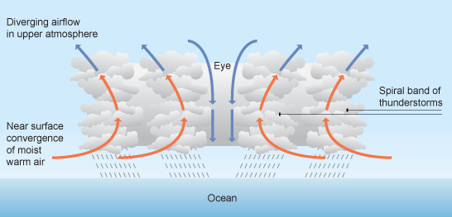
Words Fill
Low
Tropical storms are created by extremely low pressure near the surface of a warm sea or ocean. Warm air rises and this creates a swirling movement. These spirals flow Clockwise in the Northern Hemisphere and Anti-Clockwise in the Southern Hemisphere at speeds or around 75 mph in the eye of the storm. Tropical storms develop when the sea is between 26°C and 28°C. As their name suggests, they are found between the tropics of Cancer and Capricorn.
Rises
Northern Hemisphere
Anti-Clockwise
28°C
Tropics
Cancer
Capricorn
Capricorn, Anti-Clockwise, 28°C, Cancer, low, tropics, Northern Hemisphere, rises

Slide 6
Case Studies
Your MEDC Hurricane Case Study is?....
Your LEDC Hurricane Case Study is?....
Hurricane Floyd
Hurricane Mitch

Slide 7
Individual Work
Work individually to create a ‘model’ answer for that exam question using the information sheets and your own ideas
Ensure good and specific details are given to reach top marks out of 8!

Slide 8
Progress?
Learning Objectives:
(to be able to…)
Understand command words
Identifying, describing and explaining coastal defences
Develop exam answering and marking skills

Slide 9
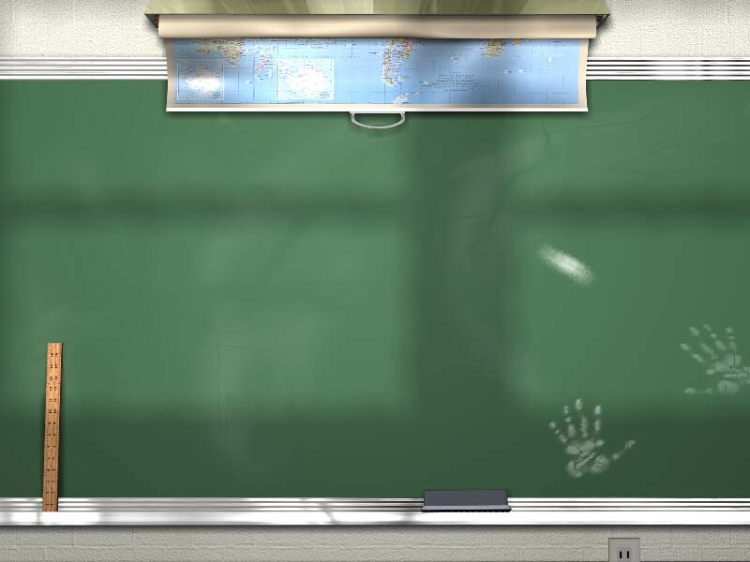

Slide 10
1,000,000
500,000
300,000
10 Year Old Topic 1
10 Year Old Topic 2
175,000
100,000
9 Year Old Topic 3
9 Year Old Topic 4
50,000
25,000
8 Year Old Topic 5
8 Year Old Topic 6
10,000
7 Year Old Topic 7
7 Year Old Topic 8
5,000
2,000
6 Year Old Topic 9
6 Year Old Topic 10
1,000

Slide 11
10 Year Old Topic 1 Question
Where are tropical storms found?

Slide 12
10 Year Old Topic 1 Answer
Between the Tropic of Cancer and the Tropic of Capricorn
Return

Slide 13
10 Year Old Topic 2 Question
What is the centre of a Tropical Storm Called?

Slide 14
10 Year Old Topic 2 Answer
The ‘Eye’
Return

Slide 15
9 Year Old Topic 3 Question
What is the Season for North Atlantic Hurricanes?

Slide 16
9 Year Old Topic 3 Answer
May to December
Return

Slide 17
9 Year Old Topic 4 Question
Where is a Typhoon Found?
Clue- Not in the Tea Caddy

Slide 18
9 Year Old Topic 4 Answer
Over the Inidan and Pacific Oceans
Return

Slide 19
8 Year Old Topic 5 Question
Where is a Willy Willy found?

Slide 20
8 Year Old Topic 5 Answer
In Australia
Return

Slide 21
8 Year Old Topic 6 Question
When did Hurricane Mitch happen?
Month and Year Required

Slide 22
8 Year Old Topic 6 Answer
November 1998
Return

Slide 23
7 Year Old Topic 7 Question
What countries did Hurricane Mitch Affect?

Slide 24
7 Year Old Topic 7 Answer
Honduras & Nicuagra
Return

Slide 25
7 Year Old Topic 8 Question
How many people died in Hurricane Mitch?

Slide 26
7 Year Old Topic 8 Answer
11,000
Return

Slide 27
6 Year Old Topic 9 Question
When did Hurricane Floyd Happen?
Month and Year

Slide 28
6 Year Old Topic 9 Answer
September 1999
Return

Slide 29
6 Year Old Topic 10 Question
What country did Hurrican Floyd affect?

Slide 30
6 Year Old Topic 10 Answer
USA (No marks for America- that’s a continent!)
Return

Slide 31
£1,000,000 Question Year Old Topic 11
How many people died in Hurricane Floyd?

Slide 32
£1,000,000 Question
How many people died in Hurricane Floyd?

Slide 33
£1,000,000 Answer
47
Return

Slide 34
Congratulations!

Slide 35
Mark Scheme
0 marks
Response does not address the question
Level 1 (1-3 marks)
Demonstrates limited knowledge and understanding of the issue.
One or more relevant ideas which include limited detail.
Mention of defences but not both hard and soft.
Vague or lacking in detail. Little or no further development.
E.g. Hurricane has caused damage to buildings. It has done this because of the strong winds which destroy thing.
Level 2 (4-6 marks)
Demonstrates sound knowledge and understanding of the issue.
One to three relevant and developed ideas (6 marks if each part is addressed and developed – human activities affecting the impact. 3 developed ideas)
e.g. The strong winds (75 mph in the eye of the Hurricane) have caused major destruction and devastation in Florida, USA. They have damaged houses, making people homeless.
Name a type of climatic hazard and the location where it took place.
Explain the natural processes which caused this event and how human activities affected the impact of the climatic hazard. Include at least three developed ideas.
(8 marks)
Level 3 (7-8)
At least three relevant developed ideas. Ideas explain the natural process, human activities and the impact
Full level 3 needs three developed ideas plus relevant place-specific detail of the example, (such as place name, costs of damage, human activities specific to locations and consequences of these responses etc..). If no relevant place-specific detail (e.g. the Hurricane Sandy create damage totalling £2 million) limit to 7 marks
Written work is legible and spelling, grammar and punctuation are accurate. Meaning is communicated very clearly.
E.g. Hurricane Floyd claimed the lives of 79 people in Florida, USA due to a poor response from the US government. There was little access to damaged areas via road, so helicopter was the only viable form of rescue transportation.

Slide 36
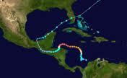
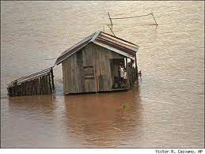
IMPACT
Major coastal flooding
River valleys washed away by intense rainfall
Landslides wiped out villages & destroyed most roads & bridges
Impact zone extended 100s of km
11,000 dead
Tens of thousands missing
2.5 million homeless
people lost EVERYTHING
Survivors stranded for over 7 days without food / medical help
Refugee camps = disease due to lack of food / clean water / sanitation
Banana crop (main export) destroyed (trees take 10 years to replace)
Mitch
Early November 1998
Hit Honduras & Nicuagra
280 kph winds & torrential rain + coastal flooding
Location was OUTSIDE (further south) usual hurricane belt so there was little expectation or preparation. Houses were unsuitable and many built onto steep valley sides.
HUMAN RESPONSE (AID/ RESCUE)
Major problem of ACCESS. With roads gone and rivers too swollen to travel HELICOPTERS were only viable transport.
People waiting for over 6 days for help
(bit of luck??) Royal Navy were sea testing a new aircraft carrier in the Caribbean
with a compliment of marines and helicopters “It was like saving Buxton from the
middle of the North Sea”-pilot
France UK & USA mobilise food, shelter within days
NGOs eg CAFOD, OXFAM put COORDINATING teams into worst hit areas.
Local people TOTALLY DEPENDANT on INTERNATIONAL HELP
USA pledges immediate £42m Europe another £50
BUT after the short term rescue: AID needed to fund a 30 year rebuilding
programme.

Slide 37
Hurricane Floyd struck on the 16th September 1999 and followed the eastern coast of America all of the way from Florida to Maine until it eventually died out. It formed in the Gulf of Mexico out at sea before hitting the Caribbean islands and mainland America. The width of the hurricane was estimated to reach around 500km and it was classified as a category 5 hurricane. Prevention, preparation and prediction measures limited human losses.
Floyd
Hurricane Floyd claimed the lives of 79 people.
42 973 homes sustained some degree of damage
14 states from Florida to Maine were effected
Agricultural costs were estimated at $1 billion
47 people died in North Carolina after 500mm of rain flooded 30 000sq km
Costs of rebuilding £4 Billion
HUMAN RESPONSE (AID/ RESCUE)
Major problem of ACCESS. With roads gone and rivers too swollen to travel HELICOPTERS were only viable transport.
People waiting for over 6 days for help
(bit of luck??) Royal Navy were sea testing a new aircraft carrier in the Caribbean
with a compliment of marines and helicopters “It was like saving Buxton from the
middle of the North Sea”-pilot
France UK & USA mobilise food, shelter within days
NGOs eg CAFOD, OXFAM put COORDINATING teams into worst hit areas.
Local people TOTALLY DEPENDANT on INTERNATIONAL HELP
USA pledges immediate £42m Europe another £50
BUT after the short term rescue: AID needed to fund a 30 year rebuilding
programme.

