Slide 1
AS Geography of Health
What is Health?
How do we Measure Health?
How can we Map Health?
What is the Distribution like of Various Health Statistics

Slide 2
Starter
With the person next to you, create a spider diagram to explain what health is
Also include measures of health

Slide 3
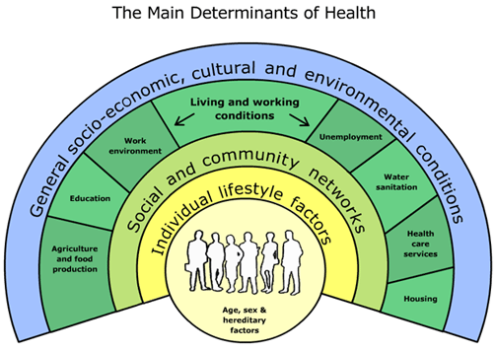
Dalgren and Whitehead Figure

Slide 4
Introduction
Geography is ever important in the field of health
Here are some examples of how it has helped save lives and make providing healthcare cheaper and more effective

Slide 5
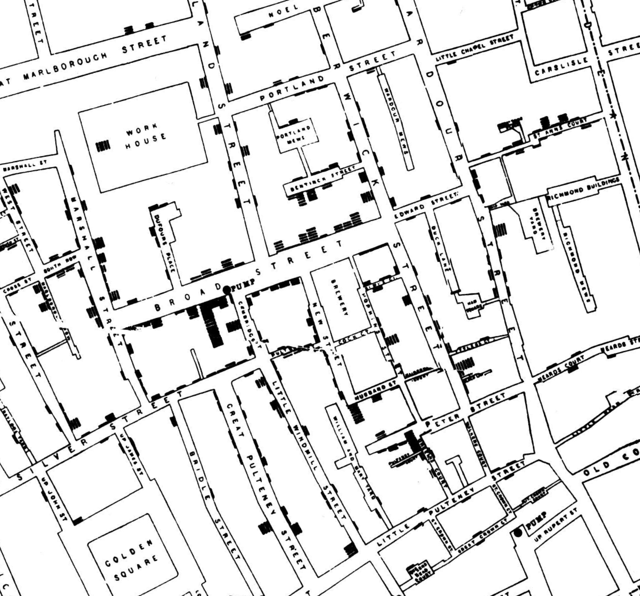
John Snow- Cholera Map

Slide 6
Mapping of Ethnicity- Link to Different Diseases
Diabetes and insulin resistance
“Population studies have consistently identified a high prevalence of non-insulin dependent diabetes amongst urban and overseas South Asians. The prevalence of diabetes is reported as 2-5% in rural Indians, 5-10% in urban Indians, and almost 20% in UK South Asians, compared to 4% of white European males13-21. In the UK, South Asians develop diabetes on average 10 years earlier than their white European counterparts22, and South Asians with diabetes show a markedly increased predisposition to cardiovascular disease. In a large prospective study, cardiovascular and CHD mortality were higher amongst South Asians with diabetes, compared with white Europeans”
If we can map ethnicity, will this not help us to choose where to site diabetes clinics?

Slide 7
Mapping of Census Data and BHS Data to Improve Siting of Hospitals with Cutbacks
Holyrood hospital closures debate
Hospital closure claims spark furious response...
NHS: Budget pressure may force hospital closures, warns BMA
No U-turn over hospital closures
A&E night closure at Welwyn's QEII hospital provokes anger

Slide 8
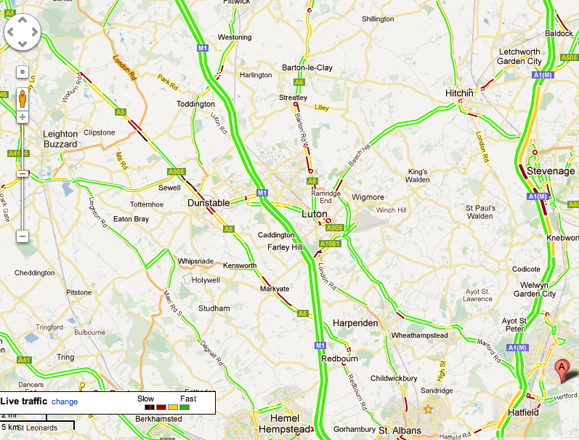
Example- Closure of A&E at QE2 Hospital in Welwyn Garden City, Hertfordshire

Slide 9
How do we Measure Health?
Some statistics have very similar meanings, however they show completely different things e.g. Fertility Rate and Crude Birth Rate
It is important to know the exact definition for each statistic
Ways of measuring health have been posted around the room. Your task is to note down each different measure and its definition

Slide 10
Lesson Objectives Recap
What is Health?
How do we Measure Health?
How can we Map Health?
What is the Distribution like of Various Health Statistics

Slide 11
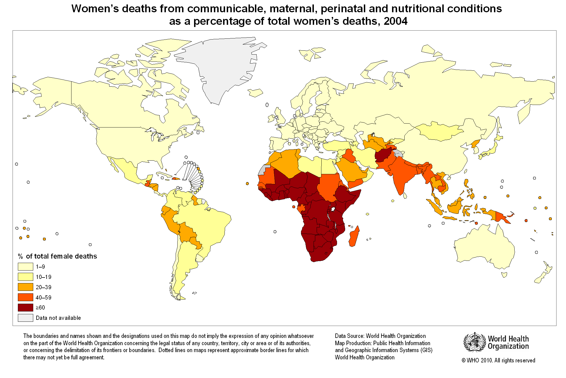
Health on a World Map
Health varies on a global scale.
Whilst some patterns are as we’d expect…

Slide 12
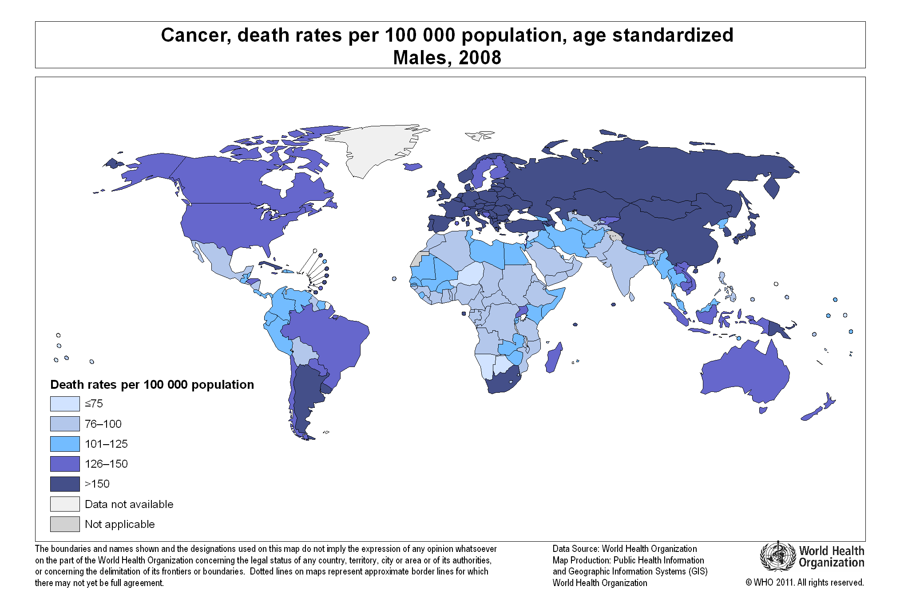
Others challenge our perceptions of the World…

Slide 13
Your Task
15 mins!
15 mins!
Each group will have a different measure of health to investigate
You have to find a map to display this statistic on a global scale
Save map to show the rest of the class on the computer at the front
Feed back to the class using as much detail as you’d need for an AS Level exam question
Make specific reference to 3 countries that you were previously unaware of where they are located.

Slide 14
E.g. “The distribution shows Self Assessed Health is better in the Northern Hemisphere, following the Brandt Line. The main exception to this is South Africa, which has a Self Assessed Health score of “Good”. The reasons for this could be linked to GDP per capita or the % of urban dwellers because poorer people can’t afford the same quality ad quantity of healthcare that richer people can. Also, hospitals tend to be cited in Cities, where more people live, meaning that people who live in cities tend to have better access to healthcare. On the flip side, it is also important to consider the value of the ‘open air’, as country living is often perceived as more healthy than living in a city.”

Slide 15
Groups
Birth Rate
Life Expectancy
Obesity Rate
Infant Mortality Rate
Maternal Mortality Rate
Total Fertility Rate
Morbidity- AIDS prevalence
Morbidity- Deaths from Malaria

Slide 16
Useful Websites
www.worldmapper.org
www.globalhealthfacts.org
www.mapsofworld.com
www.indexmundi.com
www.theglobaleducationproject.org
www.news.bbc.co.uk/
www.maps.worldbank.org/

Slide 17
Lesson Objectives Recap
What is Health?
How do we Measure Health?
How can we Map Health?
What is the Distribution like of Various Health Statistics

Slide 18
Plenary
1
2
3
4
5
6
7
8
9

Slide 19
1
Morbidity Rate is…

Slide 20
2
Birth Rate is…

Slide 21
3
Obesity Rates are highest in…

Slide 22
4
In this lesson, I learnt that…

Slide 23
5
Before the lesson I did not know that…

Slide 24
6
Pass!
Pick on someone else!

Slide 25
7
Next, I want to find out…

Slide 26
8
I know know that in an exam I must...

Slide 27
9
I now want to find out why…

