Slide 1
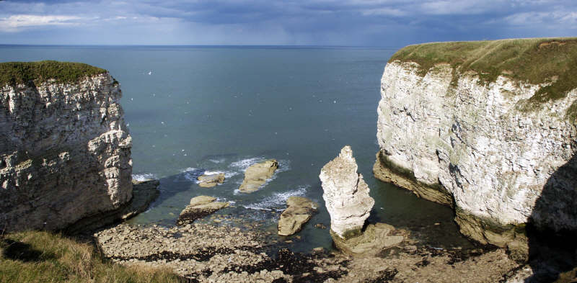
Year 10 Coasts – End of Unit Test
Name:
/40
Duration – 40 minutes
Question 1 (25 marks)
Study the OS map extract (fig. 1)
Give the six figure grid reference of the car park south of the abbey in Whitby. …………………………………………….. [1]
What type of coast management is visible along Whitby Sands? …………………………………………….. [1]
Use the water features key to suggest one other warning system other than a lighthouse which is used in grid 8911 ……………………………………….. [1]
Study the image of North Landing, Flamborough (fig. 2)
(i) Annotate the photograph to show 2 pieces of evidence to prove erosion has taken place here.
(ii) Name and describe 2 processes of coastal erosion which might have affected this area.
1)…………………………………………………………………………………………………………………………………………………………………………………………………………………………………………………………………….............………………………………………………………………………………….………2)…………………………………………………………………………………………………………………………………………………………………………………………………………………………………………………………………………………………………………………………………………..………………………... [4]
Fig. 2 – North Landing
[2]

Slide 2
(c) Explain 2 ways that geology affects the formation of coastal features/ landforms.
1)…………………………………………………………………………………………………………………………………………………………………………………………………………………………………………………………………….............………………………………………………………………………………….………2)…………………………………………………………………………………………………………………………………………………………………………………………………………………………………………………………………………………………………………………………………………..………………………... [4]
There is a tombolo along the Dorset coast connecting Weymouth to the isle of Portland (figure 3). With the aid of a diagram describe and explain how the tombolo has been formed.
…………………………………………………………………………………………………………………………………………………………………………………………………………………………………………………………………….............………………………………………………………………………………….……………..…………………………………………………………………………………………………………………………………………………………………………………………………………………………………………………………………………………………………………………………………………..………………………... [4]
Fig. 3 Chesil Beach
CASETUDY: Coastal features.
Name and locate an area of coast with distinctive coastal features:
…………………………………………………………………………………………………………………………
Describe the location of the coast. Explain how coastal processes and geology have created the distinctive features. Include at least 3 developed ideas.
…………………………………………………………………………………………………………………………………………………………………………………………………………………………………………………………………….............………………………………………………………………………………….…………………………………………………………………………………………………………………………………….

Slide 3
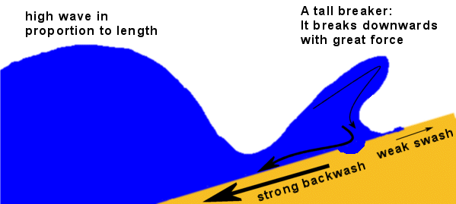
continued
…………………………………………………………………………………………………………………………………………………………………………………………………………………………………………………………………….............………………………………………………………………………………….………………………………………………………………………………………………………………………………………………………………………………………………………………………………………………………………………………………………………………………………………………………………………………………………………….............………………………………………………………………………………….…………………………………………………………………………………………………………………………………[8]
Question 2 (15 marks)
Study the wave diagram (fig. 4)
What type of wave is shown in fig. 4? …………………………………………….. [1]
Give one landform that might be created by this wave ….………………………………….. [1]
Fig. 4 - Diagram of a wave
(b) Outline the advantages of using hard engineering strategies to protect the coastline…………………………………………………………………………………………………………………………………………………………………………………………………………………………………………………………………….............………………………………………………………………………………….……………………………………………………………………………………………………………………………………………………………………………………………………………………………………………………………………………….............………………………………………………………………………………….…………………………………………………………………………………………………………………………………[3]

Slide 4
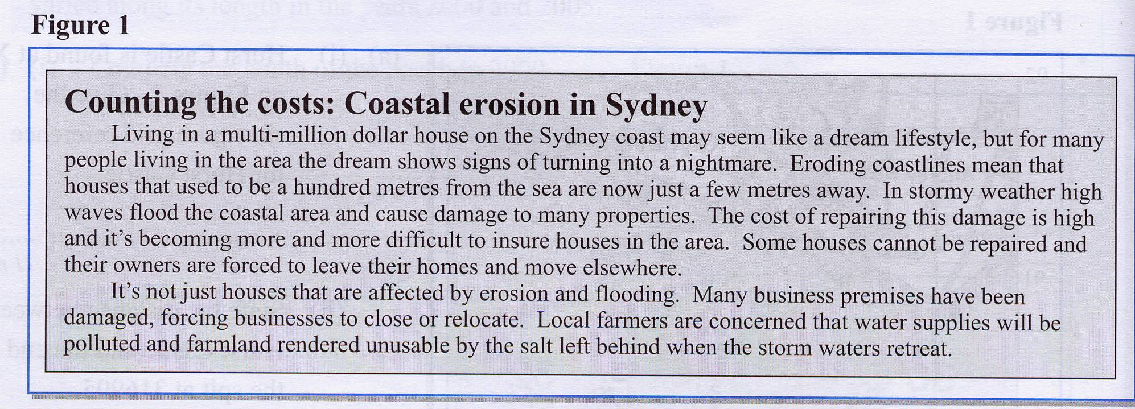
(c) Study the article below (fig. 5)
Using Figure 5,describe two social and two economic impacts of coastal flooding and erosion
.……………………………………………….............………………………………………………………………………………….……………………………………………………………………………………………………………………………………………………………………………………………………………………………………………………………………………………………………………………………………………………………………………………………………….............………………………………………………………………………………….……………………………………………………………………………………………………………………………………………………………………………………………………………………………..…[4]
Fig. 5 – Article about Coastal Erosion in Sydney
(d) (i) Explain how freeze-thaw weathering causes rock on coastal cliffs to break up
………………………………………………………………………………………………………………………………………………………………………………………………………………………………………………………………………………………………………………………………………………………………………………………….............……………………………………………………………………………………………………………………………………………………………………………………………………………………………………………………………………………………………………………………………………………..[4]
(ii) Outline the difference between coastal (marine) erosion processes and sub-aerial (weathering) processes
………….............……………………………………………………………………………………………………………………………………………………………………………………………………………………………………………………………………………………………………………………………………………..[2]

